Slide 1
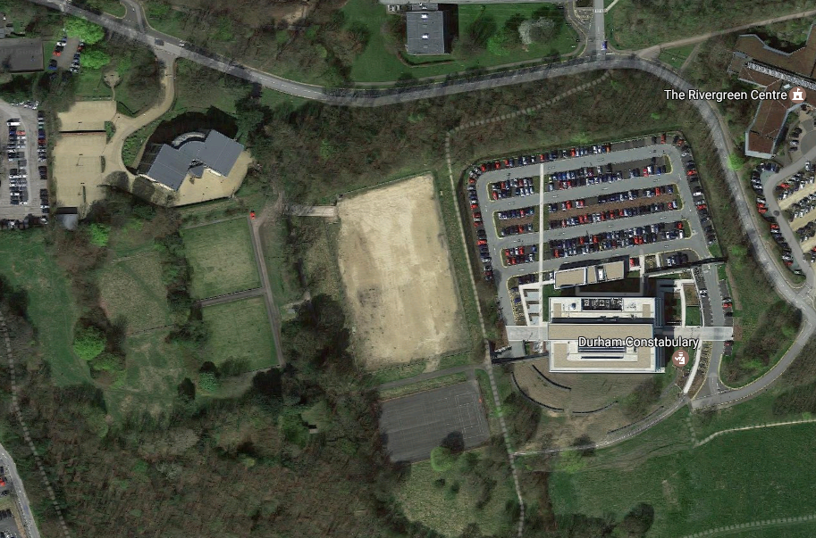
Car parking arrangements for ‘All Weather Pitch’
Police HQ, Aykley Heads, Durham, DH1 5TT
Please park in the all weather pitch over flow car park.
All weather pitch directions
Follow the white dotted line along the main road, turn right just passed Salvus House (green Building on the drivers right). This will lead to an ‘unsigned’ single track access road. Travel along this track for a short distance and then turn left onto the all weather pitch which is contained in a fenced area.
Once parked, follow the orange line towards Police HQ reception. There is a path with a small wall, follow the path round and this will lead to the front of Police HQ.
Turn from main road for access to car park
Police HQ Main Reception
All Weather Car Park
Footpath to HQ Reception

Slide 2
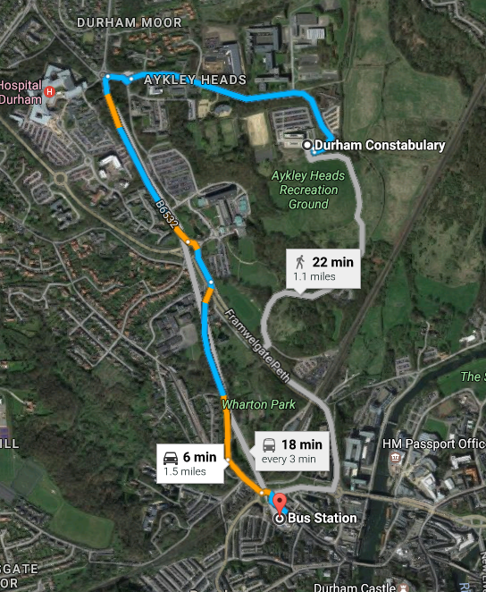
Durham Police Headquarters
According to Google the below routes are valid – also see next page

Slide 3
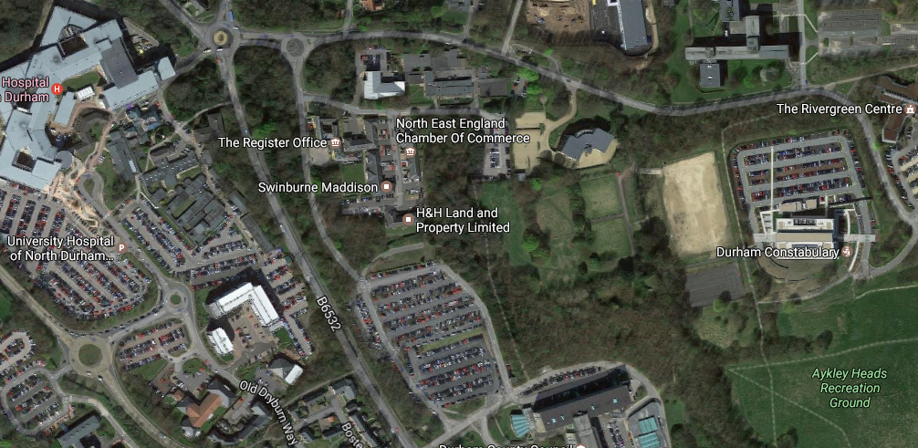
Bus stop and walking route to Headquarters
Bus stop from Durham
Police HQ Main Reception
The below image shows where the bus stop is (outside of the Hospital) to alight in order to walk to the main reception at Police Headquarters.
Follow the red dotted line which will take approximately 5 minutes to walk.
The bus which operates from the City bus station is the number 64, although alternatives also run regularly on the route. The bus stop is for the University Hospital, but is fine for Police HQ. The return bus stop is at the same location but just opposite the road.
Alternatively it is a few miles from the city centre and you could possibly consider a taxi which should be reasonably priced due to the short distance.

