Slide 1

North East North Cumbria Health Safety Collaborative Learning System:
Transitional Care
2 December 2019
#MatNeoNENC #PReCePTNENC
North East and
North Cumbria

Slide 2
Welcome and introduction
Julia Wood
North East and North Cumbria

Slide 3

Overview of MatNeo SIP
What we are here
Transitional Care Trust Updates
Next Steps

Slide 4

Maternity and Neonatal Safety Improvement Programme (previously Maternal and Neonatal Health Safety Collaborative)
National Patient Safety Collaborative rebranded to become the National Patient Safety Improvement Programme
All the workstreams which sit under this were also rebranded, including this programme

Slide 5
Maternity and Neonatal Safety Improvement Programme (previously Maternal and Neonatal Health Safety Collaborative)
To support improvement in the quality and safety of maternity and neonatal units across England
AIMS:
Contribute to the national ambition of reducing the rates of maternal and neonatal deaths, stillbirths and brain injuries that occur during or soon after birth by 20% by 2020
To improve the safety and outcomes of maternal and neonatal care by reducing unwarranted variation and provide a high quality healthcare experience for all women, babies and families across maternity and neonatal care settings in England

Slide 6
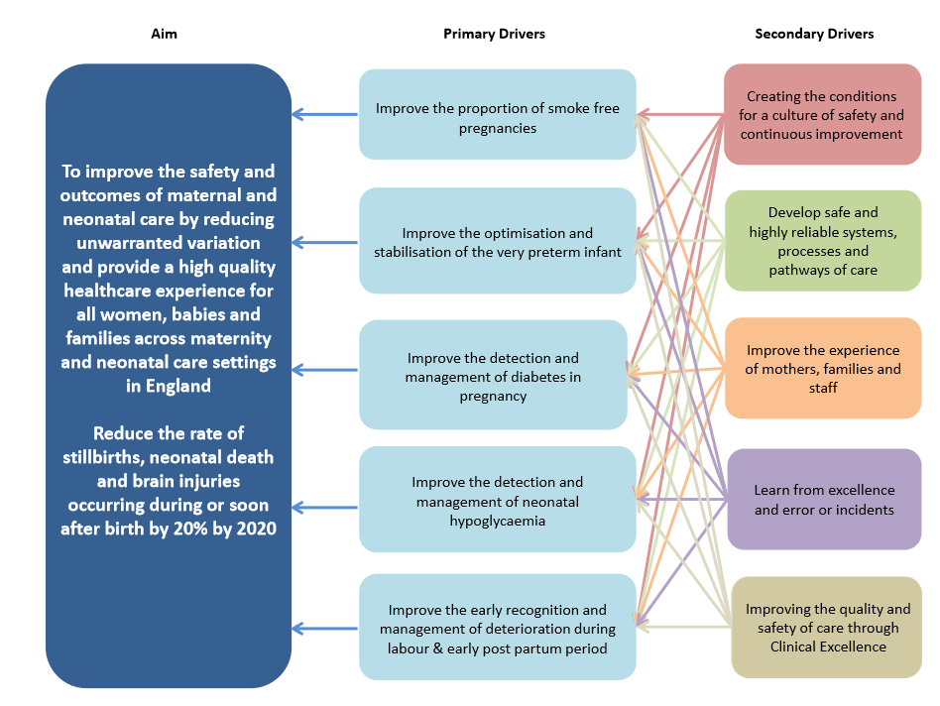

Slide 7
Two approaches, working together
Trust Improvement
Learning Systems
Trusts identify areas of focus which meet their needs (in line with National Driver Diagram)
System improvement across North East and North Cumbria
Evolve over time
Building on the great work currently going on in the region

Slide 8
Trust Improvement: Who is involved?
Wave 1 (from Apr 17) | Wave 2 (from Apr 18) | Wave 3 (from Apr 19)
North Tees & Hartlepool NHSFT | County Durham and Darlington NHSFT | North Cumbria University Hospitals NHS Trust
 | South Tees NHS FT | South Tyneside and Sunderland NHSFT
 | Gateshead Health NHS FT | The Newcastle Upon Tyne Hospitals NHS FT
 | Northumbria Healthcare NHS FT
Usually share Trust Improvements:
Only just over two months since the last event
Lots to cover regarding system-level projects
44 organisations | 43 organisations | 46 organisations
Everyone is involved in the Learning Systems

Slide 9
PReCePT
Prevention of Cerebral Palsy in PreTerm Labour
CTG
Cardiotocography
Transitional Care

Slide 10

Date for your diary
3rd March

Slide 11
Transitional Care the way forward
Sundeep Harigopal
Clinical Lead– Northern Neonatal Network
Consultant Neonatologist – RVI
North East and
North Cumbria

Slide 12
What is NTC
“A service that supports a resident mother to be or to become the primary care provider for a baby with care requirements in excess of normal newborn care, but which are not sufficient to require admission to a NNU.”

Slide 13
Recent systematic review
“transitional care benefits the health outcomes of moderately compromised infants and mothers in terms of de-medicalising care, improving mother and baby attachments, avoiding separation, developing parenting skills for dependent infants and raising the potential for shorter length of hospitalization”

Slide 14
Normal Newborn Care
Enhanced monitoring (NEWTT)
Thermoregulatory management
Monitoring blood sugars and management
Supporting establishment of infant feeding
Monitoring bilirubin for babies
Support for babies with social care needs

Slide 15
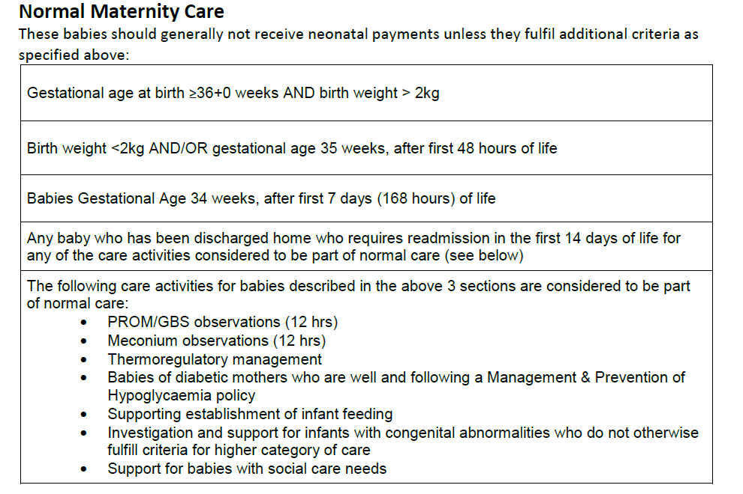

Slide 16
Why
Benefits of the baby and family
Benefits for the service

Slide 17
Benefits of the baby and family
Establishment of early breast feeding
Building confidence
Regular support
Optimise attachment
Family –friendly environment
Notes:
Family friendly environment

Slide 18
Benefits for the service
Increase breast feeding rates
Reduced admission and LOS
Better use of NICU/HDU/SC
Joint working of neonatal - midwifery staff
Reduce readmission rates
Notes:
Reduce readmission rates – better parenetal confidence

Slide 19
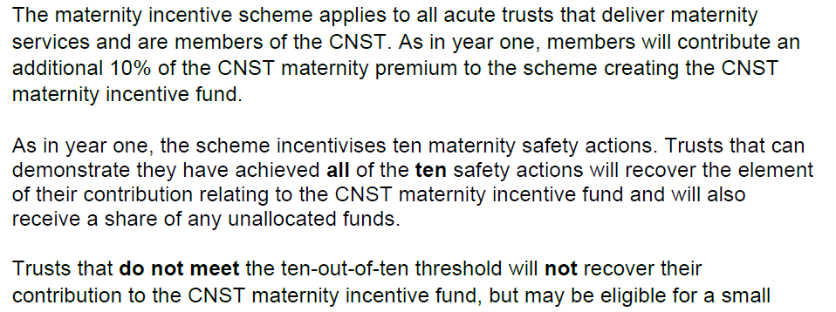

Slide 22
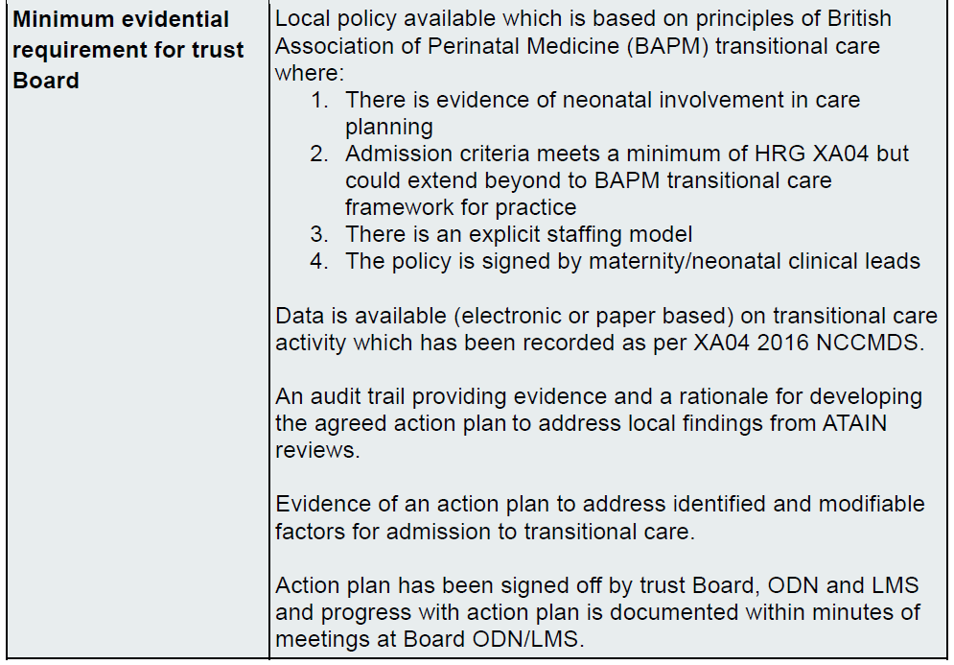

Slide 23

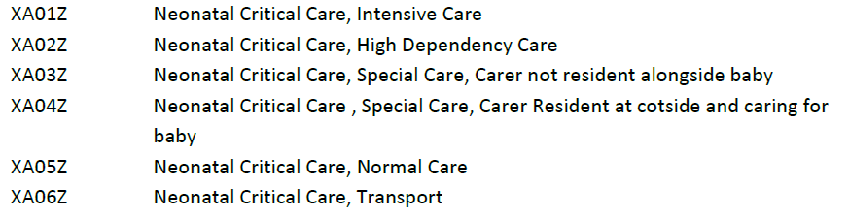

Slide 24
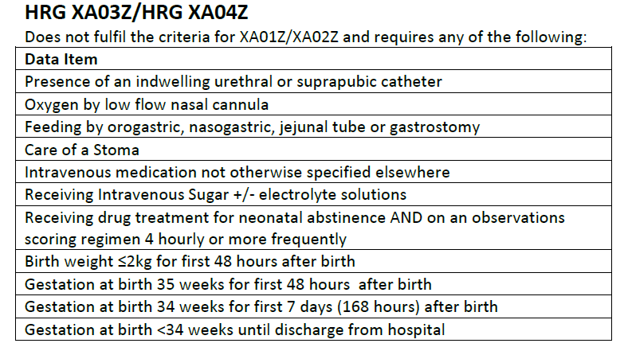
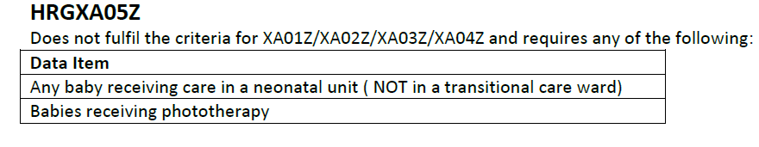

Slide 25
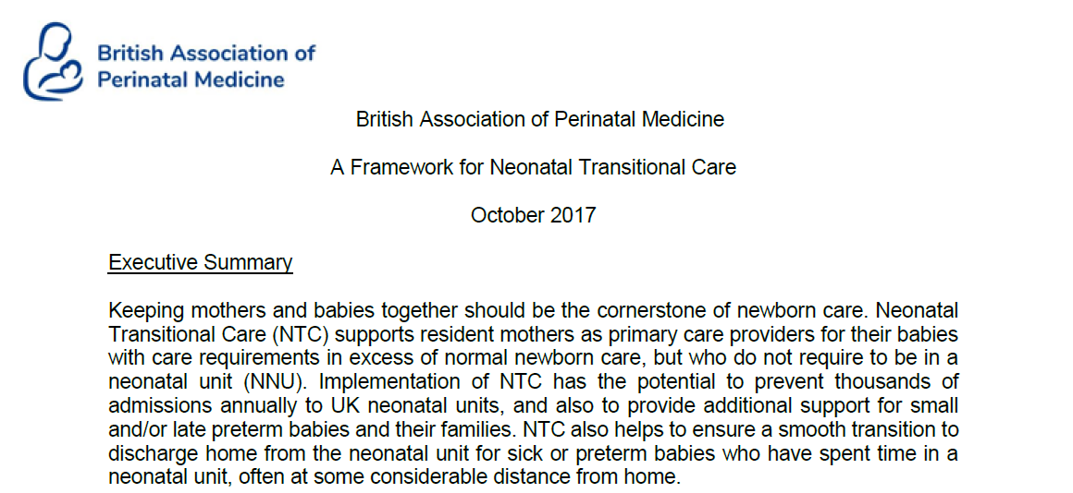

Slide 26
How
Currently provided with in different ways
  Post natal ward
  Transitional care ward
Should be regarded as a service

Slide 27
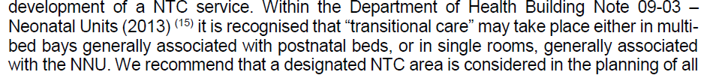
Where

Slide 28
Which babies
Antenatal
At birth
On the postnatal ward
From Special care
From home

Slide 29
Antenatal
  Congenital anomalies needing extra support eg , Trisomy 18, Trisomy 21, Cleft lip and palate
  Late preterm infants e.g. 34 weeks
  Small babies e.g. 1800 grams

Slide 30
Criteria for NTC for babies from birth:
  Gestational age 34+0 to 35+6 weeks
  Birth weight > 1600 g* and < 2000 g
  IV antibiotics, but clinically stable
  Tube feeding
  phototherapy

Slide 31
Additional care needs developing on the postnatal ward or at home:
  Inability to maintain temperature
  requiring IV antibiotics
  3 hourly nasogastric tube feeds
  NAS requiring oral medication or additional feeding support
  phototherapy

Slide 32
Babies readmitted from the community:
  Excessive weight loss and/or poor suck feeding requiring complementary nasogastric tube feeds
  phototherapy

Slide 33
Babies “stepping down” from the NNU:
  Corrected gestational age > 33+0 weeks Current weight more than 1600 g
  Tolerating 3 hourly nasogastric tube feeds
  IV antibiotics
  phototherapy
  Palliative care

Slide 34
How
Service delivery
  Parent/Carer is the primary care giver – Resident
  Staff
    Midwifery
    Neonatal staff

Slide 35
Staffing
Midwifery
  Standard postnatal care is between 1:5 and 1:8
Neonatal nursing
  Designated nursing lead (Band 7)
  Not necessary for nurses to be QIS
  Ratio 1:4
Ancillary nursing staff
  Nursery nurses and/or maternity care assistants
Medical
  Named paediatric or neonatal consultant
  Daily clinical input similar to SC

Slide 36
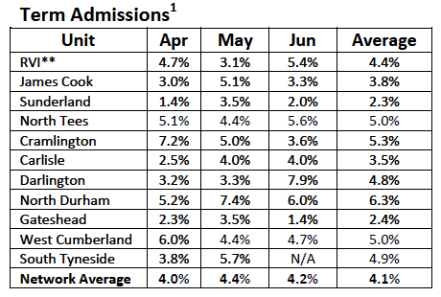

Local data
April – June 2019
LB

Slide 37
Where to we go next
MatNeo
In consultation with the maternity network
One of the priorities to help establish NTC on the network
Data collection
Funding

Slide 38
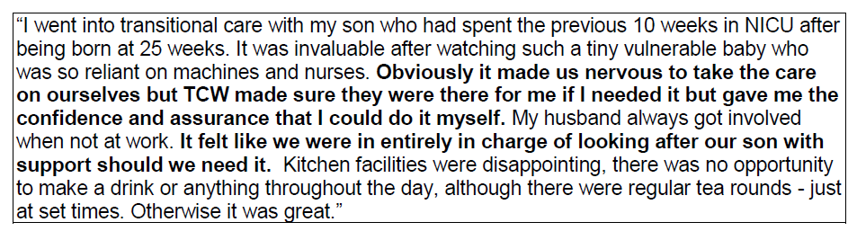
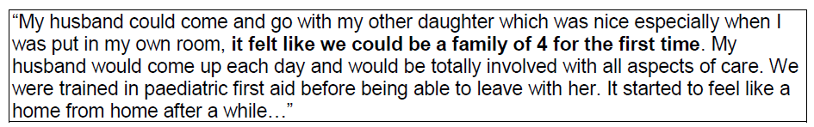

Slide 39
Transitional Care Trust Updates
Facilitated by Martyn Boyd, Manager, Northern Neonatal Network
North East and
North Cumbria

Slide 40
Next Steps
Dr Sundeep Harigopal and Martyn Boyd
North East and
North Cumbria

Slide 41
Lunch Break
#MatNeoNENC #PReCePTNENC
North East and
North Cumbria

