Slide 1
North East North Cumbria Health Safety Collaborative Learning System 2 December 2019 #MatNeoNENC #PReCePTNENC
North East and
North Cumbria

Slide 2
Welcome and introduction Julia Wood
North East and North Cumbria

Slide 3
Overview of MatNeo SIP
Patient Safety Programmes in Obstetrics – Mr Kim Hinshaw
CTG – What we know
CTG- What’s next?
System-level project updates
Regional SCORE Update
Wrap up

Slide 4
Maternity and Neonatal Safety Improvement Programme (previously Maternal and Neonatal Health Safety Collaborative)
National Patient Safety Collaborative rebranded to become the National Patient Safety Improvement Programme
All the workstreams which sit under this were also rebranded, including this programme

Slide 5
Maternity and Neonatal Safety Improvement Programme (previously Maternal and Neonatal Health Safety Collaborative)
To support improvement in the quality and safety of maternity and neonatal units across England
AIMS:
Contribute to the national ambition of reducing the rates of maternal and neonatal deaths, stillbirths and brain injuries that occur during or soon after birth by 20% by 2020
To improve the safety and outcomes of maternal and neonatal care by reducing unwarranted variation and provide a high quality healthcare experience for all women, babies and families across maternity and neonatal care settings in England

Slide 6
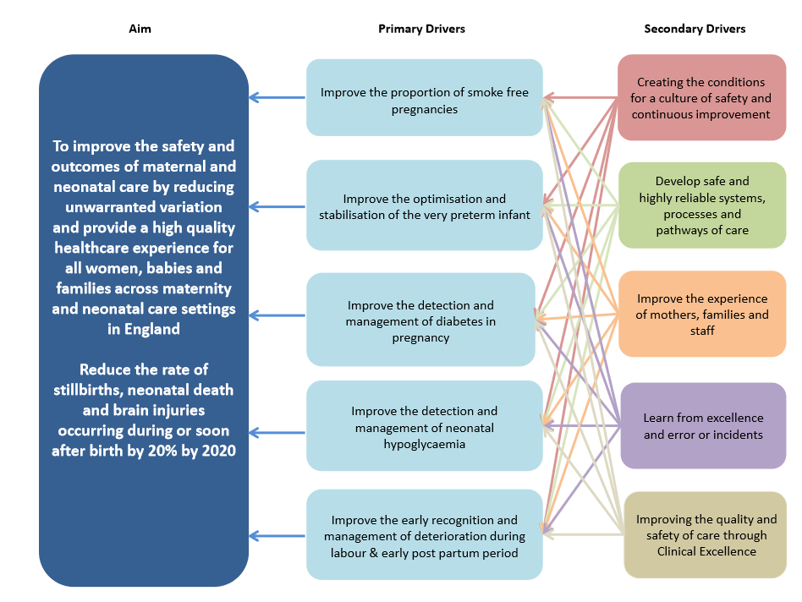

Slide 7
Two approaches, working together
Trust Improvement
Learning Systems
Trusts identify areas of focus which meet their needs (in line with National Driver Diagram)
System improvement across North East and North Cumbria
Evolve over time
Building on the great work currently going on in the region

Slide 8
Trust Improvement: Who is involved?
Wave 1 (from Apr 17) | Wave 2 (from Apr 18) | Wave 3 (from Apr 19)
North Tees & Hartlepool NHSFT | County Durham and Darlington NHSFT | North Cumbria University Hospitals NHS Trust
 | South Tees NHS FT | South Tyneside and Sunderland NHSFT
 | Gateshead Health NHS FT | The Newcastle Upon Tyne Hospitals NHS FT
 | Northumbria Healthcare NHS FT
Usually share Trust Improvements:
Only just over two months since the last event
Lots to cover regarding system-level projects
44 organisations | 43 organisations | 46 organisations
Everyone is involved in the Learning Systems

Slide 9
PReCePT
Prevention of Cerebral Palsy in PreTerm Labour
CTG
Cardiotocography
Transitional Care

Slide 10
Date for your diary
3rd March

Slide 11
Patient Safety Programmes in Obstetrics Mr Kim Hinshaw Director of Research, Consultant Obstetrician & Gynaecologist South Tyneside & Sunderland NHS Foundation Trust
North East and
North Cumbria

Slide 12
See Kim Hinshaw’s slides in the available pdf

Slide 13
CTG – What We Know Dr Stephen Sturgiss
North East and
North Cumbria

Slide 14
Physiological CTG interpretation: what do we know
Where did we get to at the end of the last meeting
Enthusiasm to propose region-wide adoption of physiological interpretation
Acknowledgement that such a decision needs wide-ranging agreement
Critical to that decision will be a bringing together of evidence
Facilitate decision-making within each provider unit, or at a bespoke meeting
Also assess training and competency assessments
Notes:
Say something about the real enthusiasm that appeared to be in the room
Note that I’ve not been on the course, but it’s something that I’ve heard from colleagues

Slide 15
Physiological CTG interpretation: what we know
What have we done since the last meeting
Contacted clinical experts & leaders (directly or indirectly)
Available literature
Tele-conferences with:
East of England
Oxford
Northern
Notes:
Not a formal literature review

Slide 16
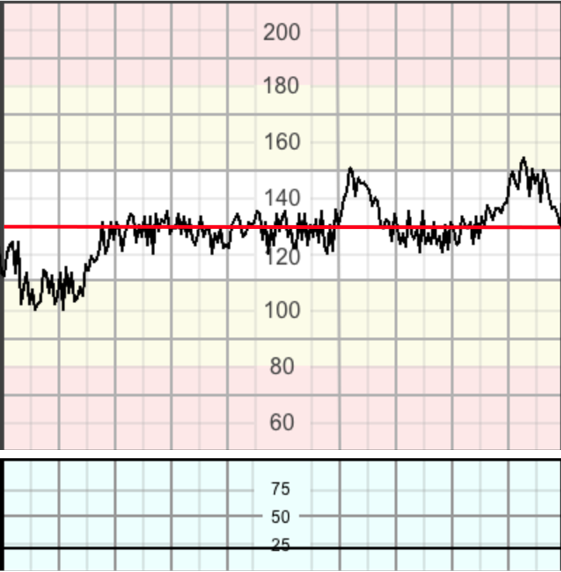
Physiological CTG interpretation CTG features – baseline heart rate
Normal baseline
Value between 110-160 bpm
Tachycardia
Baseline > 160 bpm for 10+ mins
Bradycardia
Baseline < 110 bpm for 10+ mins
Values of of 90-110 can occur in a normal fetus, especially in a postdate pregnancy
Intrapartum Fetal Monitoring Guideline – February 2018. Chandraharan et al
Notes:
Worth going thro’ for those who haven’t been on the course
Provide an idea of what it’s all about – as well as where differs from NICE
Need to say that I’m not an expert, and this is s rough overview to give an idea. It’s not an educational course
Mention Vedrana

Slide 17
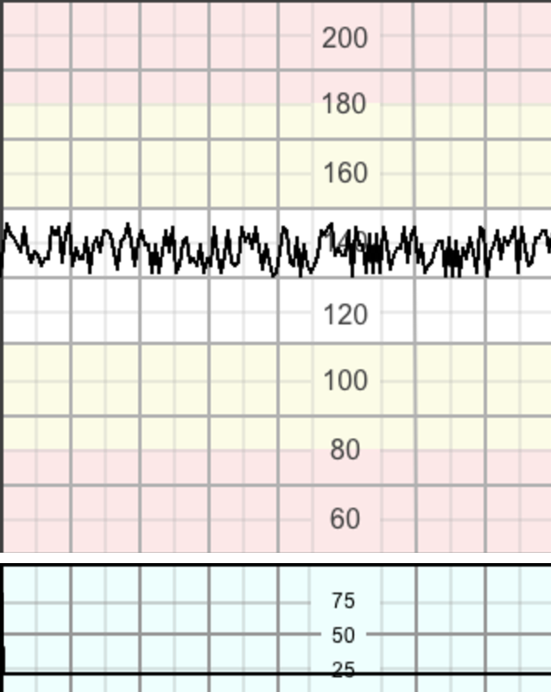
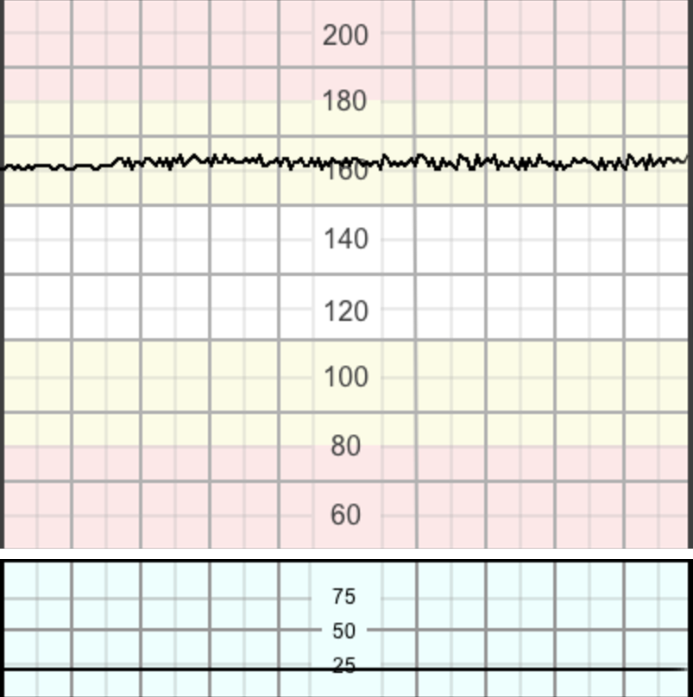
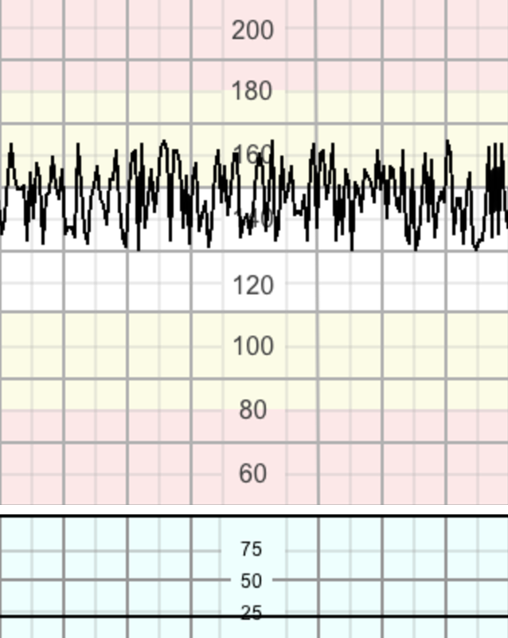
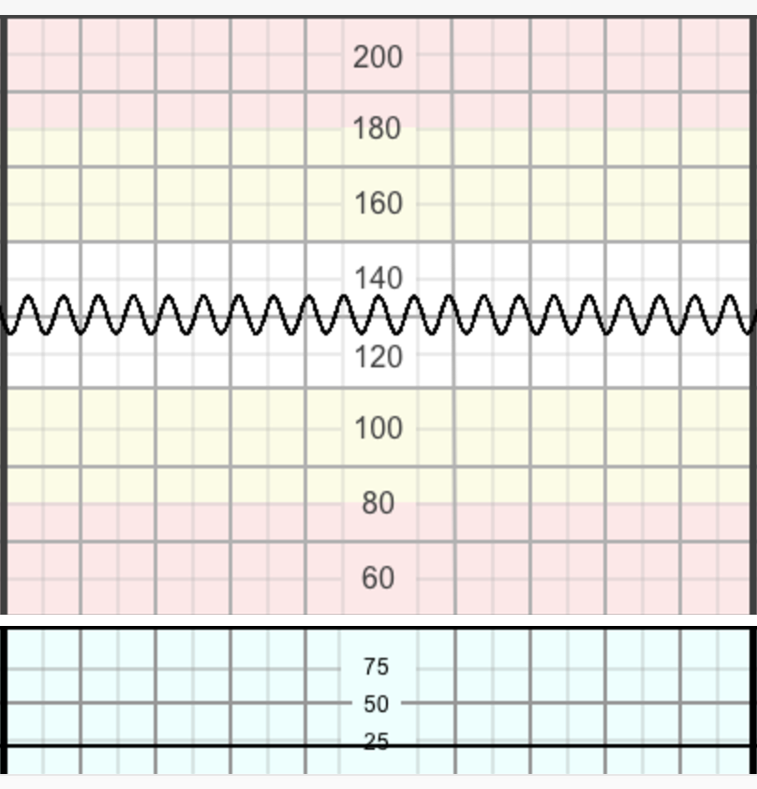
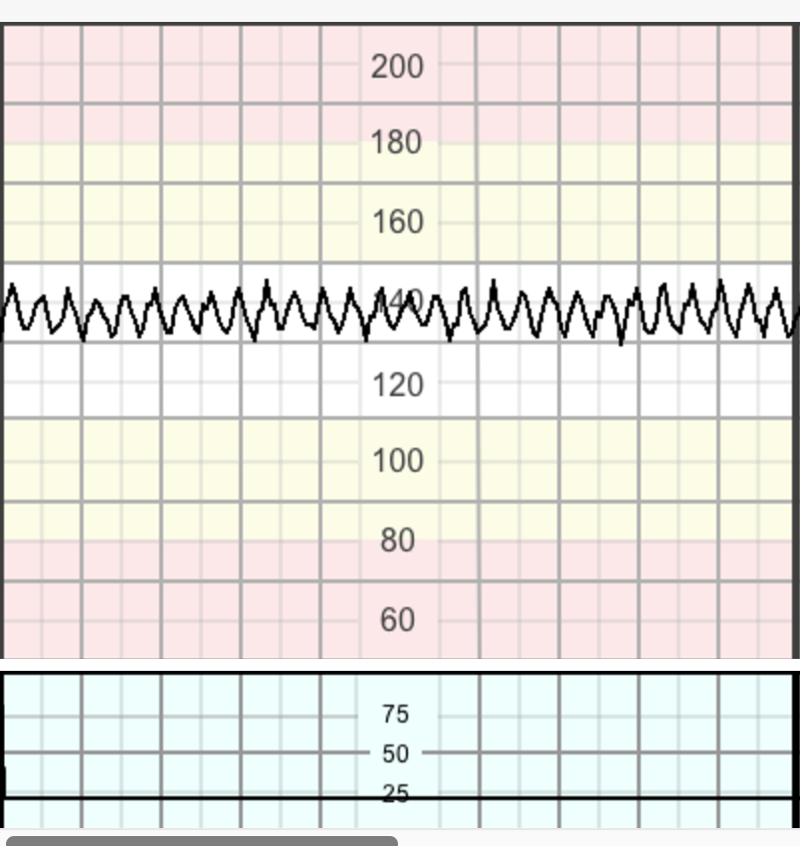
Physiological CTG interpretation CTG features - Baseline variability (BLV)
Normal:
Bandwidth amplitude 5-25 bpm
Reduced BLV:
< 5 for 50+ mins
or
3+ mins during decels
Increased BLV
(saltatory):
25+ for 30+ mins
Sinusoidal:
Regular, smooth, undulating signal at 5-15 bpm + no accels
Pseudo-sinusoidal:
Resembles sinusoidal + more ‘jagged’ pattern
Intrapartum Fetal Monitoring Guideline – February 2018. Chandraharan et al

Slide 18
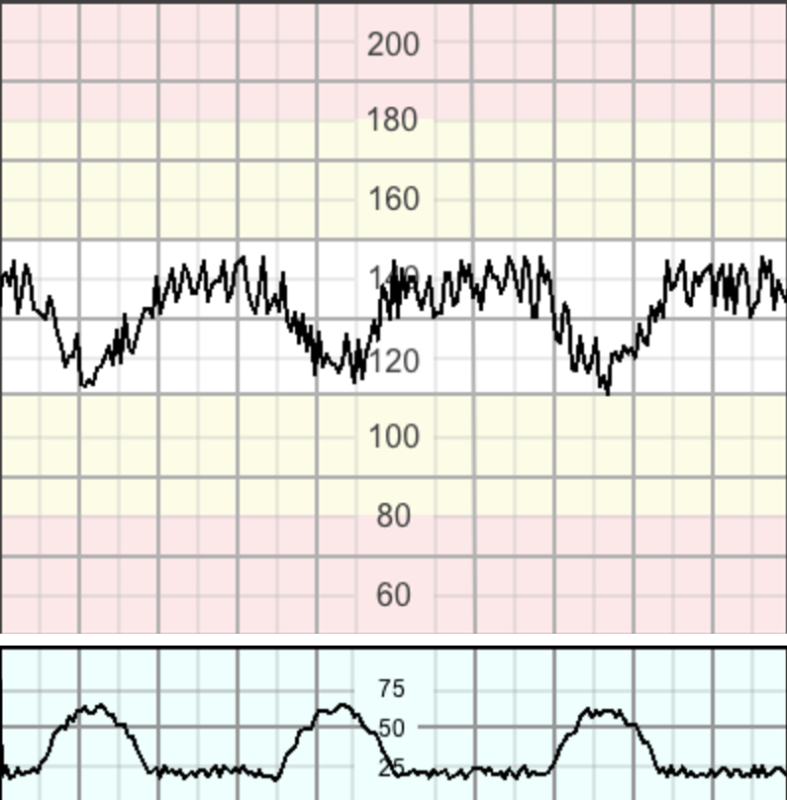
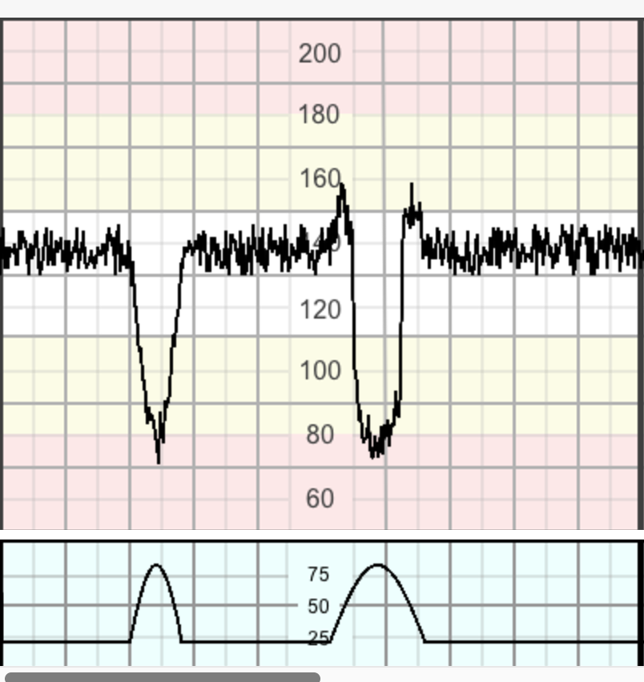
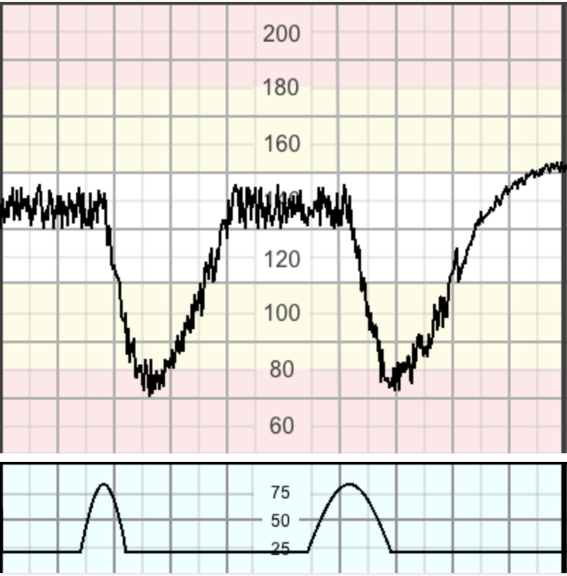
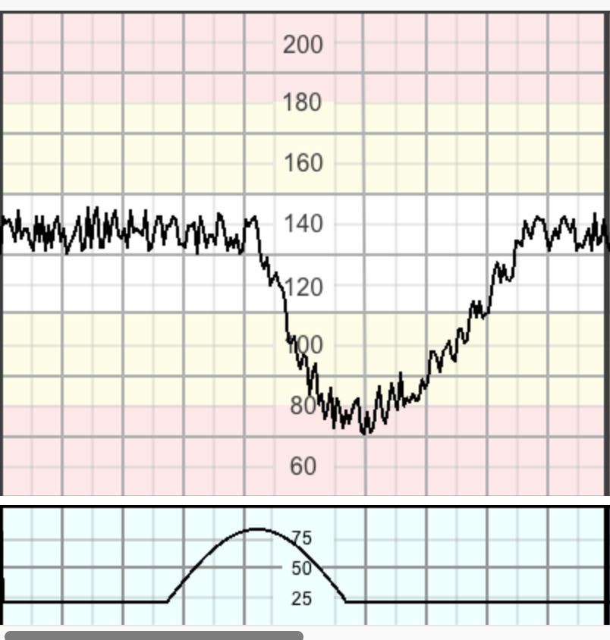
Physiological CTG interpretation CTG features – Decelerations (15+ bpm for 15+ secs)
Early decelerations:
Gradual (ie onset to nadir > 30 secs) + coincide with contractions
Variable decelerations:
V-shaped, with rapid drop (< 30 secs to nadir) + rapid recovery
Late decelerations
Gradual onset + return, + increased or reduced variability within decel
Prolonged deceleration
Decels for 3+ mins
Do not indicate hypoxia
Rarely indicate hypoxia, unless evolve to U-shape + (‘60’s criteria), or reduced / increased variability during decel
Indicative of hypoxiaemia
Likely to indicate hypoxiaemia
Intrapartum Fetal Monitoring Guideline – February 2018. Chandraharan et al

Slide 19
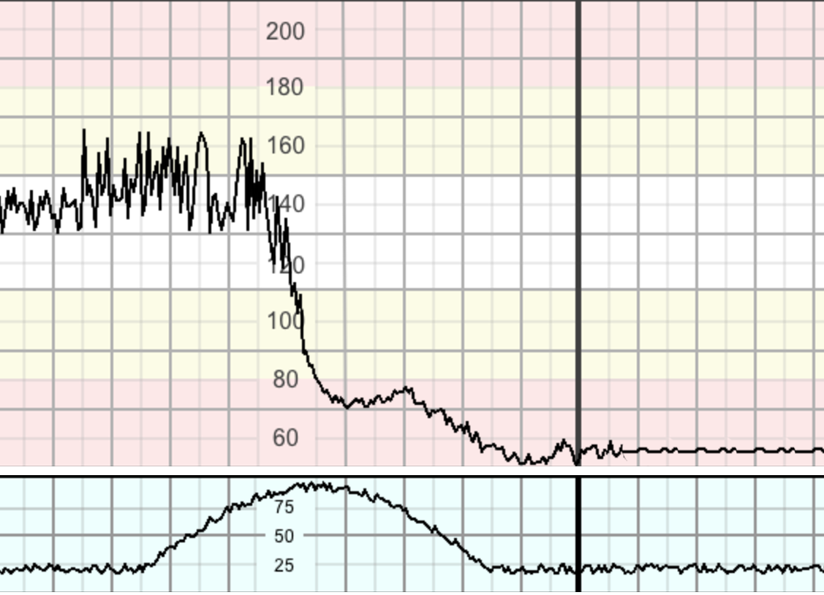
Physiology of hypoxia in labour Acute hypoxia
Prolonged decel 5+ min (or 3+ min if reduced BLV)
Causes
Accidents – cord prolapse, abruption, uterine rupture
Iatrogenic – maternal hypotension, uterine hyperstimulation
Management
3-minute rule (unless preceded by reduced BLV)
3+ min – raise emergency alarm
3-6 diagnosis
6-9 prepare for delivery
9-12 aim for delivery by 12-15 mins
Intrapartum Fetal Monitoring Guideline – February 2018. Chandraharan et al
Notes:
Guided by principles of evolving hypoxia

Slide 20
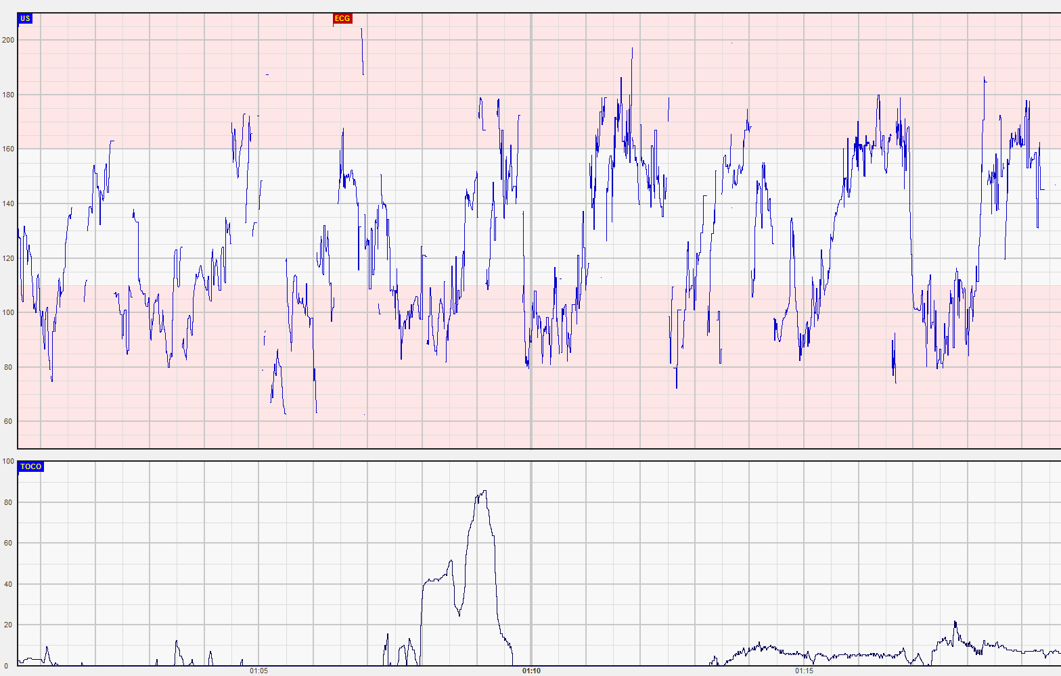
Physiology of hypoxia in labour Subacute hypoxia
Fetus spends majority of time in decels
Invariably caused by hyperstimulation
Management in 1st stage
Stop / reduce uterotonics
Avoid supine position
Start IV fluids
Consider tocolytics
Expedite delivery if persists
Management in 2nd stage
Stop pushing
Expedite delivery if no recovery in 10 mins
Intrapartum Fetal Monitoring Guideline – February 2018. Chandraharan et al

Slide 21
Physiology of hypoxia in labour Gradually evolving hypoxia (stages 1-4)
Most common form of hypoxia in labour
Stages 1-4 - represent evidence of stress + fetal compensation
Stage 1
- hypoxic stress
- decels
Stage 2
- loss of accels
- lack of cycling
Stage 3
- exaggerated response to hypoxia
- decels wider and deeper
Stage 4
- redistribution to vital organs
- facilitated by catecholamines
- rise in baseline FHR
Intrapartum Fetal Monitoring Guideline – February 2018. Chandraharan et al
Notes:
Based on animal studies – and concept of redistribution by catecholamines to protect vital organs

Slide 22
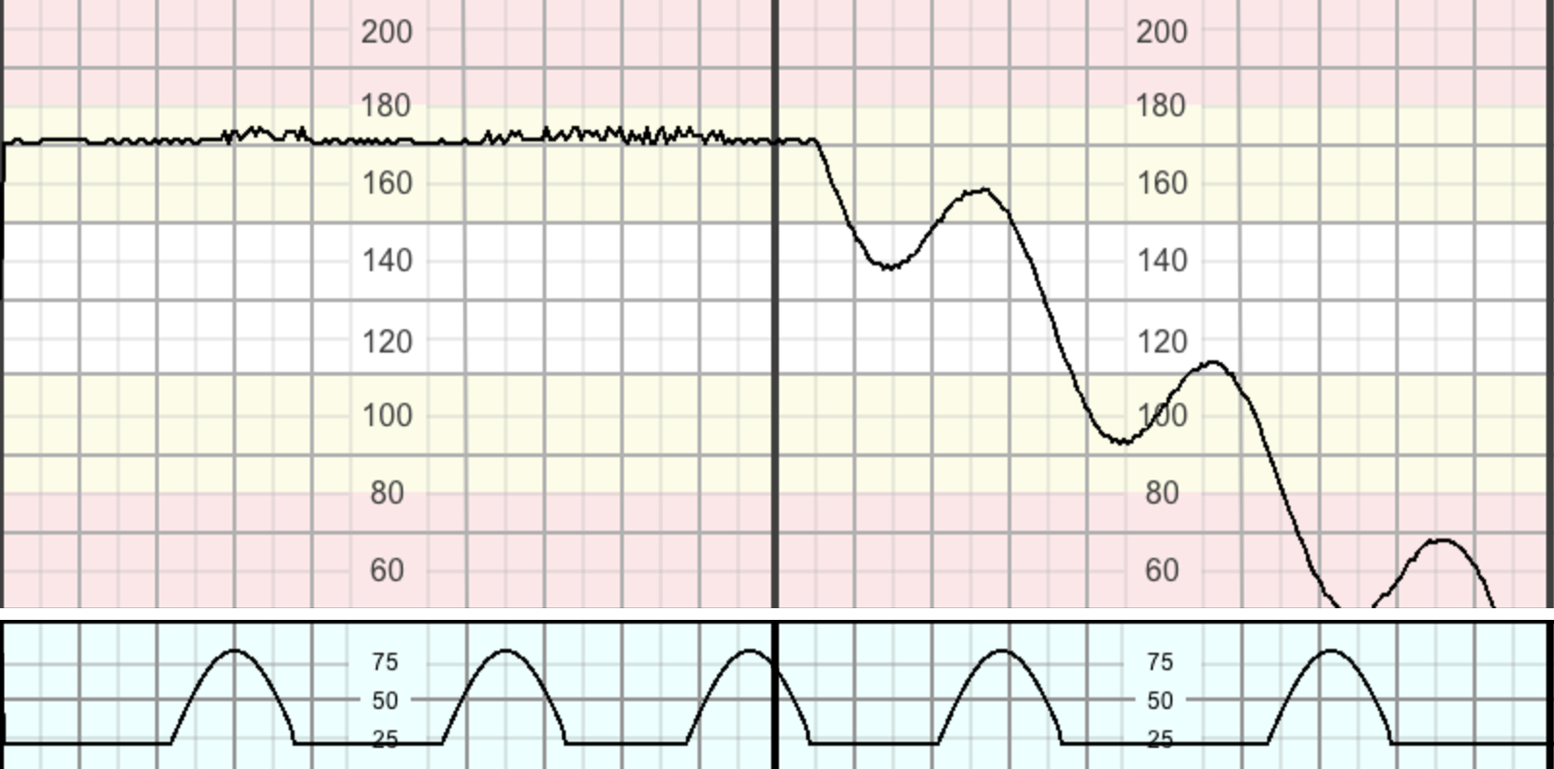
Physiology of hypoxia in labour Gradually evolving hypoxia – stages 5 & 6 (fetal decompensation)
Stages 4 (&5)
may be reversible
Stage 5
further redistribution
vasoconstriction affects brain
reduced BLV
Stage 6
terminal heart failure
unstable / progressive decline in BLR
‘step ladder pattern to death’
Management – improve fetal conditions with first signs of redistribution (stage 4)
Intrapartum Fetal Monitoring Guideline – February 2018. Chandraharan et al

Slide 23
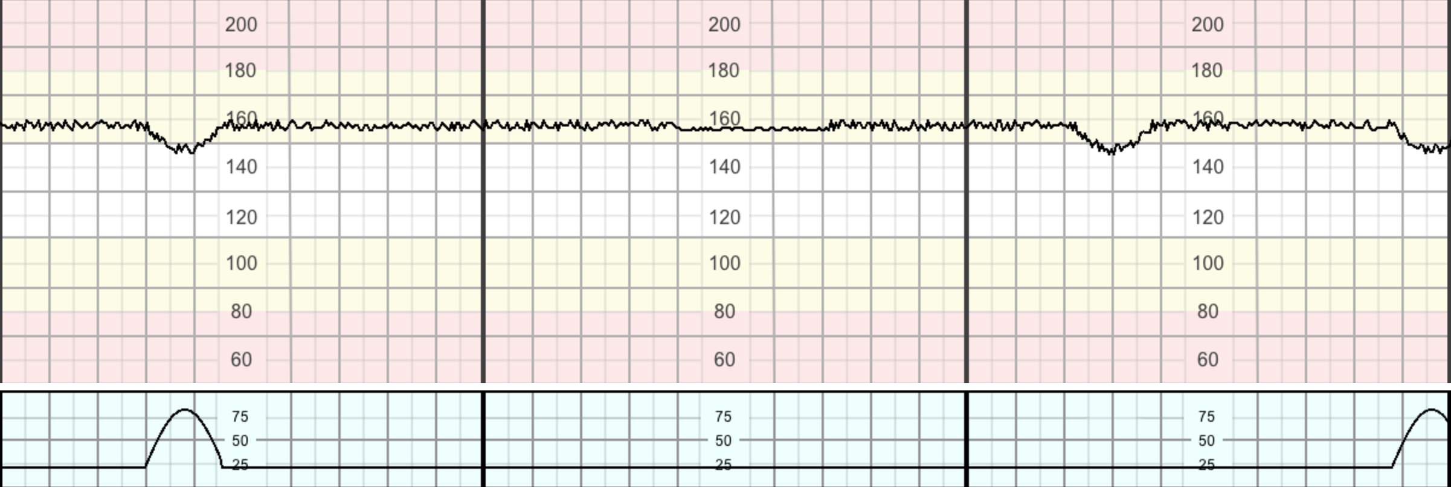
Physiology of hypoxia in labour Chronic hypoxia
Antenatal type of hypoxia
Presents as BLR at upper end of normal, with reduced BLV + often shallow decels
Indicates a fetus with reduced reserve
Low threshold for surgical intervention
Intrapartum Fetal Monitoring Guideline – February 2018. Chandraharan et al

Slide 24
Physiological interpretation of CTGs Management of suspected fetal hypoxia
Hypoxia | Features | Management
Gradually Evolving hypoxia | Compensated | Likely to respond to conservative interventions (see below) Regular review every 30-60 minutes to assess for signs of further hypoxic change, and that the intervention resulted in an improvement. Other causes such as reduced placental reserve MUST be considered and addressed accordingly
 | Rise in the baseline (with normal variability and stable baseline) preceded by decelerations and loss of accelerations
 | Decompensated | Needs urgent intervention to reverse the hypoxic insult (remove PG pessary, stop oxytocin, tocolysis) Expedite delivery if no improvement seen
 | Reduced or increased variability Unstable/ progressive decline in the baseline (step ladder pattern to death)
Intrapartum Fetal Monitoring Guideline – February 2018. Chandraharan et al

Slide 25
Physiological interpretation of CTGs Management of suspected fetal hypoxia
Hypoxia | Features | Management
Subacute hypoxia | More time spent during decelerations than at the baseline May be associated with saltatory pattern (increased variability) | First stage
 |  | Remove prostaglandins/stop oxytocin infusion If no improvement, needs urgent tocolysis If still no evidence of improvement within 10-15 minutes, review situation and expedite delivery
 |  | Second stage
 |  | Stop maternal active pushing during contractions until improvement is noted. If no improvement is noted, consider tocolysis if delivery is not imminent or expedite delivery by operative vaginal delivery
Intrapartum Fetal Monitoring Guideline – February 2018. Chandraharan et al

Slide 26
Physiological CTG interpretation: Significance of baseline FHR after onset of decelerations
 | Without tachycardia (n=81) | With tachycardia (N=262) | Z | P-value
Gestational age (weeks) | 40.4 | 40.3 | -0.868 | .386
Birthweight (g) | 3371 | 3427 | 1.157 | .247
1 min Apgar | 8.82 +/- 1.0 | 7.96 +/- 1.78 | -4.816 | 0.000
5 min Apgar | 9.79 +/- 0.47 | 9.34 +/- 1.04 | -4.03 | 0.000
Umbilical arterial pH | 7.25 +/- 0.05 | 7.20 +/- 0.1 | -3.38 | 0.001
< 7 | 0 | 13 (5%) | 2.927 | 0.087
> 7 | 81 | 249 (95%)
Jia et al (2019) J Maternal-Fetal & Neonatal Medicine
Notes:
Reinforces the concept of pathophysiology based upon progressive redistribution subsequent on catecholamine

Slide 27
Types of intrapartum hypoxia on the CTG: do they have any relationship with the type of brain injury in the MRI scan in term babies
Primary objective
Examine whether an interpretation of CTGs using ‘types of intrapartum hypoxia’ correlates with the nature of hypoxic injuries
Retrospective study of 52,187 births at St George’s (2006-17)
16 babies with postnatal diagnosis of HIE
AAP criteria from 2003 used to diagnose occurrence of acute hypoxic event
CTG traces classified independently by 2 assessors (SSY/EC)
Yatham+ J Obstet Gynecol https://doi.org/10.1080/01443615.2019.1652576
Notes:
With moderate reduction in cerebral blood flow over a period of time, the fetus shunts blood from the anterior to the posterior circulation.
This protects the brainstem, cerebellum and basal ganglia
At expense of cortex and ‘watershed’ areas

Slide 28
Types of intrapartum hypoxia on the CTG: do they have any relationship with the type of brain injury in the MRI scan in term babies
52,187 births between 2006 and 2017
16 cases of HIE (0.3 / 1000) … (cf …)
Condition |  | Year
 |  | 2012 | 2013 | 2014 | 2015
HIE | No.of cases | 1674 | 1674 | 1824 | 1742
 | Rate / 1000 LBs | 2.4 | 2.5 | 2.8 | 2.6
 | Number of term cases | 1409 | 1401 | 1480 | 1417
 | Number of term births | 640787 | 612816 | 607972 | 609076
 | Rate term cases | 2.2 | 2.2 | 2.4 | 2.3
Gale et al 2017 ArchDis Child Fetal Neonatal Ed
Yatham+ J Obstet Gynecol https://doi.org/10.1080/01443615.2019.1652576
Notes:
National Neonatal Research Database

Slide 29
Types of intrapartum hypoxia on the CTG: do they have any relationship with the type of brain injury in the MRI scan in term babies
52,187 births between 2006 and 2017
16 cases of HIE (0.3 / 1000) … (cf national of 1.4-1.8 / 1000)
Other quoted outcomes
Intrapartum emergency CS: 8.1%
Emergency CS for failed instrumental: 0.3-0.5%
Intrapartum stillbirths: None in 7+ yrs
Yatham+ J Obstet Gynecol https://doi.org/10.1080/01443615.2019.1652576

Slide 30
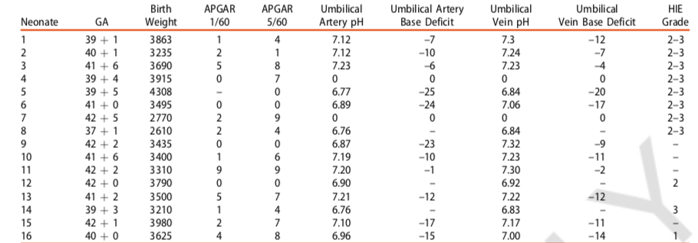
Types of intrapartum hypoxia on the CTG: do they have any relationship with the type of brain injury in the MRI scan in term babies
‘Our study has shown that, whilst our rate of HIE based on Sarnat Criteria is 0.8/1000, our actual rate of neurological damage based on neonatal MRI scan is much lower (16/52,187 births or 0.3/1000).’
Yatham+ J Obstet Gynecol https://doi.org/10.1080/01443615.2019.1652576

Slide 31
Types of intrapartum hypoxia on the CTG: do they have any relationship with the type of brain injury in the MRI scan in term babies
Inter-observer agreement: 81%
Typical reported rates: 30%
(Rhose et al, 2014. Reif et al, 2016. Hruban et al, 2016)
Yatham+ J Obstet Gynecol https://doi.org/10.1080/01443615.2019.1652576
Notes:
Matches anecdotal – report Oxford experience

Slide 32
Types of intrapartum hypoxia on the CTG: do they have any relationship with the type of brain injury in the MRI scan in term babies
Hypoxia | No. of babies | MRI findings
Subacute | 3 | Normal (1), Unavailable (2)
Evolving | 4 | Normal (1). Abnormalities in thalami (1), diffuse cortical injury (2)
Combined acute + subacute | 2 | Abnormal myelination in ares supplied by posterior circulation (1), Unavailable (1)
Combined evolving + acute | 2 | Abnormal myelination in areas supplied by post circulation + very severe HIE (1), Unavailable (1)
Evolving + subacute | 2 | Normal (1), Severe atrophy of cerebral hemisphere in watershed areas
None | 3 | Post cerebral infarct (1), Metabolic pathology (1)
Yatham+ J Obstet Gynecol https://doi.org/10.1080/01443615.2019.1652576
Notes:
Say something about my knowledge being hopeless – legal reviews, but generally supportive of theory

Slide 34
Physiologic interpretation of CTGs Case study from Lewisham & Greenwich NHS Trust
‘Sign up to Safety’ team introduced physiologic interpretation
Staff attended CTG masterclass
Weekly CTG meetings, induction program and mandatory training
Appointment of B7 midwives
32% reduction in number of babies admitted to NICU with HIE
Reduction in babies transferred out for cooling
(‘Only a couple of FBSs’)

Slide 35
Evaluating the value of intrapartum FBS to predict adverse neonatal outcomes: A UK multicentre observational study
Outcome | Test threshold | Sensitivity | Specificity | Positive predictive value | Negative predictive value | Area under the curve (95%CI, p value)
Neonatal acidaemia | Suboptimal pH | 22 | 87.3 | 4.9 | 97.4 | 0.59 (0.51-0.68, 0.31)
 | Abnormal pH | 7.3 | 94.6 | 3.9 | 97.2
Apgar < 7 at 1 min | Suboptimal pH | 14.5 | 87.5 | 23.4 | 79.6 | 0.55 (0.51-0.59, 0.004)
 | Abnormal pH | 8.8 | 95.5 | 33.8 | 79.9
Apgar < 7 at 5 mins | Suboptimal pH | 20.3 | 87.4 | 7.6 | 95.6 | 0.55 (0.48-0.62, 0.13)
 | Abnormal pH | 7.2 | 94.7 | 6.5 | 95.2
NICU admission | Suboptimal pH | 20.3 | 78.5 | 13.3 | 92.1 | 0.58 (0.52-0.53, 0.0002)
 | Abnormal pH | 9.3 | 94.7 | 14.3 | 91.8
Wattar et al 2019 Eur J Obstet Reprod Biology

Slide 36
Physiological interpretation of CTGs What do we know?
Some evidence of reduction in HIE
Underlying principles not rebutted by neuro-anatomic evidence
No evidence of increase in interventions (and potentially a reduction)
Recent evidence in relation to merit of FBS is equivocal
Very strong case for formal evaluation
Enthusiasm ++++

Slide 37
CTG – What’s next
Facilitated by Dr Stephen Sturgiss and Julia Wood

Slide 38
CTG – What’s next?: Part 1
Group Work
Focus on three areas, identified through the table discussions at the LLS in September:
Training and competence assessments (tables 1 and 2)
Ensuring staff implementation (tables 3 and 4)
Resistance to change – how to overcome it (tables 5 and 6)
Two tables focus on each area
If you want to move tables, please move now

Slide 39
Use of the Kipling Questions: Barriers
What: What are the potential barriers?
Where: Where will be the barrier/s? (so in which part of the process/system)?
Who: Who may be the barrier?
When: At which point in the process/system will the potential barrier/s become evident?
Why: Why is each barrier a problem?
How: How will we know that the potential barrier has become a problem?
20 minutes
I keep six honest serving men
(They taught me all I knew);
Their names are What and Why and When
And How and Where and Who

Slide 40
Use of the Kipling Questions: Overcoming Barriers
What/Where/Why: You have this information from the previous group work
How: How should each barrier be tackled
When: When is the best time to tackle each barrier?
Who: Who is best placed to tackle the each barrier? (individual/staff group/organisation)
20 minutes

Slide 41
Refreshment Break #MatNeoNENC #PReCePTNENC
North East and
North Cumbria

Slide 42
CTG - What’s next?: Part 2
Feedback from each table
(20 minutes in total)

Slide 43
System-level Projects Updates Dr Sundeep Harigopal Martyn Boyd Karen Hooper
System-level Projects
North East and
North Cumbria

Slide 44
TC at the RVI Dr Sundeep Harigopal
Dec 2019

Slide 45
Location
Predominantly on one of two PNW
Nursery nurse focus and TC nursing base
Overflow capacity possible on other PNW
No theoretical cot limit to TC number on any day

Slide 46
How
Mother with baby always (Dad alone tricky)
PNW run jointly by midwives and TC with nursery nurses
Baby care delivered by all of TC, nursery nurses and midwives
Oversight by consultant
Daily ward round on TC (M-F)
w/e ‘trouble shooting’

Slide 47
When
24/7 and 365 on level of mother with baby and care delivery unchanged
Deliverers of care do change
TC ‘M-F 07:30 – 15:30, junior docs OOH
W/e – some TC, more junior docs off NICU
Consultant availability always – dedicated M-F, shared with NICU, transport OOH

Slide 48
What
i.v antibiotics
NG feeds
Heated cots
Phototherapy
NAS management
‘Fresh off NICU’ (big babies and graduating older prems both accepted back)
‘other’ …(occasional stoma, complex baby etc)
NIPE for TC babies, and some ‘failsafe’ for NIPE
TC team also do BCG’s (but not viewed as TC activity)

Slide 49
Recording/reporting
TC coded by coders for financial purposes
We think by specific activity not as TC
E.g phototherapy, i.v’s etc
No current record in badger for TC babies
?we might start

Slide 50
How much
April – 356 days
May -369
June – 345

Slide 51
Challenges
Staffing – differences M’F vs w/e etc
Returning babies to normal care once in TC
Space
Stopping ‘silo’ working

Slide 52
PReCePT (prevention of cerebral palsy in preterm labour)
Update 2 December 2019

Slide 53
Exceptions September/October
September-19 – 1 BBA, 1 admitted with SROM, labour to delivery time of 17 minutes, 1 CI due to abruption
October-19 – 1 class 1 for bradycardia (GA), 1 BBA, 1 CI due to placenta previa with large bleed

Slide 54
November 2019
13 eligible women
4 did not receive – 2 imminent delivery
69% compliance

Slide 55
National breaking news!
We have 100% badgernet permissions given
Despite not hitting our 85% target nationally this quarter, there is still lots to celebrate.
Nationally, we are 80.6% towards our patient benefit count target. Therefore, we look like we will achieve our NHS England target by the end of the financial year. This really is something to celebrate as a network – well done to all!
Specific congratulations to North East North Cumbria. Despite only achieving 74.5% in Q2, you have achieved 124% of your patient benefit count target meaning you have made massive improvements against your 2017 baseline.

Slide 56
Month | Eligible mothers | Did not get MgSO4 | Compliance | Compliance* if exclude reasonable exceptions | Wrong data input
Oct-18 | 18 | 2 | 89% | 100% | 2
Nov-18 | 21 | 4 | 81% | 81% | 5
Dec-18 | 12 | 1 | 92% | 100% | 3
Jan-19 | 11 | 5 | 55% | 91% | 2
Feb-19 | 14 | 4 | 71% | 86% | 0
Mar-19 | 15 | 3 | 80% | 100% | 0
Apr-19 | 22 | 1 | 95% | 100% | 0
May-19 | 14 | 3 | 79% | 93% | 0
Jun-19 | 20 | 6 | 70% | 100% | 1
Jul-19 | 12 | 4 | 67% | 100% | 1
Aug-19 | 18 | 2 | 89% | 100% | 1
Sep-19 | 13 | 3 | 77% | 100% | 0
Oct-19 | 17 | 3 | 82% | 100% | 1

Slide 57
Since October 2018 (when the project really started) – we have had 207 eligible mothers (ie. Mothers that have delivered 1 or more babies below 30 weeks gestation), of these 41 did not receive MgSO4, meaning that the remaining 166 did (an average compliance over the 12 months of 80.2%).
35 of the 41 that didn’t get it, we believe were “reasonable” clinical exceptions such as the baby was born too quickly or before arrival at the hospital, or there were genuine clinical contraindications or decision not to administer. This means that in the past 12 months, only 6 women that were eligible potentially could have been given MgSO4 prior to delivery, and these 6 women all delivered before May 2019 – since June 2019 we have 100% compliance if we exclude the reasonable exceptions.
In addition, 97% of identified staff in all of our acute maternity units have received training in PReCePT, we have had 4 learning events for staff with opportunity for regional updates, units have made their own sustainability plans for continuing training & we have made several PReCePT films & heard from patient voices about the impact on their journey.
The number needed to treat to prevent 1 case of CP is 37 – therefore, potentially 4.5 cases of CP have been prevented in the past 12 months. Lifetime cost of 1 case of CP is approximately £800,000 – therefore potential savings of £3.6 million from just this 1 year.

Slide 58
Regional SCORE Update
Tony Roberts

Slide 59
SCORE Survey detail
The SCORE Survey is made up of 86 questions, split into 15 sections
Culture | Resilience | Engagement
Learning environment Local leadership Teamwork Safety climate | Burnout climate Personal burnout Work/Life balance Workload strain Emotional thriving Emotional recovery | Growth opportunities Job certainty Intentions to leave Decision making Advancement

Slide 60
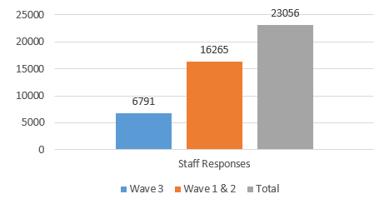
The national picture
Number of organisations and sites who took part in the
SCORE Survey:
Number of staff responses to the SCORE Survey:

Slide 61
The national picture
Document:
Measuring safety culture in maternal and neonatal services: using safety culture insight to support quality improvement
NHSI published this document in March 2019.
This document includes insights from wave 1 & 2 sites only. This is because wave 3 sites were still undertaking their SCORE survey at the time of its publication.
Copy available today if you want to look at it – speak to Julia

Slide 62
Key findings from the National Report
How culture is perceived varies widely in maternal and neonatal work settings and roles
Leadership is key to improving culture
Leaders need to understand the culture of their organisation to be effective in facilitating improvement
Culture will only improve if everyone supports the changes required
When quality improvement is linked to improvements in safety culture, both the quality of care and the culture improves
Antenatal staff have the most consistently positive perception of culture
Neonatal unit staff perception is positive of their ability to improve but with a more negative view of leadership
Midwifery managers have a more positive view of culture than midwives who are not managers
Midwives who are band 6 and below have among the lowest perception of safety culture but a more positive perception of team work
There are high rates of personal burnout within all staff groups
70% of midwives band 7 or above say they find it easy to speak up
65% of all respondents believe that there are communication breakdowns within the work setting

Slide 63
Conclusions from the National Report
There is significant variation in the way that staff perceive culture
Improvements in culture are linked to improvements in safety, quality and the experience of care
Through the process of quality improvement the quality of care improves as does the culture within the team
It is much harder to improve culture in isolation
Where a unit’s culture is positive and supportive, women, families and babies will experience the highest quality and safest care
Everyone must contribute to changing culture where this is required
Modelling and supporting positive behaviours and challenging poor behaviours creates a healthy, supportive and just culture in the work place

Slide 64
The regional picture
Trusts in the North East and North Cumbia region who have undertaken the SCORE Survey and received their findings:
County Durham and Darlington NHS FT (July 2018)
Gateshead Health NHS FT (July 2018)
Newcastle Hospitals NHS FT (April 2019)
North Cumbria University Hospitals NHS FT (April 2019)
North Tees & Hartlepool NHS FT (April 2018)
Northumbria Healthcare NHS FT (July 2018)
South Tees NHS FT (July 2018)
South Tyneside and Sunderland NHS FT - Sunderland only (April 2019)
1994
members of staff have completed the survey in the North East and North Cumbria region
Event on 18th November to discuss the findings and next steps

Slide 65
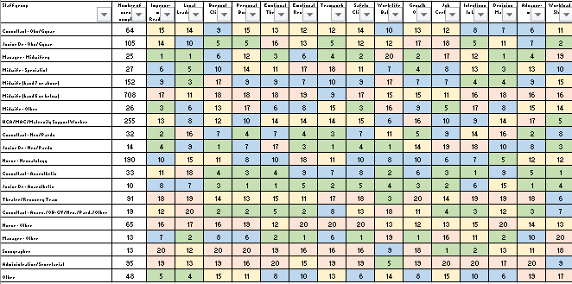
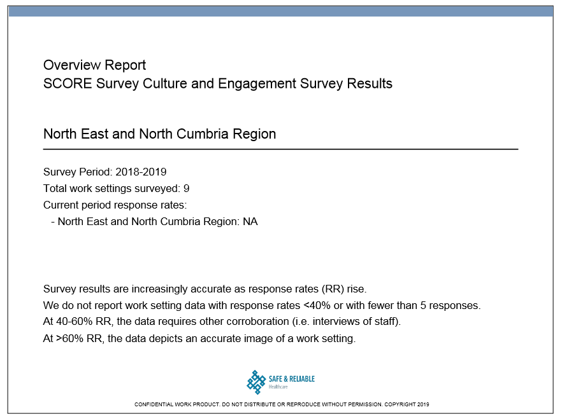
The regional picture….continued
High level anonymous regional overview report developed based on domains
High level regional analysis of how
staff groups have responded
High level regional analysis based on domains, similar to regional overview report, but data represented in a different way and includes how staff groups have responded for individual Trusts
Detailed regional analysis based on the 86 questions and includes how staff groups have responded for individual Trusts

Slide 66
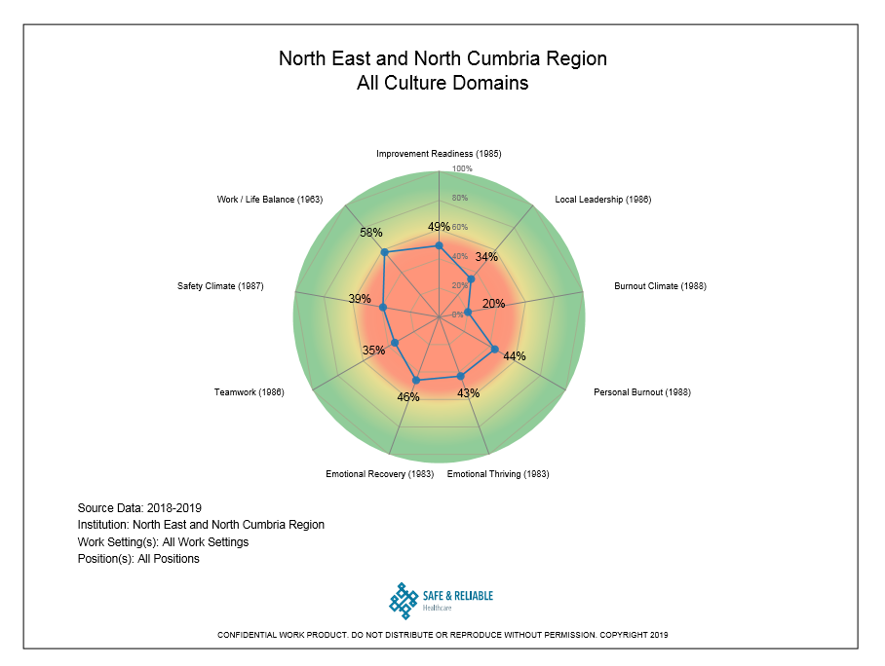
The regional picture – key findings

Slide 67
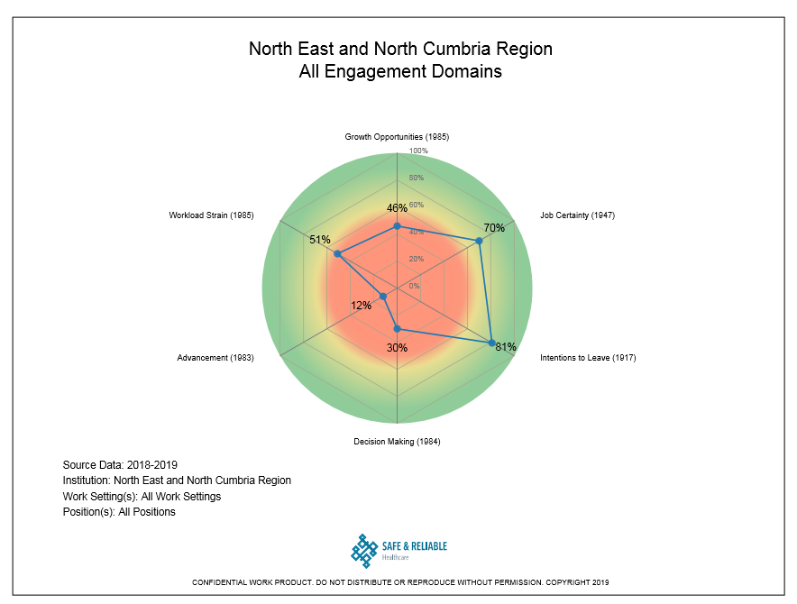
The regional picture – key findings

Slide 68
The regional picture – key findings
Trusts
No outliers
Domains
As can be seen from the previous 2 slides there are some positives
Areas where regionally we would like to focus are:
Work/Life Balance and Burnout
Team work
Leadership
Safety
Staff groups
Those who scored most positively are:
Junior Dr – Anaesthetic
Manager – Midwifery
Consultant – Anaesthetic
Those who scored most negatively are:
Administrative/Secretarial
Midwife – band 6 or below
Sonographers

Slide 69
Other SCORE work
Discussions ongoing with the national team to see if as a region we can help with national SCORE analysis
Watch this space!

Slide 70
Wrap Up Julia Wood
North East and
North Cumbria

