Slide 1
**Delete this slide before presenting**
This presentation has been adapted from County Durham CCG resources funded by the AHSN
These were originally delivered virtually to GP practice based pharmacists – if delivering to other staff members please consider whether the content should be adapted accordingly
All information is up to date as of the end of December 2019 – if using after this please ensure that the most up to date guidance is used
Possible things to discuss are included in the notes section of each slide
Considerations for the presenter are in the notes section in BOLD
Places where local adjustments should be made to content are highlighted in RED

Slide 2
Introduction to Managing Polypharmacy, and De-prescribing in Cardiovascular Disease
Presentation 1 of 4
Presenter Names
Notes:
Add in presenter names and logos for your CCG

Slide 3
De-prescribing Webinars
2 of 4 - De-prescribing in patients at risk of Acute Kidney Injury
3 of 4 -De-prescribing in Pain
4 of 4 - De-prescribing in patients at risk of Falls
Notes:
Welcome to this first in a series of 4 webinars on polypharmacy and de-prescribing. Other presentations that make up the series are listed here.
These webinars are aimed at clinical staff involved in medication reviews of patients, particularly within primary care, and it is hoped that the sessions will provide you with practical advice and education about de-prescribing in key clinical areas.
May want to add in dates of upcoming presentations

Slide 4
This Session
Polypharmacy and the de-prescribing agenda
Presenter
De-prescribing in Cardiovascular disease
Presenter
Notes:
Add in presenter names
Also may want to go through any housekeeping if delivering this on-line – i.e. use of chat box, mute, Q and As and when you want them

Slide 5
Introduction to Polypharmacy
Written by
Rachel Berry and Michelle Chapman, Medicines Optimisation Pharmacists, County Durham CCG
Notes:
Add presenter details

Slide 6
Notes:
Adverse drug reactions are a common cause of hospital admissions, and across Europe are associated with 8.6 million admissions every year.
We know that certain patient groups are more likely to suffer from an adverse drug reaction, including those on 5 or more medicines, and those over 65 years.
It is estimated that around 50% of these are preventable.
Reference for images; Scottish Government Polypharmacy Model of Care Group. Polypharmacy Guidance, Realistic Prescribing 3rd Edition, 2018. Scottish Government

Slide 7
Current Position
**Insert own area data**
Notes:
Add in graphs to show own area data for CCG/PCN compared to national – these examples are from EPACT2 polypharmacy dashboard
Some polypharmacy may be totally reasonable and required for therapeutic treatment – for example multiple evidence medicines following an MI
Other medication may be unnecessary – polypharmacy to treat side effects of other meds, continued medication with no indications, continued medication that should be short term etc
Inappropriate polypharmacy can cause increased side effects, confusion and compliance issues, increased waste, increased spend on medicines and increased risk of hospitalisation.
Therefore important to ensure that inappropriate polypharmacy is tackled and prevented where possible.

Slide 8
What is De-prescribing?
Effective cessation or tapering of inappropriate medication
Reducing harm and the use of unnecessary medicines
Particularly important if the person is frail
Notes:
De-prescribing is not about denying medication but about reducing harm
It aims to improve quality of life and avoid worsening disease or withdrawal effects
De-prescribing is the process of withdrawal of an inappropriate medication, supervised by a health care professional with the goal of managing polypharmacy and improving outcomes’. - Definition from A systematic review of the emerging deﬁnition of 'deprescribing' with network analysis: implications for future research and clinical practice. Br J Clin Pharmacol. 2015 Dec;80(6):1254-68
In partnership with the patient (and sometimes their carer) and supervised by a healthcare professional
De-prescribing should be planned, one medicine at a time, offered as a trial, the dose gradually tapered and any returning symptoms monitored
Aims of de-prescribing:
Improve quality of life
Avoid worsening of disease or causing withdrawal effects
Be effective in reducing pill burden
Key ref; Deprescribing- a practical guide http://www.derbyshiremedicinesmanagement.nhs.uk/assets/Clinical_Guidelines/clinical_guidelines_front_page/Deprescribing.pdf#:~:text=Aims%20of%20deprescribing%20Improve%20quality%20of%20life%20Avoid,initiating%20any%20new%20medicines%20for%20a%20trial%20period.

Slide 9
Barriers to De-prescribing
Time and resources
Patient factors
Multiple prescribers
Non-holistic approach to clinical management
Patients concerns
Prescriber concerns
Notes:
Lack of de-prescribing recommendations in national guidelines
Clinicians worry how patients may perceive stopping medications – has the doctor given up on them? - Needs a clear discussion about continuing to give care and focusing on achievable, patient-centred outcomes
GPs may struggle for adequate time to review longstanding medications or be reluctant to stop drugs started elsewhere by a colleague, especially a “specialist”. However usually regular review by a GP is expected and welcomed by the vast majority of specialists. Utilise the experience of practice-based pharmacists or nurses to review medications if struggling with time.
Often the clinical picture has altered significantly since the initial prescription. More co-morbidity, physical and metabolic changes, adverse effects.
Patients may over-estimate the value of medication e.g. this pill will stop me having a stroke. Prescribers may have been complicit in this in attempts to ensure treatment adherence – important to think about the language that is used when medicines are started - Consider including a discussion about how language could change around medicine use and asking attendees to reflect on their own use of language.
There may be some benefit for some people in looking at NNTs. It is good to appreciate that most trials have deliberately excluded patients with co-morbidities, the very elderly and complex. NNTs therefore can vastly overestimate the likely benefit in the frail. Ask attendees to reflect on their ability to discuss risk: benefit with patients. Can they explain NNT/NNH?

Slide 10
Practical Aspects
How can polypharmacy be prevented?
What should medication reviews look like?
How do you ensure de-prescribing is a process rather than a one-off?
Who can you utilise to help?
Which patients should be targeted?
What does the patient think?
Notes:
This is an opportunity for the attendees to reflect on the practice within their place of work – are there processes in place to help reduce inappropriate polypharmacy. You may wish to have this as a discussion if you have time, or just questions for self-reflection. Could also hold a practice/PCN level planning session based around them.

Slide 11
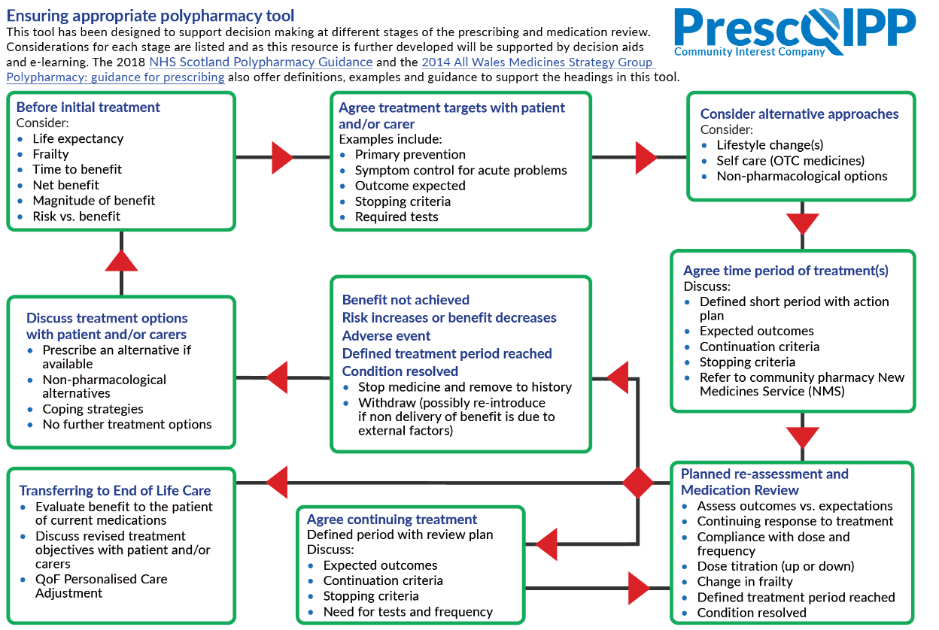
Notes:
Prescqipp tool to ensure appropriate polypharmacy - 2019 – busy tool, however highlights key aspects to consider when prescribing.
Available at https://www.prescqipp.info/our-resources/webkits/polypharmacy-and-deprescribing/
Ideally all new meds should be discussed with the patient and treatment goals set up – the patient should be aware of what the goals are, and that the medication may be stopped if those goals are not met. This is likely to be better than trying to tackle polypharmacy once a medication already established. – Consider discussing with attendees whether this is done within their clinical practice?
Requires a significant change in practice across all prescribers to manage this. What do we do about the patients who are already on multiple medications?

Slide 12
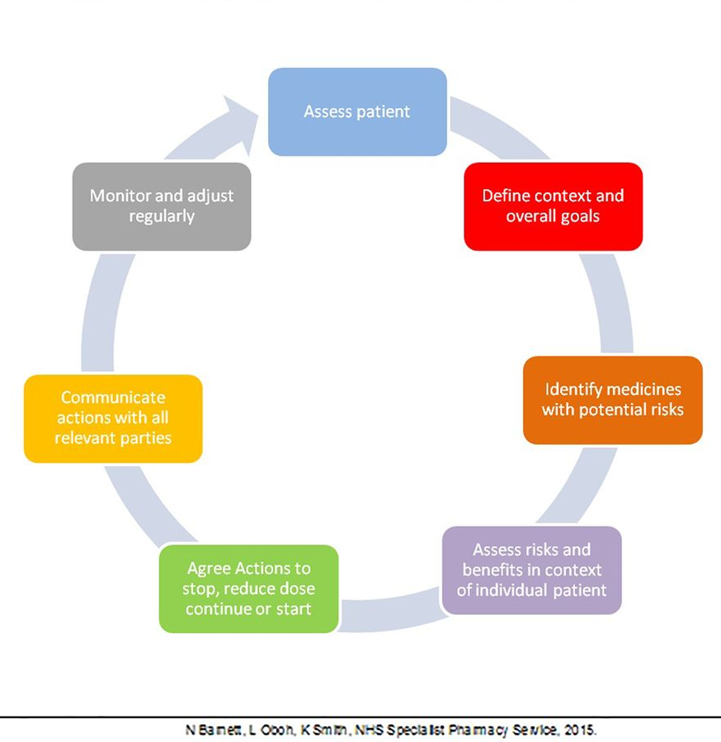
Effective Medication Review
Multiple recommendations and guidance on this, but difficult to implement
Needs to be holistic and patient focussed
Locally we have agreed to go with the Scottish Polypharmacy model of ‘Seven Steps’
Notes:
Effective medication review requires a circular process to ensure that medication remains appropriate to the patient if things change. Also needs to take into consideration the patient’s preferences, beliefs and lifestyle.
Ref; NHS Specialist Pharmacy Service 2015. A patient centred approach to polypharmacy. https://www.sps.nhs.uk/wp-content/uploads/2014/12/Polypharmacy-resource-including-patient-centred-approach-to-polypharmacy-2015.pdf

Slide 13
Scottish Polypharmacy Guidance
Notes:
Scottish Government Polypharmacy Model of Care Group. Polypharmacy Guidance, Realistic Prescribing 3rd Edition, 2018. Scottish Government. https://www.therapeutics.scot.nhs.uk/wp-content/uploads/2018/04/Polypharmacy-Guidance-2018.pdf
7 steps to appropriate polypharmacy – key focus on what the patient feels is important in addition to the clinical priorities.
Patient Views
Essential
Unnecessary
Effectiveness
Safety
Cost effectiveness
Patient Centredness

Slide 14
The Patient
De-prescribing should be planned with the patient
Should be a partnership, taking into account what the patient feels is important
Ideally should only do one medication at a time, although not always possible
May require more intensive reviews
Notes:
May wish to discuss with the attendees how they manage this is their practice? What could they improve on?

Slide 15
Consultation Skills
Changing the way we discuss medicines and de-prescribing
Exploring alternative therapies
Switching the conversations when appropriate
Explaining risks vs benefit – NNT/NNH etc.
Utilising tools that are available
Notes:
This slide focusses on changes to our own practice that may be needed to ensure that we can ensure prescribing is appropriate and involves the patient.
Language is important in engaging patients in de-prescribing, terms such as ‘helping you to take the right medicines for you’ or ‘let’s consider a trial without’.
Also, when initiating medicines, saying things
like ‘this will stop you having a heart attack’ may make stopping the medicines more difficult or prove impossible in the future, even if indicated
Need to have the skills to discuss all of this with the patient

Slide 16
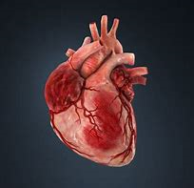
De-prescribing in Cardiovascular Disease
Written by
Briana Madden Specialist Pharmacist in Acute Medicine and Hannah Fletcher Specialist Pharmacist in Elderly Care, County Durham and Darlington NHS Foundation Trust
Jenny Carter, GP Practice Pharmacist, Intrahealth Ltd
Notes:
Will discuss using real case studies to give examples of de-prescribing in cardiovascular disease
Add in presenter details

Slide 17
Key Patient Groups
NSAIDS (including OTC) and Heart failure.
Digoxin patients – consider checking levels in AKI or elderly.
Amiodarone – monitoring and note new guidance – secondary care input
Fibrates in renal impairment.
Statins in frail elderly/end of life
Angina medication
Blood pressure medication
Anticoagulants/antiplatelets
Notes:
These are key patient groups that could be targeted for de-prescribing – some are easier to target for de-prescribing due to definitive risk/benefit considerations, however others may require additional thought
e.g. NSAIDs in heart failure – how often do you ask about OTC medication in your patients? Easy answer as no evidence in non-inflammatory pain, but ? How to manage pain in these patients? Can de-prescribe but end up prescribing something else instead which may have higher risk. What about short courses of low dose to manage acute pain?
Digoxin should be considered for reduction in elderly, however will need managing depending on symptoms. May also require alternative prescribing, so important to consider what the aims of treatment are. Monitoring to check for renal function should be done every year, and could flag patients who are a concern. If toxicity is a concern this drug could be stopped suddenly.
Amiodarone is one drug where you may wish to get specialist input on de-prescribing as may need alternative. Also recent guidance suggests that all these patients should really be managed by secondary care.
Fibrates in renal impairment are not recommended, and can be confidently de-prescribed based on risk. Individual decision will be needed however to consider whether patient needs alternative lipid lowering, although may not be many as an option as most patients will only be on them because they are intolerant to other options.
Statins in the frail elderly are a consideration for discussion. Although do have evidence on preventing heart attacks and strokes, this may have to be weighed up against side effects, tablet burden, likely life expectancy etc. They are also a good example of the difficulties of the language used around prescribing medication in the first place, as many patients will be reluctant to stop as they have been advised that they need them to prevent a heart attack. Often started in secondary care, so these conversations are relevant across the whole health economy.

Slide 18
Case 1 - Angina
72y female, PMH hypertension, T2DM,
hypothyroidism.
Seen in A&E approx. 5 years ago with an episode of chest pain. 1st episode.
Started on a number of meds during admission
Aspirin
Bisoprolol
GTN
ISMN
A&E investigation ruled out MI or PE. Outpatient cardiology investigations that followed revealed moderate ischaemia therefore patient discharged.
Medication review this week BP = 98/53mmHg
Notes:
None of patients meds had been changed in the 5 years since her admission, no further episodes either. Still had the same GTN spray at home from admission!
“If it isn't broke don’t fix it” does not strictly apply here!
Following a single unprecedented episode of chest pain with no evidence of AMI… GTN + B-blocker/CCB or single monotherapy nicorandil/ivabradine/ranolazine if not tolerated. No reason to give long-acting nitrates unless uncontrolled symptoms.
Aspirin understandable for secondary prevention but consider risk factors.

Slide 19
7 Steps
Patient Views
Essential
Unnecessary - ? ISMN, b-blocker
Effectiveness
Safety – low BP
Cost effectiveness
Patient Centredness
Notes:
This slide tries to focus on the 7 steps guidance to assist with making decisions for this case
Consider asking the attendees to think about what they feel is relevant to each step for the patient, and how they would tackle it
1 – patient views are important – this patient feels that the treatment was important, however has had no symptoms – is this because the treatment is working?
Important to have any de-prescribing agreed with the patient, so consider reducing and considering trial without the medication. How does the patient feel about this?
3 and 5 – probably overtreatment with anti-anginals therefore reduce or stop what you can – careful as sudden stopping of nitrates can lead to a worsening of symptoms, and sudden stop of beta blockers can cause rebound tachycardia, so consider reducing these one at a time, and book the patient back in for a review to reduce further.
In view of the safety aspect with this patient you would probably want to reduce the b-blocker first to improve the blood pressure, then the nitrate as more likely to cause postural drop rather than overall reduction.
7. Patient centredness – ensure the patient is happy with the ongoing plan, and schedule them in rather than assuming that it will happen, or set specific review dates on prescriptions.

Slide 20
Case Discussion
Balance symptom control with avoiding over-medicating.
Repeated issues of GTN needs flagging – are they symptomatic or just over-ordering?
1x180 dose spray used once daily should last at least 3-6 months depending on need for repeat doses
Notes:
Discussion about what processes could be put in place to prevent this in the future

Slide 21
Practical Points
Optimise existing treatments first (including confirming compliance)
Keep an eye on treatment duration plans.
Reduce doses based on changing clinical picture.
Ask the question; “is this really necessary?”

Slide 22
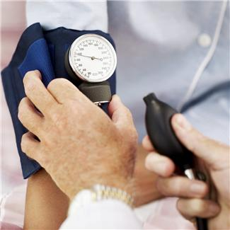
Case 2 – Hypertension
Mrs IW, 89yrs.
PMH:
Ischaemic heart disease (1989)
Hypertension(1999)
Diabetes(2008)
Depression(2013)
Medications
Acetazolamide 250mg QDS
Metformin 500mg BD
Perindopril 4mg OD
Simvastatin 10mg ON
Aspirin 75mg OM
Venlafaxine 37.5mg BD
Bendroflumethiazide 2.5mg OD
PC:Fall
Notes:
Example of a possibly preventable admission to hospital of frail lady with a fall on multiple medication. Patient has a diagnosis of hypertension from 1999- admitted due to fall, had BP measured in hospital (lying and standing)

Slide 23
Case Discussion
Date | Sitting BP | Standing BP
14/5 | 125/54 | 92/51
17/5 | 130/70 | 98/48
18/5 | 138/52 | 100/50
Orthostatic drop:
Greater than 20mmHG systolic or 10mmHg Diastolic within 3 minutes of standing
Often associated with increased heart rate
Symptoms include dizziness/lightheadedness
Difficult to diagnose unless you check sitting and standing BPs
Notes:
Past BP from GP records 07/18 144/60mmHg , 04/19 130/70mmHg (no lying and standing BPs documented)

Slide 24
Medication causing postural hypotension
Type of medication | Examples
Alpha blockers | Tamsulosin, alfuzosin,
Antidepressants | TCAs, SSRIs, Venlafaxine
Beta-blocker | Propanolol, bisoprolol
Diuretics | Bendroflumethiazide, furosemide
Opioids | Morphine, oxycodone
Vasodilators | ISMN, calcium channel blockers, hydralazine
Antipsychotics | Olanzapine, clozapine
Parkinsons medication | L-dopa
Notes:
Obviously many causes of postural drop, however many medications can cause it
Effects on heart or blood vessels– e.g. beta blockers, nitrates, alpha blockers
Effects on blood volume – diuretics
Effects on autonomic nervous system – opioids, antidepressants, antipsychotics
For further information see Postural hypotension BMJ 2011; 342

Slide 25
7 Steps
Patient Views
Essential – Diabetes, aspirin and statin
Unnecessary – acetazolamide, BP meds, antidepressant
Effectiveness
Safety
Cost effectiveness
Patient Centredness
Notes:
Based on Scottish Government Polypharmacy Model of Care Group. Polypharmacy Guidance, Realistic Prescribing 3rd Edition, 2018. Scottish Government
Key reference for this patient case - NICE Hypertension guidance 2019 - https://www.nice.org.uk/guidance/NG136
1 – patient views are important – would they be happy with a trial without some of their medication – probably more so now they have had a fall, however how would this discussion change if you were trying to prevent a fall? Discuss that risk/benefit discussions are different if a patient has had an adverse event compared to trying to prevent one.
Important to have any de-prescribing agreed with the patient, so consider reducing and considering trial without the medication
2 – Essential – continue DM medication and primary prevention, however ? Need for statin???
3. Does the hypertension still need treating?
Target BPs
Below 140/90mmHg
Diabetes below 140/80mmHg
Elderly 150/90mmHg
For frail elderly patients, consider starting treatment if the systolic blood pressure is 160 mm Hg or higher.
If the systolic pressure is below 140 mm Hg, antihypertensive medications can be reduced as long as they are not indicated for other conditions.
http://www.rrheal.scot.nhs.uk/media/233604/promoting%20higher%20blood%20pressure%20-%20target%20for%20older%20adults.pdf
LINK TO DEPRESCRIBING IN FALLS SESSION
START:
Antihypertensive therapy
• where systolic blood pressure consistently above 160 mmHg and/ or dias-tolic blood pressure consistently above 90 mmHg.
• If diabetic, if systolic blood pressure above140 mmHg and/ or diastolic blood pressure above 90 mmHg.
Therefore review BP medication – can stop BFZ immediately as not recommended for hypertension treatment, and also not ideal in diabetic patients.
Consider stopping or reducing the ACEI, depending on what the patient in happy with.
Also review the acetazolamide – what is the indication? On investigation for this patient it appears that this was started a number of years ago by a specialist eye team, however was for a set course which was never reviewed. Just because started by specialist team doesn’t mean you have to continue indefinitely – put systems in place in practice to ensure that recommendations from secondary care have appropriate treatment plans.
Also venlafaxine can cause postural drop, and does the patient still need it – can’t be stopped suddenly so needs reducing slowly – best to do one at a time.
5. Decisions will depend on how urgent the problem is – if this lady also had low BP you may consider stopping more than one at a time, decisions altered by risk of fall compared to having had a fall.
7. Patient centredness – is the patient happy with the plan, and the monitoring plan? How do they manage their medicines at home?

Slide 26
Practical Advice-Hypertension
Use paediatric cuff for small patients
Check on patients on anti-hypertensives with no recent measurement (search)
BP guidelines
Loop diuretics for hypertension not indicated
Optimise therapy before addition of new agent.
Check lying and standing BPs in elderly patients even if not symptomatic
Review BP on discharge from hospital
Adequate hydration
Notes:
Ensure you know who gets what…age/renal considerations

Slide 27
Case 3 – Antiplatelets/anticoagulants
Pt A: 66 year old female. PMH hypertension, controlled with Lisinopril 10mg daily.
Admitted to hospital with chest pain. Diagnosed NSTEMI.
Treated as inpatient with PCI.
Commenced on Aspirin/Ticagrelor/Atorvastatin/Bisoprolol.
How do we update her prescription?
Further thought… what if she also had AF and was already taking Rivaroxaban?
Notes:
Tried to come up with a case that represents the most common theme here of unnecessarily prolonged DAPT therapy… considering a “what if” bullet point at the end in terms of anticoagulation (e.g. what if pt. presented at some stage with an irregular pulse?)

Slide 28
Antiplatelets
Condition | Recommended Treatment | Recommended Duration | Alternative Options
Atrial fibrillation (AF) | FIRST LINE is anticoagulation Aspirin 75mg + Clopidogrel 75mg daily | Long-term (only if anticoagulation not possible) | Anticoagulation is 1st line treatment.
Acute coronary syndrome (ACS) | Aspirin 75mg + Ticagrelor 90mg. | 12 months (min 1 month if high bleeding risk) Max up to 36 months if v.high ischaemic risk/no bleeding complications/tolerated therapy – reduce Ticagrelor to 60mg twice daily. | Consider clopidogrel 75mg in place of Ticagrelor.
Percutaneous coronary intervention (PCI). | Aspirin + either: Prasugrel 10 mg daily OR Ticagrelor 90mg twice daily | Up to 12 months after procedure (aspirin continues alone long-term thereafter) If high risk of bleeding stop DAPT after 6 months & avoid Prasugrel. Max up to 36 months if v.high ischaemic risk/no bleeding complications/tolerated therapy – reduce Ticagrelor to 60mg twice daily. | Reduce Prasugrel to 5 mg daily if patient weight<60 kg, or if >75 years of age) Consider Clopidogrel if neither Prasugrel/Ticagrelor suitable.
PCI in people with stable coronary artery disease (secondary care initiation) | Aspirin 75mg + Clopidogrel 75mg daily | 6 months from procedure.Max 36 months. For people at high risk of bleeding, continue DAPT for 3 months. Min of 1 month if significant concerns. | Ticagrelor, or prasugrel may be considered instead of clopidogrel where appropriate.
Coronary artery bypass grafting (CABG) | According to specialist management.
Stroke, or transient ischaemic attack (TIA) | Clopidogrel 75mg daily | Long-term | M/R dipyridamole (200 mg twice a day) + 75mg aspirin (or lone therapy if either c/i)
Peripheral arterial disease (PAD), or multivascular disease | Clopidogrel 75mg daily |  | Aspirin 75mg daily.
Notes:
Summary of NICE Antiplatelet CKS 2018 (https://cks.nice.org.uk/antiplatelet-treatment#!topicSummary) and dosing information from SPC and BNF correct as of Dec 2019.
Not sure the polypharmacy steps really come in here in terms of DAPT… its really just as simple as make sure the treatment plan is followed and that the clinical plan is well communicated between both 1ry and 2ry care and to patients.
Worth noting: PAD usually doesn’t warrant DAPT. Commenced post surgical intervention is common but there’s actually no robust data to support its use. Primary care colleagues should discuss intended duration of any therapies with specialists if commenced on discharge.
* Nice guidelines seem pretty ambiguous about whether to use clopidogrel or ticagrelor + aspirin. 12months ticagrelor is listed as initial treatment, 12 months clopidogrel is listed under further treatment. From a primary care perspective the duration of treatment is still 12 months whichever second antiplatelet is given, and that’s the only factor we’ll be able to influence so for the purposes of this presentation, stopping the treatment at the right time is more important than what it was in the first place.

Slide 29
Practical Advice-Antiplatelets
Antiplatelets in Primary Prevention… STOP!
Save The Date! (repeat durations/prescription notes (community pharmacy alerted)/read code.
Consider PPI’s – may be prescribed as cover in appropriate patients - stop if no longer needed.
Notes:
Still finding patients taking aspirin for primary prevention… no evidence of benefit over risks of GI side effects.

Slide 30
Anticoagulants (AF Prophylaxis)
DOSING ADVICE | Warfarin | Dabigatran | Rivaroxaban | Apixaban | Edoxaban
CrCl >50ml/min | As per INR (usual range 2-3.0) | Patients under 80 years: 150 mg twice daily | 20 mg once daily with food | 5 mg twice daily | 60 mg once daily
Increasing Age/Decreasing Weight | As per INR (usual range 2-3.0) | Patients >80 years: 110 mg twice daily (due to the increased risk of bleeding in this population) Also consider in patients weighing <50kg |  | Reduce to 2.5 mg twice daily in patients with two or more of the following characteristics: o Age ≥80 years o Body weight ≤60kg o Serum creatinine ≥1.5 mg/dL (133 micromoles/L) | Reduce to 30 mg once daily in patients with body weight ≤60 kg.
CrCl <50ml/min | Review stability in terms of INRs to determine ongoing risks/benefits of treatment (i.e. TTR) | 110 mg twice daily when the thromboembolic risk is low and the bleeding risk is high (e.g. CrCL 30-50 mL/min) Do not use if CrCl <30ml/min. | Reduce dose to 15 mg daily | Reduce dose to 2.5 mg twice daily where CrCl 15-29ml/min | Reduce to 30 mg once daily
Interactions | As per INR. | Reduce to 110 mg twice daily in patients who are taking verapamil |  |  | Reduce to 30 mg once daily in patients with concomitant P-gp inhibitors (ciclosporin, dronedarone, erythromycin, ketoconazole)
Monitoring | Ongoing monitoring requires adjustment to the individual needs of the patient and therefore requires regular monitoring using blood tests. | U&Es, LFTs, FBC at least once a year. Repeat U&Es every 6 months if CrCl 30–60 mL/min or every 3 months if CrCl 15–30 mL/min. More frequent U&Es /LFTs advised where intercurrent illness may impact on renal or hepatic function.
Notes:
Summary of SPC and BNF information correct as of Dec 2019
Avoid all/any oral anticoagulants in CrCl <15ml/min
Remember to calculate using Cockroft-Gault NOT eGFR!!!!
Further thought – OAC + AP’s:
Ongoing monitoring
U&Es, LFTs, FBC at least once a year especially in elderly and patients with renal impairment.
Repeat U&Es every 6 months if CrCl 30–60 mL/min, patient > 75 years or fragile.
Repeat U&Es every 3 months if CrCl 15–30 mL/min.
More frequent U&Es /LFTs advised where intercurrent illness may impact on renal or hepatic function.
Need to have conversations with patients and family about risk benefit……

Slide 31
Anticoagulants (VTE/PE)
 | Warfarin | Dabigatran | Rivaroxaban | Apixaban | Edoxaban
Treatment Dose | Loading regimen (various options – local guidelines) then as per INR. Co-prescribe LMWH until 2x INRs >2.0 | 150 mg twice daily. | 15 mg twice daily for the first three weeks, followed thereafter by 20 mg once daily. | 10 mg twice daily for the first 7 days followed by 5 mg twice daily. | 60mg daily (LMWH cover for first 5 days)
Preventative Dose | As per INR (usual range 2-3.0) |  | As per treatment. | (following 6 months of treatment for DVT/PE) recommended dose 2.5 mg twice daily | As per treatment.
Post-Operative VTE Prophylaxis | Rarely used (LMWH more likely) Consider LMWH bridging in high-risk patients undergoing surgery. | Initiate within 1-4 hours of completed surgery with 110 mg and continue with 220mg daily thereafter | 10 mg once daily (initiated within 6-10 hours of completed surgery) | 2.5 mg twice daily to be started 12–24 hours after surgery | No license.
Other Considerations |  | Reduced dose across all indications if patient; Elderly Moderate-Sig renal impairment receiving concomitant Verapamil/Amiodarone | Prophylaxis of atherothrombotic events following ACS/with coronary artery disease, 2.5 mg twice daily in comb with aspirin. For symptomatic PAD at high risk of ischaemic events, 2.5 mg twice daily (in combination with aspirin. | In renal impairment see AF Prophylaxis advice. | Reduce dose to 30mg daily if one or more of the following are present: Moderate/severe renal impairment (CrCL 15–50 mL/min). Body weight <60 kg. The person is receiving concomitant treatment with ciclosporin, dronedarone, erythromycin, or ketoconazole
Notes:
Summary of SPC and BNF information correct as of Dec 2019
Note additional indications for rivaroxaban. Not very common but feasible!
Key point is to check for transition from treatment to preventative doses accordingly – if needed at all!
Easy to confuse when AF prophylaxis doses do not change after a specific time frame.
Note where LMWH cover required duration of treatment should always be clear and a decision to stop needs to be widely communicated (liase with AMS).
Need to review the use of “preventative dose”….in reality, if only one clot, it should be stopped. Think this is a point for practical advise too…needs review of how long to continue treatment in DVT/PE patients.

Slide 32
Practical Advice- Anticoagulants
Similar to DAPT;
Review dates/ Script notes / CrCl calculator.
Emphasis on need for review!
Include indication for anticoagulation in script notes.
Notes:
SystemOne GP practices can use the in built “renal disease calculator” in the tools to calculate CrCl. Emis Web practices can use in-built template. Multiple external resources/apps available.
DOACs were sold in primary care as being essentially “monitoring free” by some less than scrupulous reps! This has been passed onto patients who often believe they need no tests at all on DOACs! Must educate patients around the importance of regular checks at least once a year.
It would be very useful to add indication to DOAC as this will help with review in hospital or by GP and formulation of future treatment plans.

Slide 33
Summary
Consider and discuss the goals of treatment with patients when medications are initiated
De-prescribing needs to be a whole system process within the practice
Clinical decisions should consider: Patient views, need, effectiveness, safety, cost effectiveness and patient centred/wishes

Slide 34
Question and Answer Session

Slide 35
Thank you for listening

