Slide 1
**Delete this slide before presenting**
This presentation has been adapted from County Durham CCG resources funded by the AHSN
These were originally delivered virtually to GP practice based pharmacists – if delivering to other staff members please consider whether the content should be adapted accordingly
All information is up to date as of the end of December 2019 – if using after this please ensure that the most up to date guidance is used
Possible things to discuss are included in the notes section of each slide
Considerations for the presenter are in the notes section in BOLD
Places where local adjustments should be made to content are highlighted in RED

Slide 2
De-prescribing in Patients at risk of Acute Kidney Injury
Presentation 2 of 4
Presenters
Notes:
Add in presenter names and logos for your CCG

Slide 3
De-prescribing Webinars
1 of 4 - Introduction to Managing Polypharmacy, and De-prescribing in Cardiovascular Disease
3 of 4 - De-prescribing in Pain
4 of 4 – De-prescribing in patients at risk of Falls
Notes:
Welcome to this second in a series of 4 webinars on polypharmacy and de-prescribing. Other presentations that make up the series are listed here.
These webinars are aimed at clinical staff involved in medication reviews of patients, particularly within primary care, and it is hoped that the sessions will provide you with practical advice and education about de-prescribing in key clinical areas.
May want to add in dates of upcoming presentations

Slide 4
This Session
Polypharmacy revisited
Presenter
De-prescribing in Patients at risk of Acute Kidney Injury
Presenter
Notes:
Add in presenter names
Also may want to go through any housekeeping if delivering this on-line – i.e. use of chat box, mute, Q and As and when you want them

Slide 5
Polypharmacy Revisited
Written by
Rachel Berry and Michelle Chapman, Medicines Optimisation Pharmacists, DDES and North Durham CCGs
Notes:
Recap of slides from first presentation to remind people what was discussed. If running as separate events then may want to switch to include full slides from 1st presentation.

Slide 6
Notes:
Adverse drug reactions are a common cause of hospital admissions, and across Europe are associated with 8.6 million admissions every year.
We know that certain patient groups are more likely to suffer from an adverse drug reaction, including those on 5 or more medicines, and those over 65 years.
It Is estimated that around 50% of these are preventable.
Reference for images; Scottish Government Polypharmacy Model of Care Group. Polypharmacy Guidance, Realistic Prescribing 3rd Edition, 2018. Scottish Government

Slide 7
Current Position
**Insert own area data**
Notes:
Add in graphs to show own area data for CCG/PCN compared to national – these examples are from EPACT2 polypharmacy dashboard
Some polypharmacy may be totally reasonable and required for therapeutic treatment – for example multiple evidence medicines following an MI
Other medication may be unnecessary – polypharmacy to treat side effects of other meds, continued medication with no indications, continued medication that should be short term etc.
Inappropriate polypharmacy can cause increased side effects, confusion and compliance issues, increased waste, increased spend on medicines and increased risk of hospitalisation.
Therefore important to ensure that inappropriate polypharmacy is tackled and prevented where possible.

Slide 8
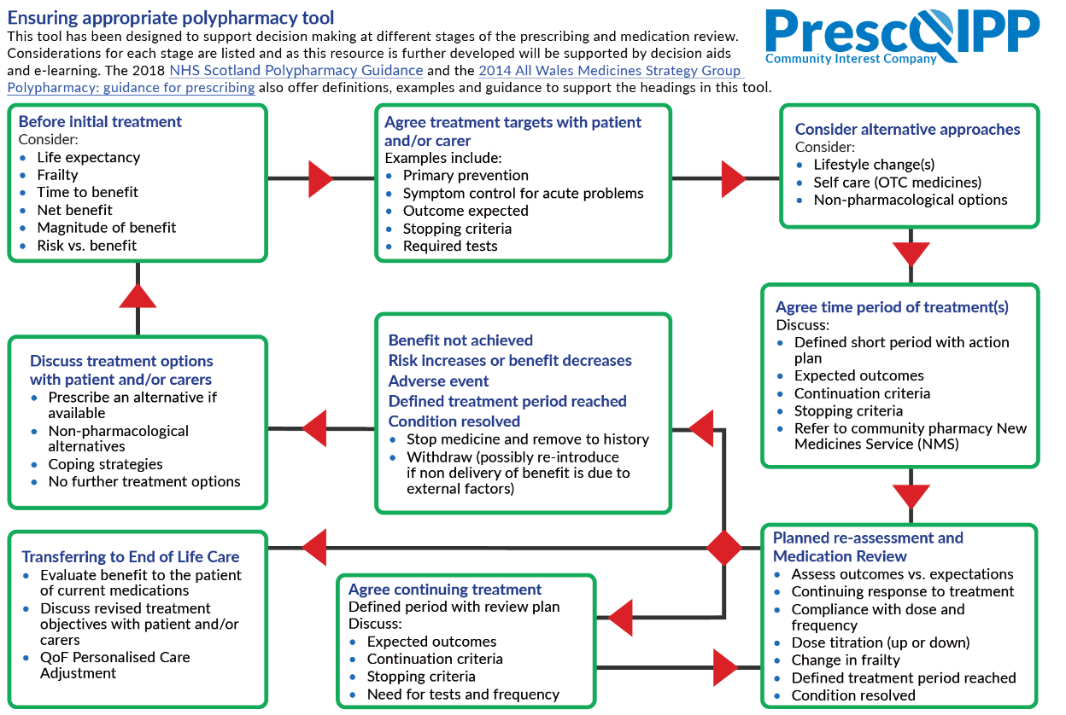
Notes:
Prescqipp tool to ensure appropriate polypharmacy - 2019 – busy tool, however highlights key aspects to consider when prescribing.
Available at https://www.prescqipp.info/our-resources/webkits/polypharmacy-and-deprescribing/
Ideally all new meds should be discussed with the patient and treatment goals set up – the patient should be aware of what the goals are, and that the medication may be stopped if those goals are not met. This is likely to be better than trying to tackle polypharmacy once a medication already established. – Consider discussing with attendees whether this is done within their clinical practice?
Requires a significant change in practice across all prescribers to manage this. What do we do about the patients who are already on multiple medications?

Slide 9
Scottish Polypharmacy Guidance
Notes:
Scottish Government Polypharmacy Model of Care Group. Polypharmacy Guidance, Realistic Prescribing 3rd Edition, 2018. Scottish Government. https://www.therapeutics.scot.nhs.uk/wp-content/uploads/2018/04/Polypharmacy-Guidance-2018.pdf
7 steps to appropriate polypharmacy – key focus on what the patient feels is important in addition to the clinical priorities.
Patient Views
Essential
Unnecessary
Effectiveness
Safety
Cost effectiveness
Patient Centredness

Slide 10
English De-prescribing Network
https://www.sps.nhs.uk/networks/english-deprescribing-network/
Notes:
Slide presented in June 2019 so may need updating with Eden work to date
Interesting webinar available on the SPS website highlighting new launch of the English de-prescribing network, giving lots of details and opportunities to sign up to closed forum to network and share resources etc. around de prescribing. Webinar gives another overview of de-prescribing background and some tools and resources already available.
Link in with the national overprescribing review work being led by Keith Ridge, STOMP agenda
Keen to get nurse prescribers, Doctors and community pharmacists more involved so

Slide 11
De-prescribing in Patients at risk of Acute Kidney Injury
Written by;
Shelley Calkin, GP Practice Pharmacist
Lorene Hold, GP Practice Pharmacist
Briana Madden, Specialist Pharmacist in Acute Medicine, County Durham and Darlington NHS Foundation Trust

Slide 12
Context
**Insert own area data**
Notes:
Insert own area data – from EPACT2 patient safety dashboard.
NSAID RAS and diuretic combination – both CCGs below national average, however still significant number of patients at risk

Slide 13
Acute kidney injury ( AKI)
Nationally approx 100,000 deaths associated with AKI
At least 1/3rd of those deaths avoidable
1 in 5 patients admitted to hospital as an emergency have their illness complicated by AKI
Over 60% of AKI occurs in the community
In 2018 there were 497,000 AKI alerts reported to the UK Renal Registry
Notes:
Data taken from NHSE Think Kidney website - https://www.england.nhs.uk/akiprogramme/ accessed June 2019
Big problem!
Main reference for the whole presentation is the Think Kidneys webiste, which has multiple resources available - https://www.thinkkidneys.nhs.uk/aki/think-kidney-publications/

Slide 14
Local data for AKI For quarter OCT – Dec 2018
AKI alerts reported to UK renal registry
approximately 870 AKI alerts in DDES CCG
approximately 828 AKI alerts in ND CCG
**Insert own area data**
Notes:
Insert own area data available at https://www.thinkkidneys.nhs.uk/aki/aki-data/
AKI alerts are prompted via pathology labs detecting changes in renal function

Slide 15
What is AKI?
Acute Kidney Injury is a sudden and recent reduction in a person’s kidney function.
Signs and Symptoms
Reduced urine output
Changes to urine colour
Nausea, vomiting
Evidence of dehydration
Thirst
Confusion and drowsiness
Notes:
Key reference – Acute Kidney Injury Toolkit - https://www.rcgp.org.uk/aki accessed June 2019

Slide 16
Stages of AKI
Notes:
Odd of death linked with increasing AKI stage
AKI also associated with adverse long term outcomes ➢Renal Health: AKI is associated with new or worsening CKD, including ESRF ► especially if severe or multi-hit AKI in 1. Elderly patients 2. Patients with diabetes 3. Patients with pre-existing CKD ➢General Health: Drugs with prognostic long term benefit (e.g. ACE-I for heart failure) may be suspended in clinical context of acute illness and AKI ► long term prognostic benefit of such drugs lost if not restarted post AKI
Picture ref – Acute Kidney Injury in Primary care slide set - https://www.thinkkidneys.nhs.uk/aki/wp-content/uploads/sites/2/2018/11/Nov-18-TK-AKI-Primary-Care-Slides-FINAL.pdf

Slide 18
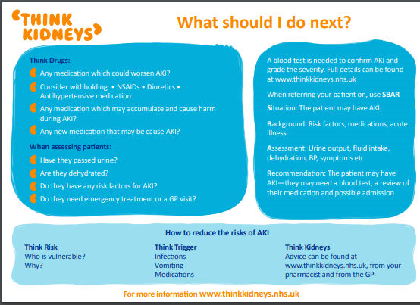
Notes:
Recommendations from Think Kidneys website about how to review patients with AKI

Slide 19
Causes/risk factors for AKI
Most common risk factors for a patient for AKI
Pre-existing kidney disease
Age – esp. >75yr
Heart failure
Atherosclerotic peripheral vascular disease
Diabetes mellitus
Liver disease
AKI may be triggered by
Sepsis/infections
Hypovolaemia – dehydration, bleeding
Hypotension- e.g. after MI
Medications- prescribed and OTC
Notes:
Medication review has a large part here? Many of our patients therefore at risk due to age or co morbidity
Also at increased risk after AKI- are we aware of all affected patients?
dehydration- what advice do we give e.g. in hot weather?

Slide 20
Prescribing in patients at risk of AKI – remember the DAMN drugs!
Medications that should be reviewed in patients at risk of AKI
Diuretics
Angiotensin Converting Enzyme inhibitors (ACEi)/Angiotensin Receptor Blockers (ARBs)
Drugs excreted by the kidneys and may accumulate if kidney function is reduced
Metformin
Opiates
Digoxin
Lithium
Medications that should be avoided or used with caution in patients at risk of AKI:
NSAIDS
Full list available in Medicines Optimisation Toolkit for AKI. link
Notes:
Direct toxicity or indirectly by reducing the blood pressure to an inappropriately low level.
Medications that are metabolised and excreted by the kidneys may accumulate in patients with AKI resulting in adverse side effects.
https://www.thinkkidneys.nhs.uk/aki/wp-content/uploads/sites/2/2016/07/Medicines-optimisation-toolkit-for-AKI-MAY17.pdf

Slide 21
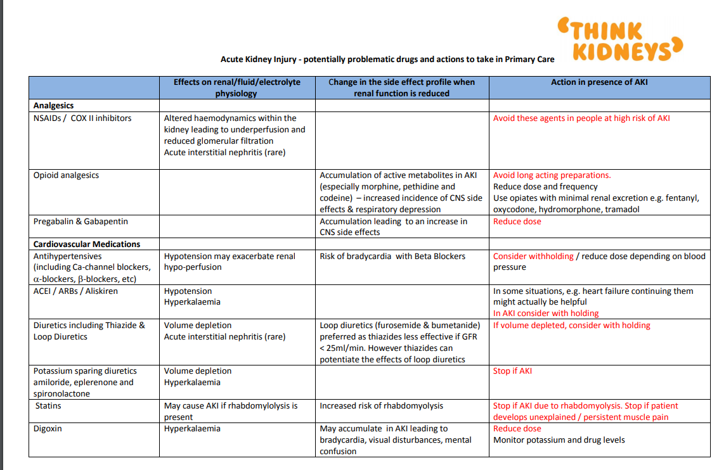
Notes:
in Medicines Optimisation Toolkit for AKI. link

Slide 22
Notes:
Can go into as much or as little detail as you want depending on the audience of attendees…
As kidney function is dependent upon adequate blood pressure, any patient who has a significant, prolonged fall in their blood pressure is at risk of developing AKI. The cause of AKI in this group is known as ‘pre-renal’, and includes the following patient groups:
• Patients with sepsis - this is because the blood pressure falls during sepsis as a result of vasodilatation
• Patients with increased losses leading to volume depletion, for example vomiting and diarrhoea, severe bleeding
• Patients who are at risk of dehydration because they are unable to maintain good hydration without help from others
• Patients with reduced cardiac output or heart failure that leads to hypotension
There are also patient groups who are at risk because of ‘intrinsic’ causes. Intrinsic means that the kidneys are damaged. Intrinsic renal causes include:
• Prolonged ‘pre-renal’ AKI, whereby a sustained drop in blood pressure results in cell damage (most common cause)
• Medications that may exacerbate hypovolaemia and hypotension • Angiotensin Converting Enzyme inhibitors (ACEi) • Angiotensin Receptor Blockers (ARBs) • Loop diuretics
• Medications that can be potentially harmful to the kidneys in the setting of acute illness • Non-steroidal, anti-inflammatory drugs (NSAIDs) – some of these drugs can be bought as over the counter medications e.g. Ibuprofen
• Gentamicin • Amphotericin Information on communities at risk of acute kidney injury 4
• Toxins • Iodinated contrast, especially if the route of administration is intra-arterial or if the patient is hypovolaemic, and hypotensive • Myoglobin – released following muscle injury secondary to trauma, infections or some medications results in rhabdomyolysis and damage to the kidneys particularly in the setting of acidaemia and hypovolaemia.
• Diseases of the kidney e.g. glomerulonephritis, tubulointerstitial nephritis
• Systemic disease processes that can involve the kidney e.g. vasculitis and myeloma
Another group of patients at risk of AKI include those who may develop obstruction to urinary flow within the renal tract, which is often referred to as a ‘post-renal’ AKI. Examples of this include:
• Males with enlarged prostate
• Pelvic/abdominal masses
• Kidney/renal tract stones
• Congenital obstructive uropathy presenting in neonates (especially males with posterior urethral valves). This can be detected with antenatal ultrasound scans. Delays in relieving the obstruction will increase the degree of damage to the kidneys.

Slide 24
Case Study 1 – 66 year old lady
PMH- Essential hypertension
Osteoarthritis
Current repeat medication
Ferrous sulphate 200mg tabs 1 tds
Furosemide 20mg tabs-1-2 tabs each morning and 1-2tabs at lunchtime prn
Simvastatin 40mg tablets 1 on
Spironolactone 25mg tabs 1 each morning if swelling persists
Current BP 110/60mmHg Current eGFR 53ml/min/1.73m2
Lisinopril 20mg tabs od
Ibuprofen 10% gel Apply prn up to 3 to 4 times a day
Ibuprofen 200mg tabs 1-2 prn up to tds
Hydroxocobalamin 1mg/ml injection every 12 weeks
Evacal D3 tabs 1 BD
Felodipine 2.5mg m/r tablets 1 daily
Notes:
The indication for Felodipine, Furosemide, Spironolactone were all for Essential hypertension. Patient had no HF.
Looking through records patients was a bariatric patient when medication was started BMI 48.88Kg/m2.
Amlodipine was introduced in 2013 alongside the diuretics after patient felt her ankles were more swollen. The swollen ankles may have been side effect of amlodipine and weight. She also had 3 readings of high BP 184/82mmHg in 2013 and then a spike again in 2014 where BP increased to 180/110mmHg and Lisinopril was then introduced.
She had bariatric surgery in 2015 - weight and BP decreased overtime but medication was unfortunately not reviewed.
Patients renal function deteriorating with triple whammy ACE inhibitor, 2 diuretics and NSAID.

Slide 25
7 Steps
Patient Views
Essential
Unnecessary
Effectiveness
Safety
Cost effectiveness
Patient Centredness
Notes:
Scottish Government Polypharmacy Model of Care Group. Polypharmacy Guidance, Realistic Prescribing 3rd Edition, 2018. Scottish Government
Risk Factors
Her risk factors for AKI
Age
BP
Drugs?
Diuretics
Furosemide and Spironolactone –Both diuretics and with a decrease in fluid intake could cause dehydration
Lisinopril ACE inhibitor- These type of antihypertensives have nephrotoxic potential when a patient is dehydrated and are also associated with hyperkalaemia
NSAIDs-Inhibition of prostaglandins results in acute deterioration of renal function. Increased risk if dehydrated as well.
1-Ensure that you ask the patient what matters to them and try to establish treatment objectives with patient through SHARED DECISION MAKING.
2-Which medications are essential-Review hypertension meds and diuretics – Patients BP is on the lower range at 110/60mmHg. As tight control is not needed. Aim for target BP. Diuretics potentially not indicated.
3-Unneccessary medication –NSAID – Ibuprofen tabs and gel? No mention in records that the patient has tried paracetamol. Patient has had a gastric bypass NSAID not indicated. Discuss alternative pain relief with patient and explain risks of ADR which is Step 5
5 Explain risks of ADR of oral NSAID and diuretics-Go over the SICK DAY rules with patient. Print leaflet of on SystmOne or EMIS if possible.
7 Ensure patient is aware of other methods for swollen ankles rather than the diuretic. This may no longer be an issue as she has substantial weight loss and amlodipine was stopped previously which may have been causing the ankle swelling. Consider using TEACH BACK technique in consultation to ensure understanding.

Slide 26
Case Study 2
82yrs old lady
PMH: T2DM, Hypertensive disease 1990, anaemia, Hypothyroidism 2016
Current repeat medication
Lisinopril 20mg / Hydrochlorothiazide 12.5mg tablets - take two daily
Zimovane 7.5mg tablets 1on
Atorvastatin 20mg tablets 1 od
Levothyroxine sodium 50microgram tablets 1 om
Ramipril 5mg capsules 1 od
Doxazosin 8mg modified-release tablets 1 od
Ferrous sulfate 200mg tablets - 1 bd
Metformin 850mg tablets 1 tds
Nifedipine 30mg modified-release tablets 1 bd
Notes:
Lisinopril 20mg / Hydrochlorothiazide 12.5mg tablets had previously been prescribed under the brand name Carace in 1999 in 10mg strength then increased to 20 plus in 2002.
The ramipril was then introduced in 2008 at 2.5mg dose and titrated upwards. Potentially the 2 ACE inhibitors have been initiated and weren’t identified due to the branded name of Carace being used initially?
Noted raised K+ level 5.9mmol/L and reduced renal function eGFR 21 mL/min/1.73m*2
Also concerned over Metformin still being used in patient with deteriorating renal function. Manufacturer advises avoid if eGFR is less than 30 mL/minute/1.73 m2 in adults.
Most recent HbA1c was 39mmol/mol.
Now on peritoneal dialysis

Slide 27
7 Steps
Patient Views
Essential
Unnecessary
Effectiveness
Safety
Cost effectiveness
Patient Centredness
Notes:
Scottish Government Polypharmacy Model of Care Group. Polypharmacy Guidance, Realistic Prescribing 3rd Edition, 2018. Scottish Government
This patient was booked for a home visit for a medication review.
1.Important to engage the patient in the shared decision making process
2.Metformin was slowly reduced and stopped due to renal function and HbA1c was 39mmol/mol. District nurse for blood monitoring was arranged and follow up with GP in 2 weeks.
3. Recent blood tests results showed further gradual decline in renal functions - now reaching to CKD 4 with eGFR 19, and serum potassium^ at 6, also has normochromic normocytic anaemia and increased ALP.
Patient was asymptomatic, no fluid retention, no palpitation or breathlessness or syncopal symptoms or chest pain etc.. She was passing urine and had no urinary symptoms to suggest acute urinary infection.
Medication stopped Lisinopril/Hydrochlorothiazide combination, Ramipril and Metformin.
4. U&Es, eGFR, HbA1C, calcium and bone profiles + also urine for Albumin to lab please + body weight were needed. Repeat BP and indication to increase dose of CCB or switch to a different one if still increased. Unfortunately this patient needed referred further onto nephrologist.

Slide 28
Case Study 3
Male patient -78 yrs. old
PMH: Type 2 Diabetes
COPD
CKD stage 3
Multiple medications including ACE inhibitor and NSAID
Patient ended up in hospital as an unplanned admission with gastroenteritis which was also complicated by AKI requiring intensive therapy.
AKI on discharge but not coded in GP records.
Discharge stated to suspend ACE inhibitor. No mention of NSAID. No medication ended up being suspended and follow up bloods were also not done.
Notes:
Mr B experienced an episode of gastroenteritis – without a GP assessment this led to an unplanned hospital admission. The episode of illness was complicated by acute kidney injury requiring a period of intensive care.
The hospital discharge summary included acute kidney injury – but was not then coded in GP records. Recommendation was that the ACE Inhibitor was to be suspended, but there was no mention of NSAIDS. Unfortunately neither drugs were suspended by the primary care team. Kidney function was not rechecked post-discharge.
Patient had further GP appointments and treated for exacerbations of COPD. No temporary cessation of medicines during these episodes of acute illness or information provided to patient on sick day rules etc..
Key Learning Opportunities
Case discussion at a weekly clinical meeting with medicines management pharmacist led to the development of register for patients who have experienced an episode of acute kidney injury, along with e-alerts to ensure patients have medication review and renal function rechecked post discharge.
Coding needs to be improved at practice for patient who have experienced an AKI.
Practice needs to improve the education given to patients in the event of acute illness at home.
Alerts/prompts need to be added to patient’s computer records/prescriptions.

Slide 29
Practical points in practice to consider to review medications with the aim to reduce risk of AKI
Search for patients in practice on 2 ACE inhibitors or on and ACE and ARB combination not being used for heart failure.
Search for patients on Metformin that have a low eGFR and monitor appropriately.
Review patients on multiple combinations of DAMN drugs
Identify patients prescribed an NSAID and one or more other unique medicines likely to cause kidney injury aged 75 years and over. Carry out a medication review with a view to reducing this risk
Follow NICE CG177 for osteoarthritis care and management in adults
Provide patients with Sick Day Guidance cards or letters.
Notes:
Also look for alerts for patients already at risk of AKI if recorded correctly in coding when thinking of prescribing a medication that may induce, exacerbate or complicate AKI to patient already coded as at risk.
NICE OA guidance (2014, https://www.nice.org.uk/guidance/CG177) advises the following; Recommend exercise as a core treatment, to improve muscle strength and general aerobic fitness. • Consider paracetamol and/or topical NSAIDs before oral NSAIDs, COX2 inhibitors or opioids

Slide 30
Notes:
You may wish to show local examples if available
Note- think Kidney position statement 2018 suggests that Sick day cards should be targeted at specific patients rather than given out to everyone, but clinicians are well placed to ensure that patients get appropriate counselling. - https://www.thinkkidneys.nhs.uk/aki/wp-content/uploads/sites/2/2018/01/Think-Kidneys-Sick-Day-Guidance-2018.pdf

Slide 31
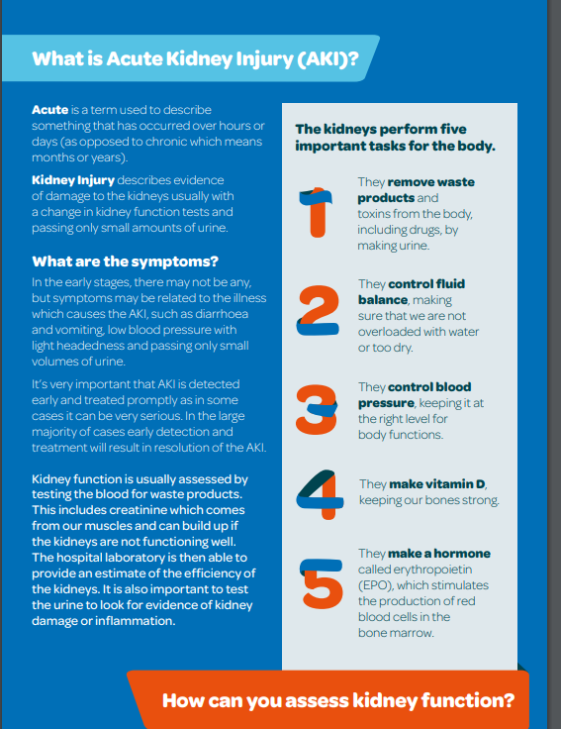
Notes:
Patient information leaflet available from Think Kidneys
Do we inform patients that they had AKI?

Slide 33
When (or if) to re-start ACEI, ARB, diuretics and other antihypertensive drugs after AKI
1. Review original indication.
2. Use an alternative class of drug if a specific contraindication to RAS drugs is identified ( e.g. renal artery stenosis)
3. Previously stable HF patients
- re-start as soon as clinically reasonable, and re-titrated to achieve the best control of fluid balance and blood pressure.
4. Previously stable CKD patients
-restart on these drugs unless there is a new contra-indication e.g. pre-treatment serum potassium > 5 mmol/L
5. Previously stable essential hypertension patients
- AKI should prompt review of the anti-hypertensives. BP should be reviewed in primary care within 6 weeks ( ideally with home or ABP) to decide on any appropriate treatment.
Notes:
Meds often stopped when patients are admitted with AKI. Discharged often say “ Ramipril held while inpatient GP to review”
Difficult to know when /if to restart meds

Slide 34
Notes:
Link
https://www.thinkkidneys.nhs.uk/aki/wp-content/uploads/sites/2/2016/02/Changes-in-kidney-function-during-ACEI-ARB-diuretic.pdf
sick day guidance
https://www.thinkkidneys.nhs.uk/aki/wp-content/uploads/sites/2/2015/07/Think-Kidneys-Sick-Day-Guidance-v8-131115.pdf

Slide 35
What do we do in practice?
Do we code for AKI?
How do we follow up patients with an episode of AKI?
Sick day guidance- is this on all ACE/ARB prescriptions? Is this appropriate?
Do we target AKI patients for medication review?
Routine safety searches used?
Notes:
Could have discussion as part of the session or leave for self reflection on practice.

Slide 36
Question and Answer Session

Slide 37
Resources
Think kidneys www.thinkkidneys.nhs.uk
Think kidneys app
RCGP elearning AKI
https://elearning.rcgp.org.uk/course/info.php?id=213

