Slide 1
**Delete this slide before presenting**
This presentation has been adapted from County Durham CCG resources funded by the AHSN
These were originally delivered virtually to GP practice based pharmacists – if delivering to other staff members please consider whether the content should be adapted accordingly
All information is up to date as of the end of December 2019 – if using after this please ensure that the most up to date guidance is used
Possible things to discuss are included in the notes section of each slide
Considerations for the presenter are in the notes section in BOLD
Places where local adjustments should be made to content are highlighted in RED

Slide 2
De-prescribing in Persistent, Non-Cancer Pain
Presentation 3 of 4
Presenters
Notes:
Add in presenter names and logos for your CCG

Slide 3
De-prescribing Webinars
1 of 4 - Introduction to Managing Polypharmacy, and De-prescribing in Cardiovascular Disease
2 of 4 - De-prescribing in patients at risk of AKI
4 of 4 – De-prescribing in patients at risk of falls
Notes:
Welcome to this third presentation in a series of 4 webinars on polypharmacy and de-prescribing. Other presentations that make up the series are listed here.
These webinars are aimed at clinical staff involved in medication reviews of patients, particularly within primary care, and it is hoped that the sessions will provide you with practical advice and education about de-prescribing in key clinical areas.
May want to add in dates of upcoming presentations

Slide 4
This Session
Polypharmacy revisited
  Presenter
De-prescribing in Persistent, Non-Cancer Pain
  Presenter
Notes:
Add in presenter names
Also may want to go through any housekeeping if delivering this on-line – i.e. use of chat box, mute, Q and As and when you want them

Slide 5
Polypharmacy Revisited
Written by
Rachel Berry and Michelle Chapman, Medicines Optimisation Pharmacists, DDES and North Durham CCGs
Notes:
Recap of slides from first presentation to remind people what was discussed. If running as separate events then may want to switch to include full slides from 1st presentation.

Slide 6
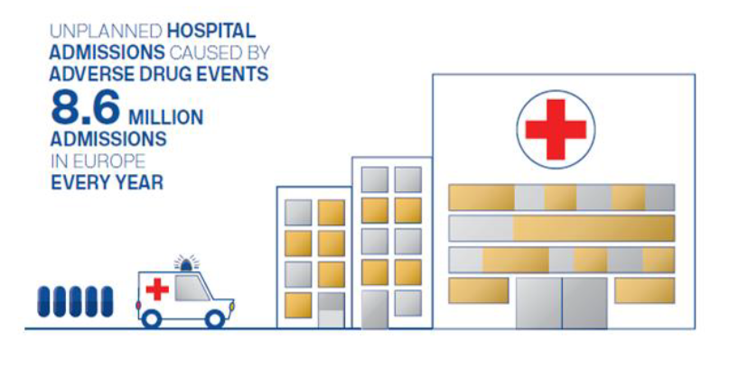
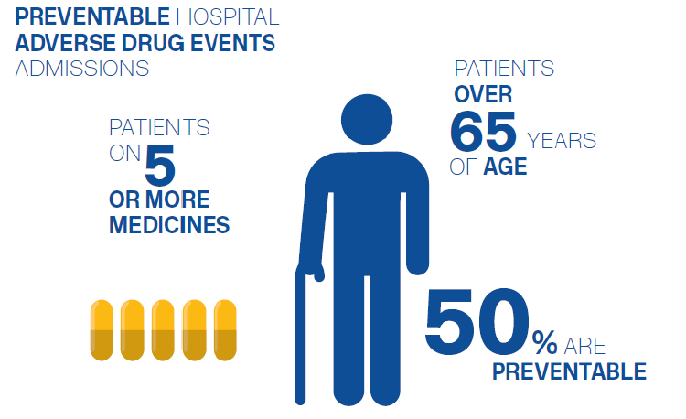
Notes:
Adverse drug reactions are a common cause of hospital admissions, and across Europe are associated with 8.6 million admissions every year.
We know that certain patient groups are more likely to suffer from an adverse drug reaction, including those on 5 or more medicines, and those over 65 years.
It is estimated that around 50% of these are preventable.
Reference for images; Scottish Government Polypharmacy Model of Care Group. Polypharmacy Guidance, Realistic Prescribing 3rd Edition, 2018. Scottish Government

Slide 7
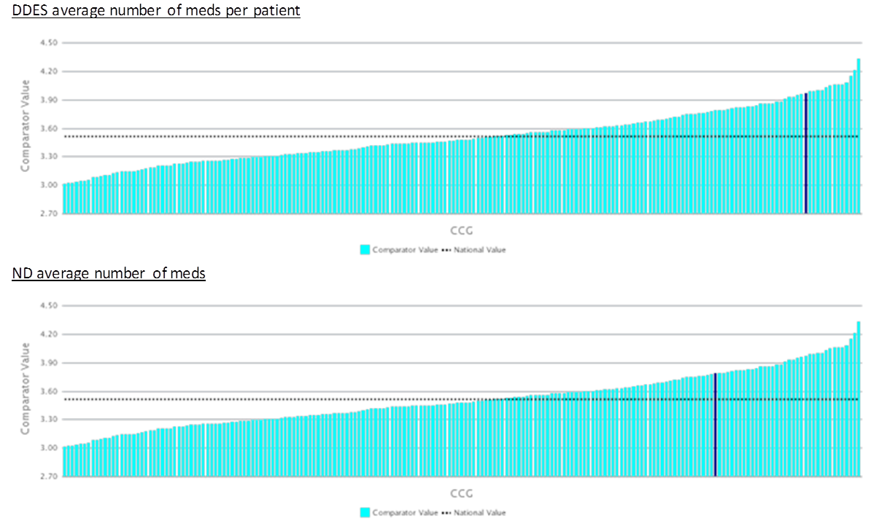
Current Position
**Insert own area data**
Notes:
Add in graphs to show own area data for CCG/PCN compared to national – these examples are from EPACT2 polypharmacy dashboard
Some polypharmacy may be totally reasonable and required for therapeutic treatment – for example multiple evidence medicines following an MI
Other medication may be unnecessary – polypharmacy to treat side effects of other meds, continued medication with no indications, continued medication that should be short term etc..
Inappropriate polypharmacy can cause increased side effects, confusion and compliance issues, increased waste, increased spend on medicines and increased risk of hospitalisation.
Therefore important to ensure that inappropriate polypharmacy is tackled and prevented where possible.

Slide 8
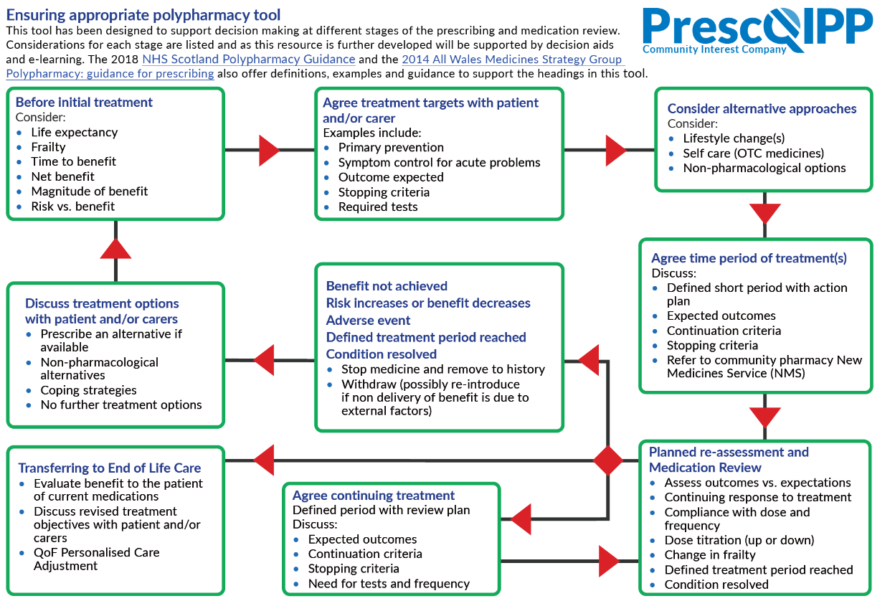
Notes:
Prescqipp tool to ensure appropriate polypharmacy - 2019 – busy tool, however highlights key aspects to consider when prescribing.
Available at https://www.prescqipp.info/our-resources/webkits/polypharmacy-and-deprescribing/
Ideally all new meds should be discussed with the patient and treatment goals set up – the patient should be aware of what the goals are, and that the medication may be stopped if those goals are not met. This is likely to be better than trying to tackle polypharmacy once a medication already established. – Consider discussing with attendees whether this is done within their clinical practice?
Requires a significant change in practice across all prescribers to manage this. What do we do about the patients who are already on multiple medications?

Slide 9
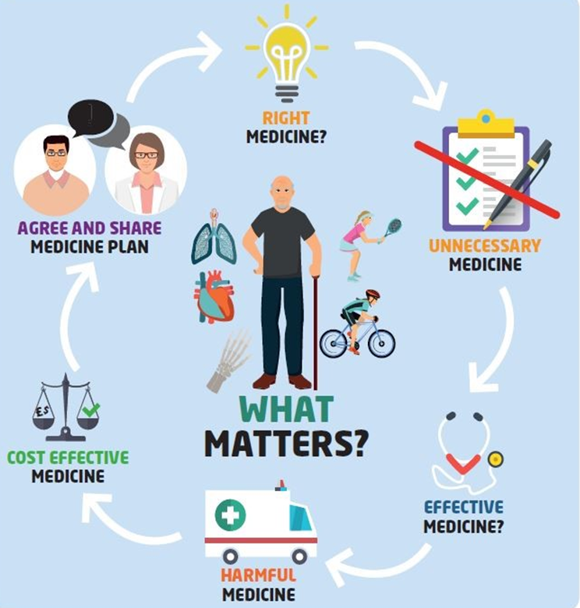
Scottish Polypharmacy Guidance
Notes:
Scottish Government Polypharmacy Model of Care Group. Polypharmacy Guidance, Realistic Prescribing 3rd Edition, 2018. Scottish Government. https://www.therapeutics.scot.nhs.uk/wp-content/uploads/2018/04/Polypharmacy-Guidance-2018.pdf
7 steps to appropriate polypharmacy – key focus on what the patient feels is important in addition to the clinical priorities.
Patient Views
Essential
Unnecessary
Effectiveness
Safety
Cost effectiveness
Patient Centredness

Slide 10
STOPP-START Tool
STOPP-START toolkit
Evidence-based tool for prescribing and de-prescribing in >65 years
Available on the clinical systems and can be utilised to highlight possible medications to review
Consider whether this would be useful to incorporate into practice processes
Notes:
Can access via the attached hyperlink https://www.networks.nhs.uk/nhs-networks/nhs-cumbria-ccg/medicines-management/guidelines-and-other-publications/Stop start pdf final Feb 2013 version.pdf

Slide 11
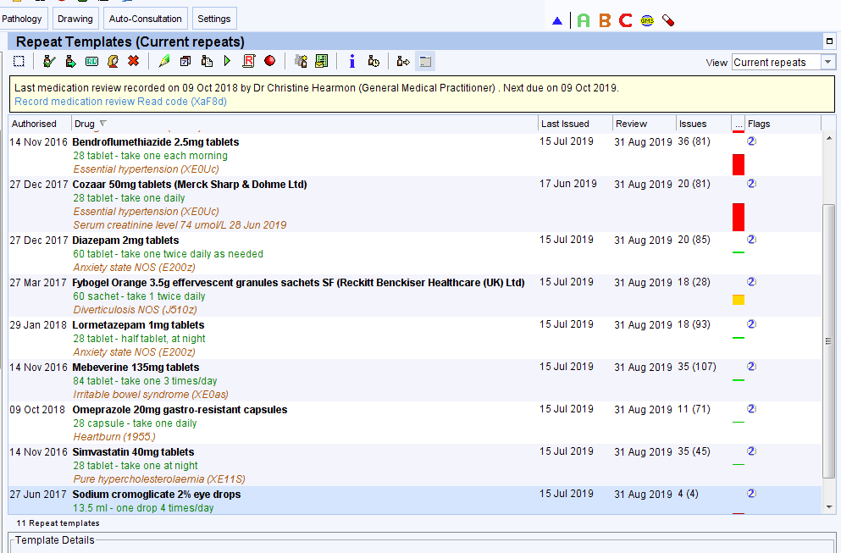
SystmOne

Slide 12
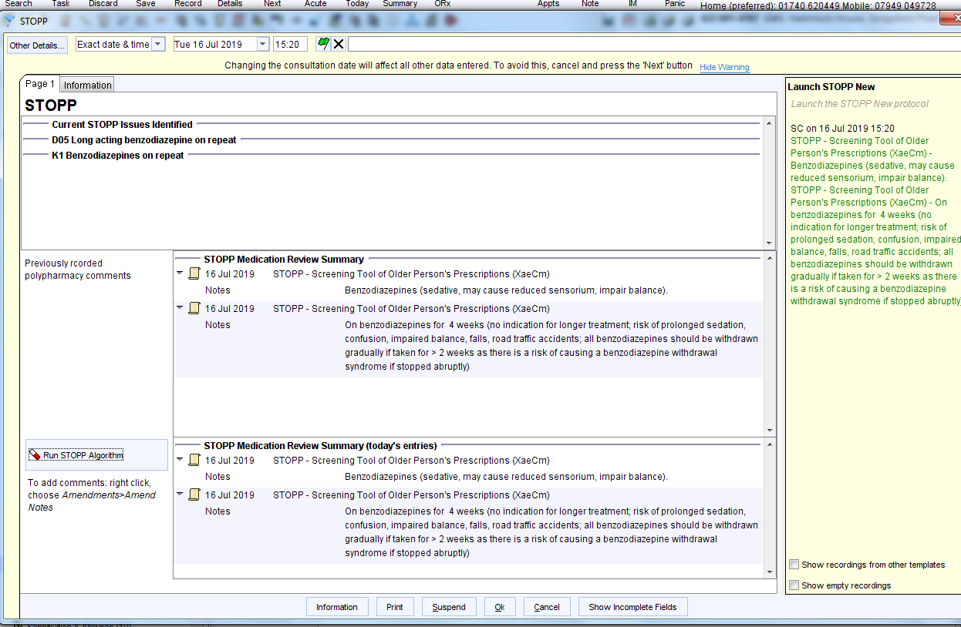

Slide 13
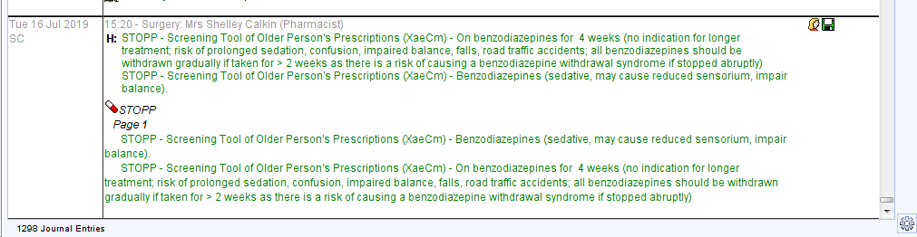

Slide 14
STOPP tool on EMIS

Slide 15
STOPP tool on EMIS continued

Slide 16
STOPP-START tool
Useful tool to highlight potential polypharmacy issues in older people
Available on EMIS and S1
Does not give a clinical judgement on whether these should be actioned, or how
Need to be actioned as a separate task

Slide 17
De-prescribing in Persistent, Non-Cancer Pain
  Written by:
  Kathryn Featherstone, GP Practice Pharmacist, IPS Ltd
  Franchesca Beavis, Specialist Pharmacist in Orthopaedic Surgery, CDDFT

Slide 18
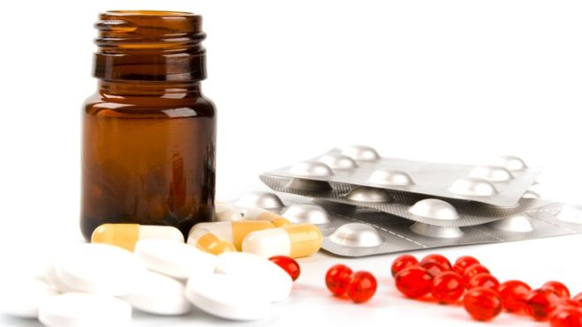
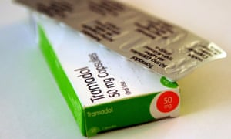
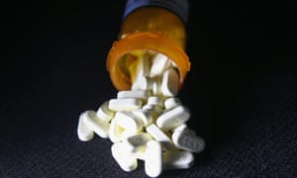
NHS accused of fuelling rise in opioid addiction
By David Rhodes BBC News
15 March 2018imorphine
Doctors warn the NHS is fuelling an addiction crisis because of an increase in the prescribing of powerful painkillers.
Nearly 24 million opioids, such as morphine, were prescribed in 2017 - equivalent to 2,700 packs an hour.
A drugs counsellor and former user told the BBC the NHS was "creating drug addicts".
Prescription of opioid drugs continues to rise in England
Doctors give patients drugs such as tramadol despite risks of addiction and ineffectiveness when treating chronic pain
Sarah Boseley Health editor
Tramadol was the most commonly prescribed opioid in England from August 2010 to February 2014. The prescription of opioid drugs by GPs in England is steadily rising, especially in more deprived communities, even though they are potentially dangerous and do not work for chronic pain, a new study reveals.
GPs prescribe more opioid drugs for pain in poorer areas of England
This article is more than 5 months old
Study finds nine areas in the north among top 10 highest prescribers in the country
Experts say opioids prescribed for chronic pain are not the most effective form of treatment.
People living in deprived areas of England are more likely to be prescribed opioid drugs for pain relief than those in wealthier parts of the country, according to research.
Notes:
Key reference - Faculty of Pain Medicine Opioid Aware Toolkit - https://fpm.ac.uk/opioids-aware (accessed July 2019)
Big changes in practice compared to most of our clinical training
Pain ladder is NOT appropriate for chronic pain – only cancer pain – ref; WHO analgesic ladder: a good concept gone astray. BMJ 2016; 352
Need to change both our own and patients expectations around the treatment of pain –
Pain treatment may not work
May cause more harm than good
Sometimes we cannot do anything for pain but we may be able to help patients manage life with pain better
Two types of de-prescribing – preventing overprescribing in pain and reducing those already on high doses – easier to manage from the start however still need to reduce high doses in line with safety messages

Slide 19
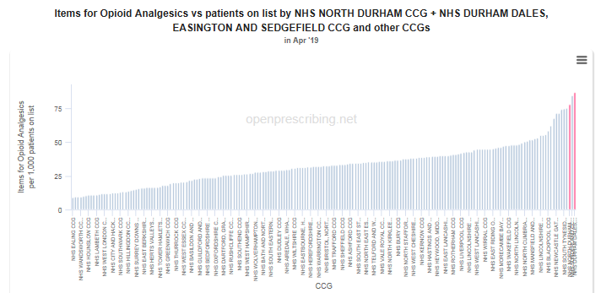
Opioid prescribing per patient
**Insert own area data**
Notes:
Insert own area data – this was taken from openprescribing.net but others are available e.g. RAIDR

Slide 20
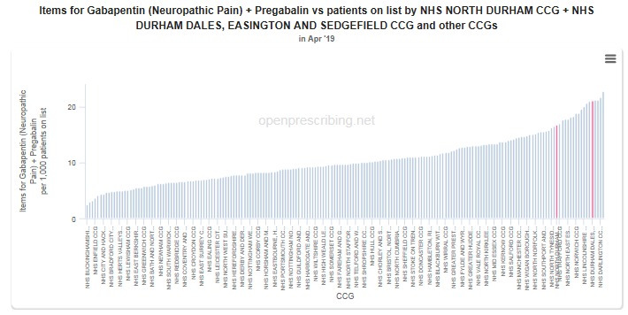
Gabapentinoid prescribing per patient
**Insert own area data**
Notes:
Insert own area data – this was taken from openprescribing.net but others are available e.g. RAIDR

Slide 21
Case 1 - Acute on Chronic pain
Male 47 yrs.
PMH includes: chondromalacia, L Meniscal tear, OA of hip & knee
Medication includes: Fluoxetine 40mg OD; Morphine 10mg/5ml QDS (started in Oct 18 previously tried tramadol 400mg daily, codeine 240mg daily & declines MR morphine)
Had hip replacement in March 2019, discharged on additional codeine 60mg QDS
Notes:
Common scenario that pain medication increased post surgery – can lead to inappropriate polypharmacy
Not just Opioids – could be additional NSAIDs, lidocaine patches, benzos for muscle spasms etc., nefopam.

Slide 22
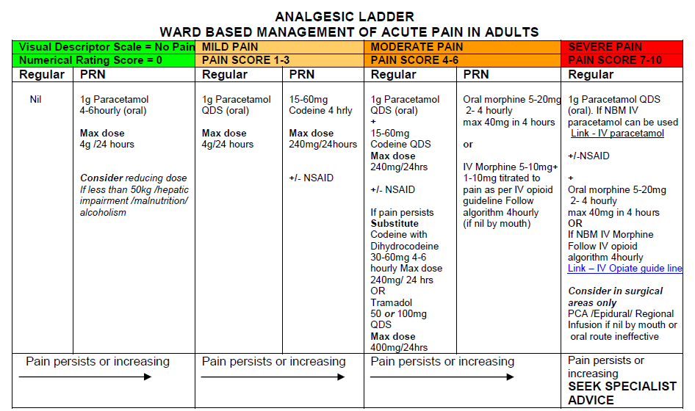
Notes:
Example of the Secondary care pain protocol used post surgery. NB This ones comes from CDDFT - Review whether to include local policy in here

Slide 23
7 Steps
Patient Views
Essential
Unnecessary
Effectiveness
Safety
Cost effectiveness
Patient Centredness
Notes:
3 – ? unnecessary
Important to note that oromorph solution is often not recommended as difficult to determine how much patients are taking – pts often swig it from the bottle and therefore difficult to determine how much they have taken etc. Solid dosage forms may be more appropriate.
Is the medication necessary – could PRN morphine be temporarily increased? Or take the codeine regularly with the oromorph PRN ONLY – NOT BOTH
Discuss with the patient how their pain is feeling, is it being improved by the codeine - Difficulties as this patient has already tried codeine and tramadol in the past – there is evidence that 30% of patients will not respond to codeine, and therefore also tramadol and oxycodone as the majority of the analgesic effect of codeine results from the ≤10% of codeine which is converted to morphine by CYP2D6 metabolism. Patients how are slow metabolisers in this enzyme pathway may not have therapeutic effect.
Why were they on the pain killers originally – ideally after acute pain of the surgery is resolved there should not be ongoing pain from the hip
Are they under physio for their post surgery rehab?
5 – safety
Combination of opioids causes increased side effects with minimal increase in pain relief
Use of oromorph not recommended as easy to take more than prescribed – patients may swig from the bottle and therefore difficult to determine how much they have taken!
7 – Ensure the patient is aware that any increase in pain relief is temporary, and how long it should last for. Also safety netting about large increases in pain that may be associated with infections etc.. Ensure patient continues with their physio/exercises
If pain continues for longer than expected may need to review and reassess – could there be a neuropathic element post surgery that hasn’t been considered.

Slide 24
Practical points to consider
Try to avoid adding pain relief post surgery to repeat lists
Discuss with the patient if possible what was advised in hospital regarding course lengths
Specify review dates on prescriptions
Consider what is available OTC
Combination products should not be routinely used as difficult to titrate
Remember that lidocaine patches, nefopam, opioid patches have limited place in acute pain
Notes:
Need practice processes
Community pharmacy colleagues could help flag long term prescriptions if dates are added
Would usually expect regular paracetamol as well – can be bought OTC
Ideally want to ensure that hospital prescriptions state durations or reviews by the GP – sometimes difficult if already on painkillers due to the pre-op pain, need to review

Slide 25
Case 2 - Chronic pain
Female 66yrs
PMH: Osteoarthritis Lumbar Disc Degeneration, Emphysema, Hypertension
Pain medication includes:
  Buprenorphine patch 70mcg/hr every 4 days + buprenorphine patch 20mcg/hr every 7 days (drug started in 2011 & titrated quite quickly over following year)
  Pregabalin 300mg BD (started in 2011 & titrated quickly to this strength)
  Paracetamol prn use – quite low
Notes:
High dose opioids – high dose calculator indicate that on around 200mg per day morphine equivalence
High risk of medication mix up with two strengths and times of opioid patches – lots of concerns about these in general as patients forget to remove/switch them etc.. Also some concerns about wearing them in bath as can increase absorption leading to toxicity.
Lack of evidence for gabapentinoids in back pain – NICE guidance on low back pain and sciatica 2016 (https://www.nice.org.uk/guidance/ng59) recommends that they should not be used, however some degenerative back pain may have a neuropathic pain element.

Slide 26
Pain assessments- SOCRATES
S ite – where is the pain
O nset
C haracter
R adiation
A ssociated symptoms
T ime course
E xacerbating/relieving factors
S everity – on a scale of 0-10 how severe is the pain
Notes:
Can go through this in as much or little detail as required depending on target audience
Important to do a full review of pain to ensue that correct treatment is being considered, red flags have been ruled out and also to assure the patient that you are taking their concerns seriously. Patient expectation is key with this patient group, and appointments will probably take longer!
Site – where is the pain?
•Cervical / Thoracic / Lumbar / Sacral / Coccygeal / Paraspinal
•Pain directly overlying the spine – fracture/arthritis
•Paraspinal – muscle spasm/muscle sprain
•Lateral back pain – renal pain / pleuritic pain (e.g. pulmonary embolism or pneumonia) / hip pain
•Unilateral flank pain – pyelonephritis / renal colic
•Pain between the scapula – dissecting thoracic aortic aneurysm / myocardial infarction
To clarify the location of the pain it may be helpful to ask the patient to point to the location on themselves or yourself.
Onset:
•When did the pain first start?
•Did the pain come on suddenly or has it been gradually worsening?
•What was the patient doing at the time of onset? – fracture and muscular related pain often has a sudden onset associated with some form of trauma (fall/heavy lifting/sudden twisting motion)
Character:
•Is the pain constant (e.g. spinal fracture/inflammatory arthritis) or intermittent (e.g. muscular spasm)?
•Is the pain present at rest? / Does the pain wake the patient at night? – consider inflammatory causes (e.g. rheumatoid arthritis/ankylosing spondylitis) and malignancy (e.g. metastatic deposits)
•Has the patient suffered pain like this before? / What was felt to be the cause? / How was it managed?
•Type of pain – sharp / dull ache / burning / tearing / crushing
•Pain described as “burning” in nature is typically neuropathic in origin (e.g. nerve root compression)
•Tearing/ripping thoracic back pain is typically associated with aortic dissection
•Crushing thoracic back pain is associated with myocardial infarction
•Sharp pain is less specific but is associated with acute spinal fracture, muscular spasm and pulmonary embolism (pleuritic)
Radiation (“Does the pain move anywhere else?”):
•Buttocks or legs – sciatic nerve compression/irritation (“sciatica”)
•Upper/lower limbs – radiculopathy (spinal nerve root compression)
•Flank to the ipsilateral groin – renal colic
•Chest – myocardial infarction / dissecting aortic aneurysm
•Epigastrium – peptic ulcer disease
•Abdomen – abdominal aortic aneurysm dissection / ischaemic bowel
Associated symptoms:
•Sensory disturbances – radiculopathy / cauda equina syndrome (e.g. saddle paresthesia) / spinal cord compression
•Motor disturbances (weakness) – cord compression (displaced fracture/prolapsed intervertebral disc/epidural abscess/haematoma)
•Urinary retention – cauda equina syndrome / spinal cord compression / severe back pain
•Urinary incontinence – cauda equina syndrome / spinal cord compression
•Other urinary symptoms (e.g. dysuria, increased frequency, haematuria) – urinary tract infections / pyelonephritis
•Fever/chills – pyelonephritis / pneumonia / vertebral discitis
•Nausea and vomiting – pyelonephritis / renal colic / myocardial infarction
•Fatigue/malaise – pyelonephritis / inflammatory arthritis / malignancy
•Weight loss – malignancy
•Haematemesis or melaena – peptic ulcer / duodenal ulcer / gastrointestinal malignancy
•Early morning stiffness – ankylosing spondylitis / rheumatoid arthritis
•Diaphoresis/dyspnoea – myocardial infarction
•Muscular spasms – can occur alongside fracture/trauma
Time course:
•Duration –minutes / hours / days / weeks
•Course – worsening / improving / fluctuating
Exacerbating/relieving factors:
•Does anything make the pain worse?◾Sneezing or coughing – acute fracture / pulmonary embolism / pneumonia
◾Worse following meals – duodenal ulcer
◾Worse at night – ankylosing spondylitis / spinal malignancy / radiculopathy
◾Physical activity – osteoarthritis / fracture
•Does anything relieve or reduce the pain?◾Physical activity – ankylosing spondylitis / rheumatoid arthritis
◾Analgesic medication
Severity – on a scale of 0-10 how severe is the pain?

Slide 27
Changing the conversation
https://livewellwithpain.co.uk/
Useful site with resources on how to shift the conversation towards self management of pain
Need to discuss risk of medication with patient
Need to make it clear on initiation that the pain medication may not work and will be reviewed regularly
Investigate alternative therapies – e.g. physio etc.
Notes:
Check whether alternative local websites that would give similar signposting to patients
Try and switch the conversation so that patients become more familiar with thinking about their pain as something they can manage or control without medication if necessary – this may require specialist input or longer appointments, however will have benefits in the long term that patients are at less risk, issues with side effects may be reduced and therefore may have reduced impact on GP time overall
When thinking about their health it is important to ensure they are aware of the risks associated with the medication – high doses of opioids, combination of gabapentinoids etc.. The main aim of treatment needs to be an increase in QoL, and we know that patients struggle with side effects of the medication – it may be that reducing their medication improves their QoL even if they still have some pain.
Pain management plans could help – gives them practical advice of what to do if they have a flare up rather than just coming to GP for increased medication – see live well with pain website for resources. Community pain services is providing patients with these so worth asking if they have one.
Ideally we would be discussing these aspects of pain management prior to starting opioids, however should be discussed with long term patients too
May need referrals to other services – physio, community pain clinic etc..

Slide 28
Five practical steps to reduce high dose opioids
1. Education: explain the importance of reducing opioids to the patient
2. Engagement: give the patient as much choice as possible around how to reduce their
opioids.
3. Effecting the weaning plan
4. Emotional impact: manage anxiety and depression
5. Expectations: ensure the patient understands that this can be difficult, and that they need
Support
(Oxford Pain Management Service )
The British Pain Society recommends a maximum of 120mg morphine equivalent dose in 24 hours:
www.rcoa.ac.uk/faculty-of-pain-medicine/opioids-aware
If the patient still describes significant pain at this dose, it can be assumed that the pain is not opioid, and the opioids should be reduced and stopped.
Although patients are now unlikely to be started on opioids for chronic pain, there is a large group of patients who have been established on long-term opioids, but who may struggle to reduce and stop their opioids. These patients are unlikely to be deriving any benefit from the opioids but are exposed to significant harm, with some on extremely high doses.
https://www.ouh.nhs.uk/services/referrals/pain/opioids-chronic-pain.aspx
Notes:
Use the resources that are available locally, national guidance, community pain services if necessary – Can discuss what resources are available locally to support this

Slide 29
7 Steps
Patient Views
Essential
Unnecessary
Effectiveness
Safety
Cost effectiveness
Patient Centredness
Notes:
Scottish Government Polypharmacy Model of Care Group. Polypharmacy Guidance, Realistic Prescribing 3rd Edition, 2018. Scottish Government
Link to any local resources that you have to support clinicians – may want to add some slides here
1 – patients views are really key to this scenario – patient needs to be aware of the risks of the medication before agreeing to reduction. Also needs to be aware of the side effects etc.. that may occur when reducing the medication and how to manage them – i.e. come back if they are not bearable for a slower reduction
4 and 5 – key aspects of this case are around the effectiveness and safety of the treatment – probably most appropriate to reduce the opioid first and then any other medication, as the high dose opioid is most risky. In this case reduced monthly, and stopped reducing when other clinical issues e.g. ICOPD and hospital admission. Also need to consider whether to convert to alternative opioid to allow easier titration
7. Patient needs to be aware of the plan and happy to continue. Needs to be aware of follow up appointments and what reducing effects they may get – cramps, shivering etc. and what to do about them i.e. how long they might last, when to worry etc.. Signpost to patient resources.

Slide 30
Tips for Pain Medication Review
If an analgesic is started and no benefit- stop it and try another, do not just keep adding to it.
Monitor breakthrough use/requests
Manage patient expectations at the start
Referral to community pain team if appropriate
Reduce opioids slowly
Do not need to see the patient for each reduction if they are managing ok – write a plan and advise when it would be appropriate for them to come back
Sign-post them to useful resources which can provide them with extra support/advice.
Notes:
Stopping analgesics may mean that patient is on no treatment – this needs to be accepted – may require difficult conversations with the patient, difficult for us as clinicians to accept – changing conversations towards self management and living with the pain
If frequent requests for breakthrough – are the meds working; if not requesting frequently should we bring the patient back to review need to continue prescription at current dose.
10% per week may be reasonable but probably easier within primary care to reduce monthly and then review. Some patients who have taken opioids for a long time might find even slower tapers more useful, and may want to personalise their reduction appropriately e.g. delaying reductions for holidays etc..
Ideally would have a written a plan and advise when it would be appropriate for them to come back – may want to follow up via phone calls to check all is on track.

Slide 31
Summary of practical points relating to de-prescribing
Multidisciplinary input
All clinicians in practice on board/aware
Honest discussion with patient to start process and proposed plan
Regular review with patient, including reassurance and changing pace of plan if necessary
Lots of resources available
Notes:
Make sure that consultation notes are thorough so that other practice staff know what is going on
May want to have a discussion about experiences of the attendees and how they have managed difficult patients in the past.

Slide 32
Case 3 - Complex high dose mixed analgesia regime
64yr female
PMHx: ME chronic fatigue, IBS, insomnia,
Social: Lives with family, stays in bed most the day.
Drug History included:
  Amitriptyline 75mg ON
  Codeine 60mg QDS
  Hyoscine butylbromide 20mg PRN QDS
  Diazepam 2mg QDS
  Propranolol 80mg TDS
  Amobarbital 460mg ON
Reason for admission: Viral URTI with AKI. Noted to be very drowsy ?opioid toxicity
Notes:
This is an example of a really complex patient, but really highlights the difficulties of managing these patients in acute deterioration e.g. AKI.,
You may not want to go through this is loads of detail, but use as illustration of importance of involving MDT

Slide 33
Complex High dose mixed analgesia regime- Issues
Polypharmacy
Prolonged duration of mixed prescription (amobarbital for 30-35years)
Presentation on admission potentially linked to medications but multifactorial (exacerbated by infection, AKI)
Amobarbital unlicensed- limited information available
Patient previously reluctant to reduce doses when approached by GP’s.
Lack of engagement with community services
Withdrawal risk- including seizures
Medication availability (amobarbital smallest 60mg cap)

Slide 34
Interventions
Outcomes:
Amobarbital weaned from 460mg to 300mg (GP following up potential further decreases)
Diazepam stopped
Codeine decreased from 240mg daily to 15mg PRN
Mild withdrawal, More alert, mobility improved.
Following initial apprehension and concern, PATIENT WAS HAPPY WITH THE OVERALL OUTCOME.
Full MDT involvement;
GP, Consultant and ward doctors, Pharmacy, Nurses, Physio, Mental health team advice, Patient and family
Communication
Withdrawal side effects to be expected
Why we are de-prescribing
Close monitoring
inpatient admission
Safer environment in hospital
If this was community setting, slower and smaller reductions maybe more appropriate and follow up appointments scheduled/ telephone reviews.
Education
Re-assurance for patient
Support during process
Set clear goals
Patient involvement

Slide 35
Question and Answer Session

