Slide 1
**Delete this slide before presenting**
This presentation has been adapted from County Durham CCG resources funded by the AHSN
These were originally delivered virtually to GP practice based pharmacists – if delivering to other staff members please consider whether the content should be adapted accordingly
All information is up to date as of the end of December 2019 – if using after this please ensure that the most up to date guidance is used
Possible things to discuss are included in the notes section of each slide
Considerations for the presenter are in the notes section in BOLD
Places where local adjustments should be made to content are highlighted in RED

Slide 2
De-prescribing in Patients at risk of Falls
Presentation 4 of 4
Presenters
Notes:
Add in presenter names and logos for your CCG

Slide 3
De-prescribing Webinars
1 of 4 - Introduction to Managing Polypharmacy, and De-prescribing in Cardiovascular Disease
2 of 4 - De-prescribing in patients at risk of AKI
3 of 4 – De-prescribing in Pain
Notes:
Welcome to this fourth and final presentation in a series of 4 webinars on polypharmacy and de-prescribing. Other presentations that make up the series are listed here.
These webinars are aimed at clinical staff involved in medication reviews of patients, particularly within primary care, and it is hoped that the sessions will provide you with practical advice and education about de-prescribing in key clinical areas.
May want to add in dates of upcoming presentations

Slide 4
This session
Introduction to polypharmacy
Presenters
De-prescribing in patients at risk of falls–
Presenters
Notes:
Add in presenter names
Also may want to go through any housekeeping if delivering this on-line – i.e. use of chat box, mute, Q and As and when you want them

Slide 5
Polypharmacy Revisited
Written by
Rachel Berry and Michelle Chapman, Medicines Optimisation Pharmacists, DDES and North Durham CCGs
Notes:
Recap of slides from first presentation to remind people what was discussed. If running as separate events then may want to switch to include full slides from 1st presentation.

Slide 6
Notes:
Adverse drug reactions are a common cause of hospital admissions, and across Europe are associated with 8.6 million admissions every year.
We know that certain patient groups are more likely to suffer from an adverse drug reaction, including those on 5 or more medicines, and those over 65 years.
It is estimated that around 50% of these are preventable.
Reference for images; Scottish Government Polypharmacy Model of Care Group. Polypharmacy Guidance, Realistic Prescribing 3rd Edition, 2018. Scottish Government

Slide 7
Current Position
**Insert own area data**
Notes:
Add in graphs to show own area data for CCG/PCN compared to national – these examples are from EPACT2 polypharmacy dashboard
Some polypharmacy may be totally reasonable and required for therapeutic treatment – for example multiple evidence medicines following an MI
Other medication may be unnecessary – polypharmacy to treat side effects of other meds, continued medication with no indications, continued medication that should be short term etc.
Inappropriate polypharmacy can cause increased side effects, confusion and compliance issues, increased waste, increased spend on medicines and increased risk of hospitalisation.
Therefore important to ensure that inappropriate polypharmacy is tackled and prevented where possible.

Slide 8
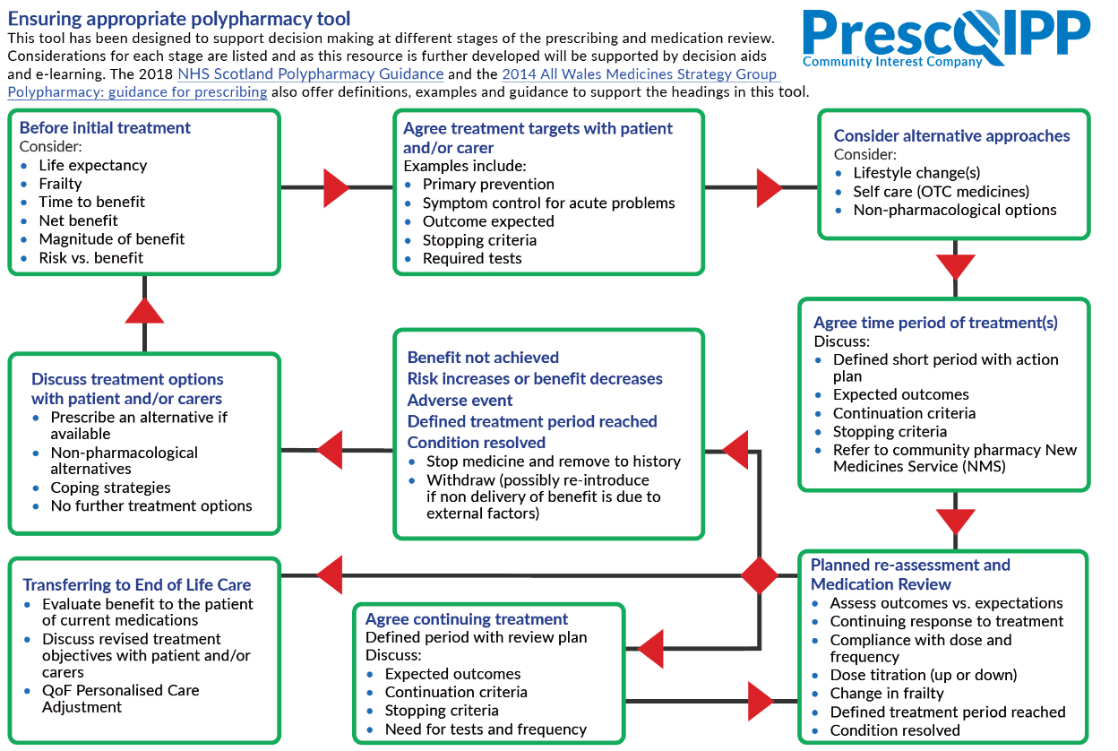
Notes:
Prescqipp tool to ensure appropriate polypharmacy - 2019 – busy tool, however highlights key aspects to consider when prescribing.
Available at https://www.prescqipp.info/our-resources/webkits/polypharmacy-and-deprescribing/
Ideally all new meds should be discussed with the patient and treatment goals set up – the patient should be aware of what the goals are, and that the medication may be stopped if those goals are not met. This is likely to be better than trying to tackle polypharmacy once a medication already established. – Consider discussing with attendees whether this is done within their clinical practice?
Requires a significant change in practice across all prescribers to manage this. What do we do about the patients who are already on multiple medications?

Slide 9
Scottish Polypharmacy Guidance
Notes:
Scottish Government Polypharmacy Model of Care Group. Polypharmacy Guidance, Realistic Prescribing 3rd Edition, 2018. Scottish Government. https://www.therapeutics.scot.nhs.uk/wp-content/uploads/2018/04/Polypharmacy-Guidance-2018.pdf
7 steps to appropriate polypharmacy – key focus on what the patient feels is important in addition to the clinical priorities.
Patient Views
Essential
Unnecessary
Effectiveness
Safety
Cost effectiveness
Patient Centredness

Slide 10
De-prescribing in patients at risk of Falls
Written by;
Nick Watt, Care of the Elderly Pharmacist, CDDFT
Sen Knathan, Practice Pharmacist

Slide 11
Why are we covering falls?
6060 admissions in County Durham due to falls between April 15 and Oct 18
Large impact on patient quality of life
Significant spend on admissions
Common ADR that is preventable, and increased risk in patients with multiple meds
Notes:
May want to add local data or remove.
Affects patients and carers, and has significant morbidity and mortality

Slide 12
Drugs can increase risk of falls if they cause…..
Sedation or drowsiness
Impaired postural stability or muscle weakness
Hypoglycaemia
Hypothermia
Confusion
Dehydration or electrolyte disturbances
Vestibular damage (tinnitus, deafness)
Visual impairment (blurred vision, dry eyes)
Orthostatic hypotension
Drug induced Parkinsonism

Slide 13
Drugs can cause increased risk if a patient falls if…..
Increase severity of the fall
Bleeding or bruising risk
Anticoagulants
Increase fracture risk
Steroids, PPIs,

Slide 14
Anticholinergic burden
Anticholinergics are linked to impaired cognition and falls risk
Also linked to increased morbidity and mortality
Cause of constipation, blurred vision and urinary retention
Score of greater than 3 is deemed to be problematic
Notes:
Anticholinergics have long been associated with falls and impaired cognition, but only more recently recognised that they can affect morbidity and mortality.
Side effects increase risk of falls.
Score of three is deemed to be problematic

Slide 15
Notes:
Ageing brain recommendations, in-line with EPACT2
https://www.uea.ac.uk/documents/3306616/10940915/Anticholinergics/088bb9e6-3ee2-4b75-b8ce-b2d59dc538c2#:~:text=ANTICHOLINERGIC%20COGNITIVE%20BURDEN%20SCALE%20Aging%20Brain%20Care%202012,scale%20-%20legal%20size.indd%202%201%2F31%2F13%2011%3A43%20AM

Slide 16
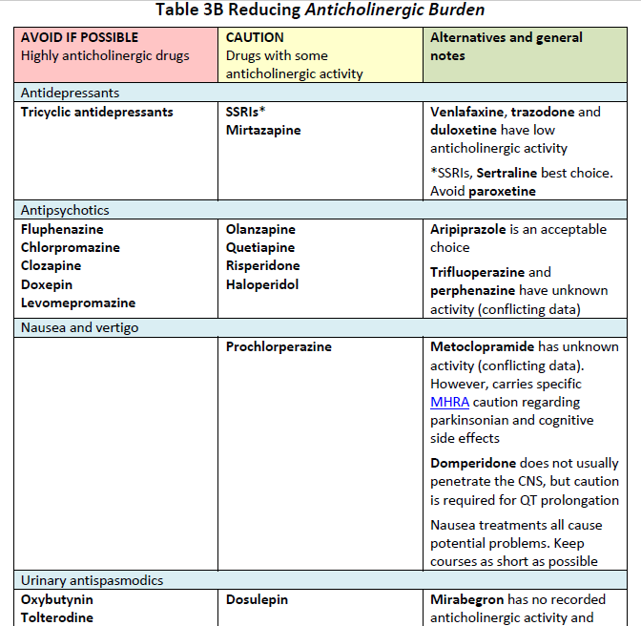
Notes:
Scottish Polypharmacy guidance has some useful advice on options to help reduce anticholinergic burden, however there is not much evidence in this area, so use with caution. Scottish Government Polypharmacy Model of Care Group. Polypharmacy Guidance, Realistic Prescribing 3rd Edition, 2018. Scottish Government
Notes: This is a developing area with disagreements between different sources. Some of this table is based on incomplete or poor evidence, or on expert opinion. The anticholinergic effects of drugs may become better understood with time. Some of these therapeutic areas are highly specialised (for example Parkinson’s disease) and would require expert advice before considering a change. As noted here less anticholinergic alternatives often have other concerns. If an anticholinergic agent must be used, consider reducing the dose.

Slide 17
Percentage of patients over 65 with an anticholinergic burden score of 6 or more
**Insert own area data**
DDES
ND
Notes:
Insert own area data – EPACT2 polypharmacy dashboard.

Slide 18
Case 1 - MRS MW
86 years old, lives alone, housebound
Asthma/COPD, IHD, Depression
Aspirin 75mg od, Furosemide 40mg mane, GTN spray, ISMN 20mg BD, Simvastatin 40mg on
Calcichew D3 Forte OD, Domperidone 10mg TDS, Dosulepin 50mg on
Chlorphenamine 4mg on, Omeprazole 20mg BD, Nitrazepam 5mg on
Paracetamol 1g QDS PRN, Tramadol 50mg BD
Braltus 10mcg od, Symbicort 400/12 Turbohaler 1 puff BD
Salbutamol 100mcg MDI 2 puffs PRN

Slide 19
CASE STUDY – MRS MWCASE STUDY – MRS MRS MWW
86 years old, lives alone, housebound
Asthma/COPD, IHD, Depression
Aspirin 75mg od, Furosemide 40mg mane, GTN spray, ISMN 20mg BD, Simvastatin 40mg on
Calcichew D3 Forte OD, Domperidone 10mg TDS, Dosulepin 50mg on
Chlorphenamine 4mg on, Omeprazole 20mg BD, Nitrazepam 5mg on
Paracetamol 1g QDS PRN, Tramadol 50mg BD
Braltus 10mcg od, Symbicort 400/12 Turbohaler 1 puff BD
Salbutamol 100mcg MDI 2 puffs PRN
Notes:
ACB score of 5 according to Ageing Brain.

Slide 20
7 Steps
Patient Views
Essential
Unnecessary
Effectiveness
Safety
Cost effectiveness
Patient Centredness
Notes:
Scottish Government Polypharmacy Model of Care Group. Polypharmacy Guidance, Realistic Prescribing 3rd Edition, 2018. Scottish Government
3. Does the patient need the furosemide all the time – no indication of HF? Could the ISMN be reduced if chest pain is controlled?
Patient is on lots of sedation at night – (dosulepin, chlorpheniramine, nitrazepam) Is this working? Could it be reviewed and reduced? This would also reduce ACB score
Safety – high ACB score, high sedation risk – need to have conversation with the patient about risk/benefit and which she would be happy to review – May need to reduce some down slowly e.g. antidepressant and nitrazepam.
7. Ensure the patient is happy, consider follow up via telephone if needed to reduce medication down.

Slide 21
CASE STUDY – MRS MWCASE STUDY – MRS MRS MWMWCASE STUDY – MRS MW
MEDICATION STOPPED:
Chlorphenamine, Domperidone (MHRA safety alert)
Nitrazepam - 5mg nocte for 2/52 then 2.5mg nocte for 2/52 then STOP
Dosulepin - 25mg nocte for 4/52 then STOP
MEDICATION CHANGED:
Calcichew D3 Forte switched to Calcichew D3 caplets (one BD)
Omeprazole 20mg BD reduced to 20mg OD
Dosulepin switched to Mirtazapine 15mg nocte (started in third week of reduction)
Furosemide 40mg mane reduced to 20mg mane
ACB score reduced from 5 to 2

Slide 22
Case 2 - Mrs JM
82 year old, 50kg, 152 cm
Hypertension, MI, CCF, chronic knee pain, TKR 6 months ago, recent BP – 100/60
Amitriptyline 75mg OD Bumetanide 2mg OD
Ramipril 5mg OD Bisoprolol 2.5mg OD
Atorvastatin 80mg OD Zopiclone 7.5mg ON
Pregabalin 150mg BD Rivaroxaban 10mg OD
Lansoprazole 30mg OD Movicol 2 OD
Co-codamol 30/500 2 QDS Fentanyl 25mcg patch every 3 days
Notes:
Ask attendees which of the medications they would be concerned about with regards to falls….

Slide 23
Which meds are you worried about with regards to falls?
Amitriptyline 75mg OD Bumetanide 2mg OD
Ramipril 5mg OD Bisoprolol 2.5mg OD
Atorvastatin 80mg OD Zopiclone 7.5mg ON
Pregabalin 150mg BD Rivaroxaban 10mg OD
Lansoprazole 30mg OD Movicol 2 OD
Co-codamol 30/500 2 QDS
Fentanyl 25mcg patch every 3 days
Notes:
Worries about all of them – this helps demonstrate how the 7 steps process can assist with making prioritisation decisions.
Amitriptyline 75mg OD – ACB, postural drop and sedation
Bumetanide 2mg OD – ACB, dehydration, BP. Also increased need to use bathroom
Ramipril 5mg OD – BP
Bisoprolol 2.5mg OD – BP and heart rate can increase risk of falls if over treated
Atorvastatin 80mg OD – muscle weakness
Zopiclone 7.5mg ON – sedation, ACB
Pregabalin 150mg BD – sedation, ACB
Rivaroxaban 10mg OD – increased risk of bleeding
Lansoprazole 30mg OD – increased fracture risk with high dose PPIs
Movicol 2 OD – dehydration, increased need to use bathroom
Co-codamol 30/500 2 QDS – ACB, sedation and confusion
Fentanyl 25mcg patch every 3 days – ACB, sedation and confusion

Slide 24
7 Steps
Patient Views
Essential
Unnecessary
Effectiveness
Safety
Cost effectiveness
Patient Centredness

Slide 25
Need to make specific for the patient
Scottish polypharmacy guidelines 7 steps
What are they being used for?
Rivaroxaban, amitriptyline, lansoprazole, zopiclone
Which are essential?
Ideally manage low BP without stopping ACEI and beta blockers – reduce doses
Which are not required?
Rivaroxaban
?Bumetanide
Notes:
STOPP-START toolkit - https://www.cgakit.com/m-2-stopp-start#!
Scottish polypharmacy guidelines - Scottish Government Polypharmacy Model of Care Group. Polypharmacy Guidance, Realistic Prescribing 3rd Edition, 2018. Scottish Government
Rivaroxaban - ? Indication – not in AF, ? Left on from TKR
Amitriptyline is depression dose, does she have depression?
Lansoprazole increase fracture risk, what is the indication
Zopiclone – does she need it regularly – review sleep

Slide 26
Are therapeutic goals being achieved?
Pain relief
Is the patient suffering ADRs or interactions?
Constipation
Falls (!)
Anticholinergic and opioid burden
Interactions
Is the drug therapy cost effective?
Is the patient willing and able to take the meds as prescribed?
Notes:
Evidence that opioids are not appropriate in persistent pain
Pregabalin in addition
Anticholinergic – amitriptyline (high), fentanyl (mild), codeine (mild)
Opioids – patient taking equivalent to around 100mg morphine a day
Need to check timings of meds – e.g. diuretics in the morning, sedating meds at night,

Slide 27
Continue
Ramipril – reduce dose
Bisoprolol – reduce dose
Review with an aim to stop
Amitriptyline
Zopiclone
Fentanyl and pregabalin
Stop
Rivaroxaban
Co-codamol
Check
Is she having side effects with atorvastatin?
Does she still need movicol?
Does she still need lansoprazole?
Does she still need bumetanide?
Notes:
Review depression – consider non-pharmacological therapy. If meds needed consider less sedating antidepressant at lower dose e.g. Citalopram 10mg
Review sleeping – consider reducing dose, PRN only, etc.
Review pain in-line with new guidance – increased risk of severe side effects, falls, esp. in combination with pregabalin.
Do they need movicol?
Make sure any changes are monitored closely – BP etc. Reduce meds slowly where appropriate.

Slide 28
De-prescribing Osteoporosis Prophylaxis
Review at the following intervals:
Three years for patients with multimorbidity
Three years for zoledronic acid
Five years for alendronic acid, risedronate sodium, and ibandronic acid
Ten year review for all patients as there is no evidence to support prescribing beyond ten years.
When a drug treatment break is started, reassess the need for recommencing at; 18 months for risedronate sodium
Two years for alendronic acid or ibandronic acid
Three years for zoledronic acid.
or sooner if there is a new fracture
Notes:
Link to PrescQIPP bulletin –Bisphosphonate treatment for osteoporossis 2019 https://www.prescqipp.info/umbraco/surface/authorisedmediasurface/index?url=%2fmedia%2f3986%2f231-bisphosphonate-treatment-for-osteoporosis-20.pdf

Slide 29
Question and Answer Session

Slide 30
Thank you for attending the sessions
Think about how to incorporate reviews like this into practice and personal professional processes
How do we manage patients with multiple disease – need consider them holistically

