Slide 1
An introduction to using routinely collected digital healthcare data for the purposes of research, evaluation or quality improvement
Gemma Donovan
Academic practitioner, NHS Sunderland CCG & University of Sunderland
WITH SUPPORT FROM:
ADAM RATHBONE
ANNA ROBINSON

Slide 2
Introduction
An introduction to using routinely collected digital healthcare data for the purposes of research, evaluation or quality improvement
This will include:
What data sources may be helpful for medicines-related research
Examples of how data can be used and optimised to appropriately answer research questions
Things to consider when working with routinely collected healthcare data

Slide 3
WORKSHOP Exercise 1
Your research, evaluation or innovation interests
Routinely collected datasets you think you have access to
Write down 5-10 words to describe your research, evaluation or innovation topics you are interested in on one side of the page
Now write down all the routinely collected datasets you think you have access to
Draw lines to connect where you think these routine data sets align with your interests

Slide 4
What routinely collected datasets did you identify in that exercise?
Type your answer in the teams Chat →

Slide 5
Examples of routinely collected medicines-related data (that we could think of)
Group messaging channels (e.g.WhatsApp groups)
Incident reporting data (e.g. DATIX)
Records of meetings (e.g. minutes)
Prescribing data (e.g. primary care dispensing data, ePrescribing systems)
Service delivery records (e.g. PharmOutcomes)
Medical records (e.g. EMIS searches)
Patient-generated data (e.g. national questionnaires)
National project data (e.g. coordinated audits)
Healthcare utilization data (e.g. Hospital Episode Statistics)

Slide 6
Which of the following analysis methods do you feel comfortable with?
ⓘ Start presenting to display the poll results on this slide.

Slide 7
Quantitative analysis poll
For the purposes of evaluation, description is usually most useful analysis approach, because:
Your dataset may be small (and therefore inferential statistics will be underpowered)
It will still help you understand what is happening in your organization
Better to triangulate your findings (looking at your research question from multiple sources) than do a more sophisticated analysis on a single dataset
If you do want to use more advanced statistical techniques, get some support/ advice (and you should still do the descriptive bits first!)

Slide 8
Raw or pre-analysed datAsets?
Pre-analysed data
Raw data
Usually anonymized
May be pre-integrated with other data
Analysis more efficient
More easily accessible
Confidentiality considerations
Can choose integrations with other data
Analysis more bespoke
Will likely require approvals

Slide 9
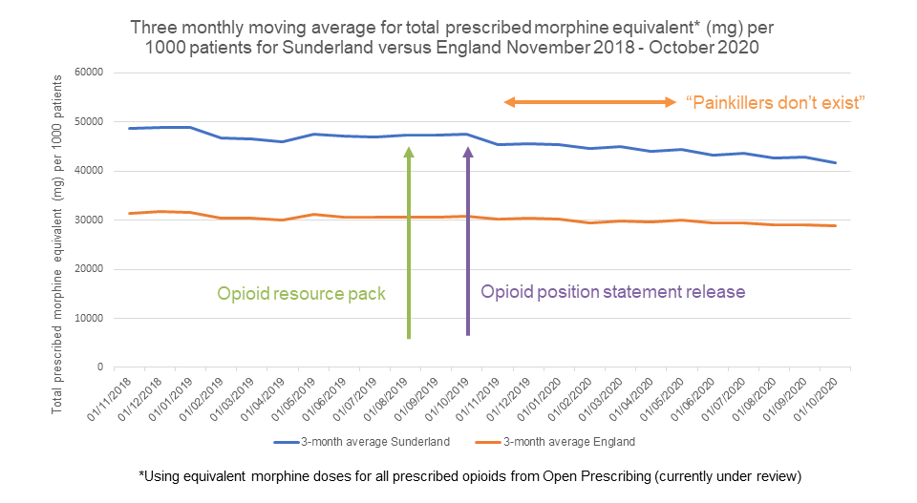
Example: evaluation of opioid reduction in nhs Sunderland ccg

Slide 10
Can you read a document and do the following?
ⓘ Start presenting to display the poll results on this slide.

Slide 11
Qualitative analysis poll
Qualitative research helps to explore, conceptualize and understand
Excellent for innovative services or new roles and patient or professional experiences research
Important to acknowledge the role of the researcher and how this informs the research
If you do want to use more advanced analysis to link your findings to theory, get some support/ advice (and you should still do the descriptive bits first!)

Slide 12
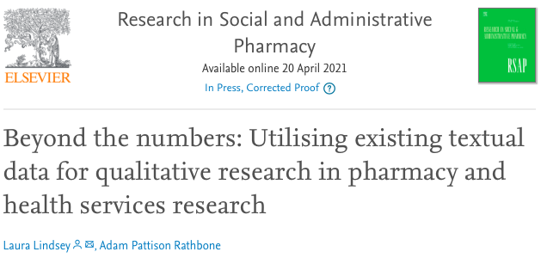
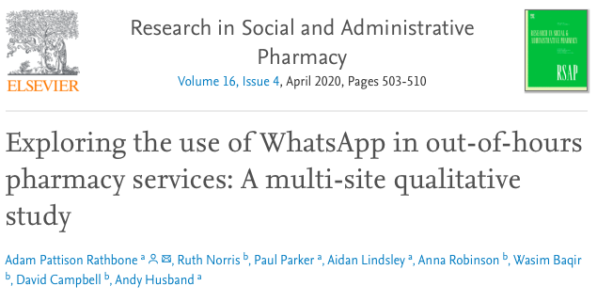
Examples

Slide 13
WORKSHOP Exercise 2
Your research, evaluation or innovation interests
Routinely collected datasets you think you have access to
Go back to your original diagram
Can you add more routinely collected datasets?
Can you draw more lines between what you are interested in and what data is available?

Slide 14
Writing research questions
What matters, to whom, and why?
Commissioners/ payers
Patients/ service users
Regulators / governance
Stakeholders / interested parties
Could they be collaborators in the research question writing process?
FINERMAPS (Feasible, Interesting, Novel, Ethical, Relevant, Manageable, Appropriate, Potential value and publishability, Systematic)

Slide 15
What will the data allow you to do?
Identify a hypothesised problem or phenomenon
Describe or classify a particular issue
Deconstruct something to see how it works
Identify relationships between things
Compare outcomes between different conditions
Detect causality

Slide 16
Planning a project using routinely collected healthcare data
Research Question
Available Data

Slide 17
Workshop Exercise 3
Your research, evaluation or innovation interests
Routinely collected datasets you think you have access to
Go back to your original diagram
For one of the lines you have drawn, can you have a go at writing one (or more!) potential research questions which you could answer with that data

Slide 18
Things to think about
Prioritise suitability over availability
Consider the context in which the data was generated in the first place (e.g. payments, purpose of document generation, timing of data generation)
Could you actively collect data to complement the use of routinely collected data? (e.g. identify patients who you could then send a questionnaire)
Can you improve the quality or utility of the data you are using? (e.g. coding, tags)
What ethics or governance approvals do you need?

Slide 19
Why we should do this
As a profession, we need to be thinking about evaluating what we do, how we do it, if it works, and why
Using routinely collected healthcare data gives us more opportunities than ever before to do this
It’s power is that it (usually) includes everyone, not just those who ‘opt in’
It can also allow a process of continuous evaluation and improvement
We shouldn’t just be providing good quality patient care, we should also be contributing to improving what ‘good quality’ looks like

Slide 20
Get help!
Build an evaluation team (consider clinical and methodological experts)
Get advice on ethics and governance approvals (see link to research and development team directory in workshop supplement)
Speak to someone with experience (Universities, people who have done previous evaluation or research projects)
Could this be a funded project? (advice available from the Research Design Service)

Slide 21
Any questions for us?
Contact us via email
Gemma.Donovan@sunderland.ac.uk
Adam.Rathbone@Newcastle.ac.uk
Anna.Robinson@Newcastle.ac.uk
Contact us via Twitter
@AbsoluteGem
@AdamPRathbone
@AnnaRobPharm

