Slide 1
National Lipid Management and Familial Hypercholesterolaemia Programme
Julia Newton
AAC/AHSN National Lipid and
FH Programme Lead

Slide 2
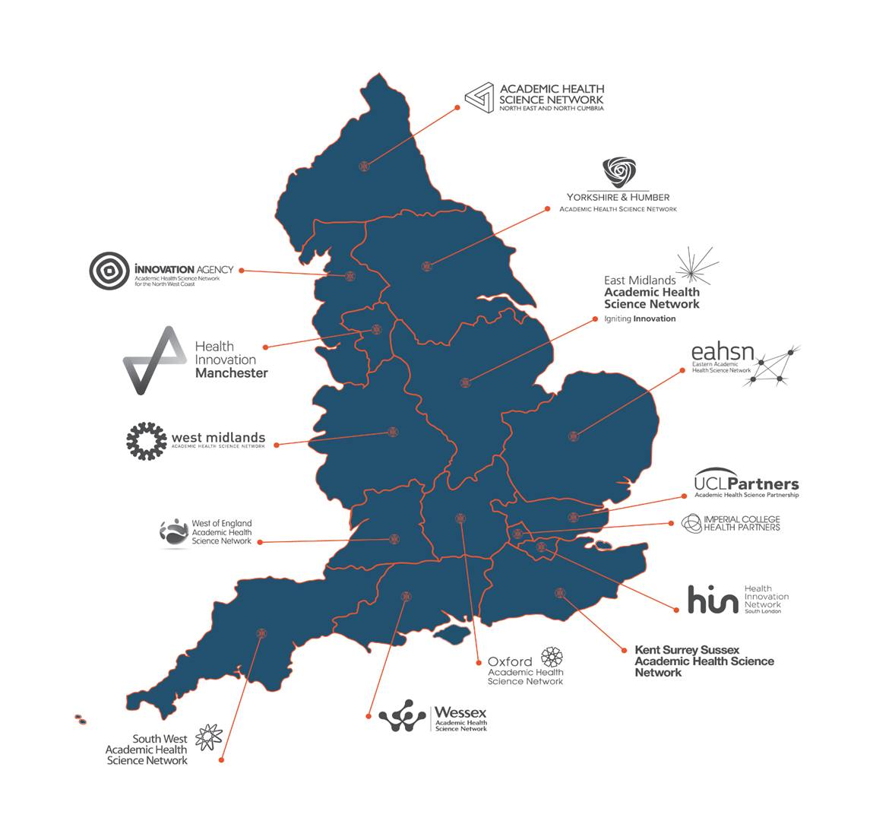
There is Always An AHSN Near YOU!
AHSN Network commissioned by NHSE/l to deliver a national programme across England aimed at ‘Lipid Management and identification of FH
NENC is the lead AHSN for the Lipid and FH Programme
Working in partnership with the NHSE’s AAC/RUP team across the whole lipid clinical pathway
Delivery is led by the team from NENC and overseen by Prof Julia Newton as executive lead and Dr Dermot Neely as Programme Specialist Advisor / Clinical Champion.
Notes:
Indeed, there is an Academic Health Science Network near you with a total of 15 AHSNs in England. We are commissioned by NHSE/I to deliver the national lipids and FH programme with NENC being the lead AHSN for the programme. We work in partnership with Vicky’s NHSE’s AAC/RUP team to implement the whole lipid clinical pathway. Programme delivery is overseen by Prof Julia Newton as executive lead and Dr Dermot Neely our specialist programme clinical advisor.

Slide 3
AAC/AHSN Lipid and FH Programme Driver Diagram
Aim
Primary Drivers
Secondary Drivers
Contribute to the NHS LTP ambition to reduce 150,000 avoidable CVD related deaths annually by 2029.
Improve FH detection from current 4% to 15% of the prevalent English population by 2023.
Optimise lipid management for at risk patients.
Systematic adoption and use of national lipid management guidelines within primary and secondary treatment pathways
National lipid guidance signed off by RMOCs and act on barriers for adoption
Education strategy role out to stakeholders to enhance workforce capability
Share case study examples on regional delivery of lipid and FH programme
Community of Practice with dedicated workspace where programme management tools and database resources are shared
Support AHSNs to produce local delivery plans to enable implementation of the national programme
Lipid optimisation through delivery of PTF projects, and update of RUP and new novel therapies
Stakeholders to use marketing and communication strategies to engage providers
AHSNs to support providers to access new funding streams for pilot programmes e.g., CPS
PPIE involvement to co-produce national programme
Develop robust set of programme wide metrics
Implementation of Adoption and Spread Plans by AHSNs and their providers
Systematic case finding through validated search tools
Use CVDPrevent audit data to proportionately target patients at highest risk of CVD
Providers to use search tools such as CDRC, PRIMIS, UCL to perform primary care searches
Key Enablers
Tackle CVD health inequalities
Development of a CoP
Workforce capacity & capability
PPI/E programme coproduction
Programme wide metrics
Clinical leadership
Notes:
This is a snapshot of our programme driver diagram which is rooted within the NHS LTP key ambitions – reducing avoidable deaths, improving FH detection from current 4% to 15% of the prevalent English population and the need to optimise lipid management for at risk patients including promoting RUPs

Slide 4
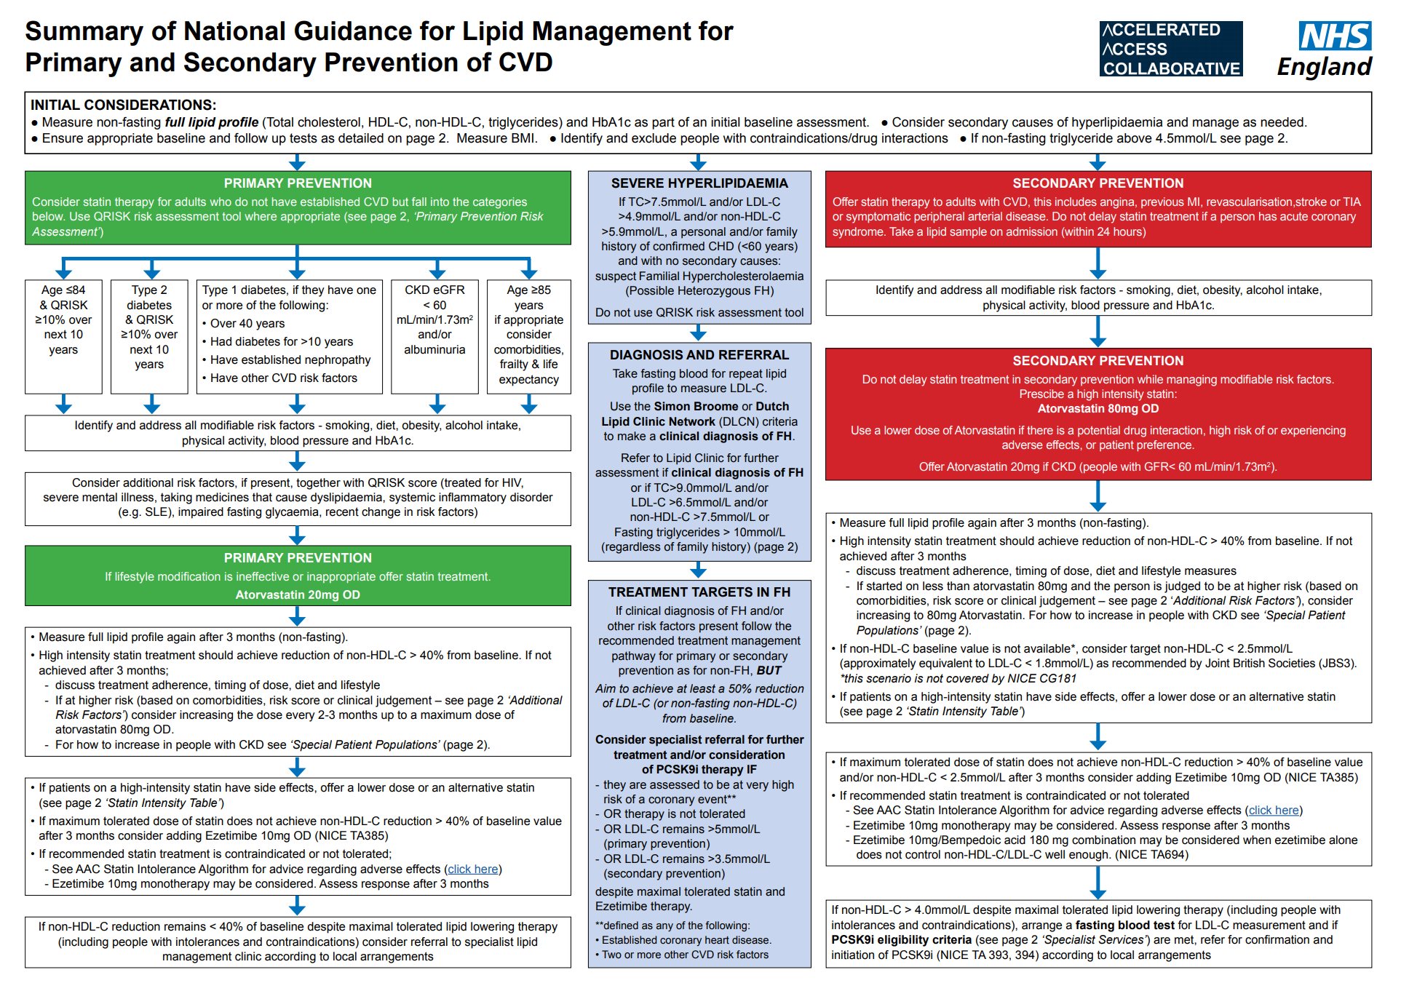

Slide 6
AAC/AHSN Lipid Programme Metrics 20/21 THESE WILL EVOLVE AS CVDPREVENT IS PUBLISHED
% of known cases of Familial Hypercholesterolaemia (FH)
% CCGs engaged with adoption of the lipid management and FH programmes
% HIST prescribed compared to all statin prescribing in primary care
Absolute prescription item numbers of ezetimibe​
% PCSK9i prescribed as a proportion of eligible population for PCSK9i
% Inclisiran prescribed as a proportion of eligible population ​(pending NICE approval)

Slide 7
Two approaches to achieving the NHS Long term Plan Ambitions

Slide 8
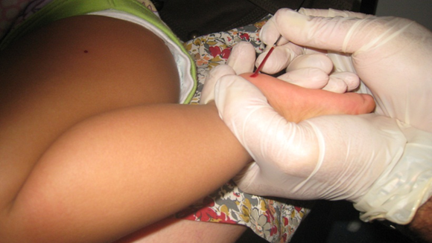
Take the evidence and implement the clinical pathway

Slide 9
AHSN Child-Parent Programme 7 Pilot sites
NENC AHSN
Innovations Agency North West
Coast AHSN
Eastern AHSN
West Midlands AHSN
West of England AHSN
Imperial Health College Partners AHSN
Oxford AHSN
Notes:
A core element of the NICE lipid management guidance which I just shown is FH case finding – we have secured funding from NHSE through a robust business case for the CPS with 7 pilot sites now funded from August to put CPS into practice as early adopters. And these are the location of the 7 sites

Slide 10
Watch Child Parent Screening videos at:
www.explainmyprocedure.com/ahsn
OR
Scan QR Code with smart device:

Slide 11
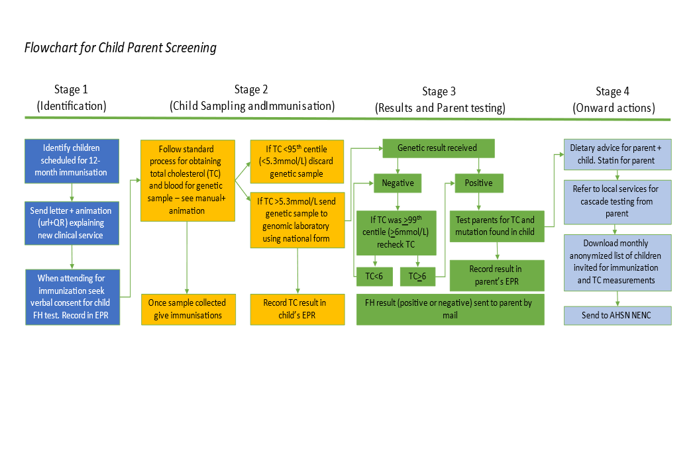

Slide 12
www.heartuk.org.uk/tackling-cholesterol-together/home

Slide 13
Programme Contacts:
Julia.Newton@ahsn-nenc.org.uk
NationalLipidProgramme@ahsn-nenc.org.uk

