Slide 1
Agenda
14:00 | Welcome and Introductions
14:05 | UCLP Proactive Care Frameworks: doing differently, not doing more What are the frameworks? How do they work in practice? How are the frameworks being used?
14:20 | Hypertension: A Clinical Perspective
14:30 | Support from AHSN NENC
14:35 | Q&A and closing comments

Slide 2
House Keeping
Please ensure your microphone and video are turned off during the session. This is to help with the quality of the call.
If you need to take a break, please feel free to drop off the call at any time and re-join.
Live captions are available if required. To turn on click on the 3 dots on your toolbar and select ‘Turn on Live Captioning’.
This event will be recorded and photographs/screenshots may be taken.
Please ask any questions you have through the chat facility. We will try to address questions during the Q&A session at the end of the webinar, but if we don’t manage to answer all questions we will follow up after the event with a Frequently Asked Questions sheet.
If you cannot see the chat please email your question/s to emma.wharfe@ahsn-nenc.org.uk
Speaker presentations and recording will be circulated following the event.

Slide 3
Preventing Heart Attacks and Strokes at Scale The National Blood Pressure Optimisation Programme
Dr Matt Kearney
Executive Clinical Director for Cardiovascular Health, UCLPartners
6th September 2022

Slide 4
Cardiovascular Disease Prevention – A National and Local Priority
£19 billion
One death every 3 minutes
100,000 hospital admissions
- heart attack
38,000 stroke deaths each year
Driver of inequalities
27% all UK deaths due to CVD
Stroke: leading cause of disability
CVD drives health inequalities: accounting for 1/4 life expectancy gap
1 admission every 5 minutes
Overall annual CVD costs the UK economy
But CVD is highly preventable…

Slide 5
What risk factors drive most premature death and disability?*
England
Treatment of high impact metabolic risk factors is very effective at preventing mortality and morbidity.
But under detection and under treatment is common.
*Global Burden of Disease Study 2019

Slide 6
COVID-19: Impact on Care and Outcomes in Long-Term Conditions
Urgent Challenge – LTC Recovery
Pandemic resulted in dramatic change in primary care: reduced face to face access and high clinical demand (COVID surges and vaccination)
Disruption of routine, proactive care in high impact conditions such as CVD, hypertension, diabetes, COPD, asthma
Risk of deterioration/exacerbation in these conditions driving further waves of demand for urgent care and increasing premature mortality and morbidity
Opportunity
Restore and transform proactive care for people with long term conditions
Optimise clinical management to address historical under treatment
Optimise support for patient education, self management and lifestyle change

Slide 7
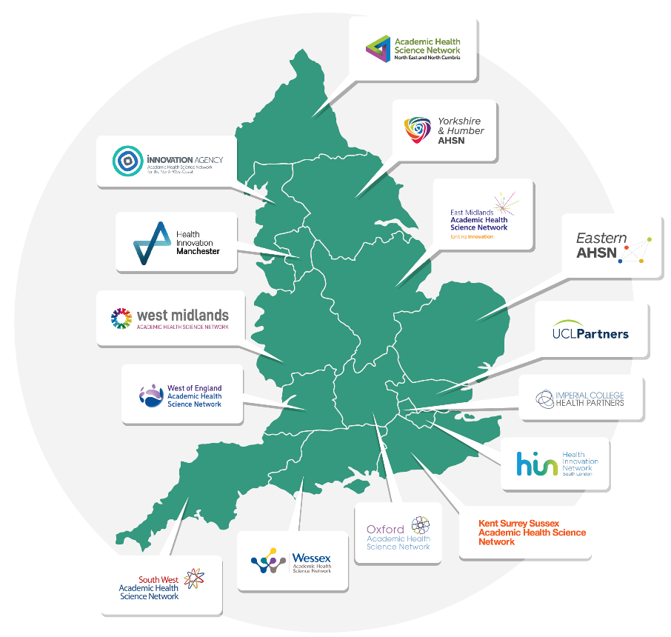
National Blood Pressure Optimisation Programme
All 15 AHSNs supporting local Integrated Care Systems
Implementation of UCLPartners Proactive Care Framework for hypertension
Risk stratification and prioritisation to optimise blood pressure and cholesterol in people with hypertension
Structured support for patient education and self management
Case finding for undiagnosed hypertension
Targeted roll out to maximise impact on health inequalities

Slide 8
Frameworks to support primary care transformation
www.uclpartners.com/proactive-care

Slide 9
UCLPartners Proactive Care Frameworks
High Impact Conditions
CVD prevention
Atrial Fibrillation
Blood pressure
Cholesterol
Type 2 Diabetes
Respiratory
Asthma
COPD
In development
Heart Failure
SMI
Population Health Management Approach
Risk stratification based on NICE guidance
Prioritisation to optimise treatment early in those with greatest need
Deploy wider workforce to support self-management and personalisation of care
Framework Principles
Primary care led with PPI support
Improve clinical care and self-care
Free clinician capacity

Slide 10
UCLPartners Proactive Care Framework for Hypertension
Healthcare Assistants/Health & Wellbeing Coaches and other trained staff
Gather information e.g. Up to date bloods, BP, weight, smoking status, run QRISK score​
Self management e.g. Education (blood pressure, CVD risk), self care (eg BP measurement), signpost resources
Behaviour change e.g. Brief interventions and signposting e.g. smoking, weight, diet, exercise, alcohol​
Stratification & Prioritisation
Priority One
BP >180/120
Priority Two
BP160/100 or >140/90 if BAME plus comorbidities
No BP record in 18 months
Priority Three
BP >140/90
Priority Four
BP <140/90 under age 80 years
OR
BP <150/90 aged 80 years and over
Prescribing Clinician
Optimise blood pressure and CVD risk reduction
Review: blood results, risk scores & symptoms
Check adherence and adverse effects
Review complications and co-morbidities
Initiate or optimise blood pressure medication
CVD risk – optimise lipid management and other risk factors

Slide 11
Cholesterol – Secondary Prevention (pre-existing CVD)
Healthcare assistants/other appropriately trained staff
Gather information e.g. Up to date bloods, BP, weight, smoking status
Self-management e.g. Education (cholesterol, CVD risk), BP monitors (what to buy, how to use), signpost to shared decision making resources
Behaviour change e.g. Brief interventions and signposting e.g. smoking, weight, diet, exercise, alcohol
Stratification
Priority One
Not on statin therapy
Priority Two (A)
On suboptimal intensity statin*
Priority Two (B)
On suboptimal statin dose**
Priority Three – routine follow up
Sub-optimal non-HDL (>2.5mmol/l) levels despite maximal statin therapy
Prescribing clinician
Optimise lipid modification therapy and CVD risk reduction
Review CVD risk factors, lipid results and liver function tests
Initiate or optimise statin to high intensity – e.g. atorvastatin 80mg
Titrate therapy against reduction in LDLc/non-HDLc (statin>ezetimibe>PCSK9i)
Optimise BP and other comorbidities
Use intolerance pathway and shared decision-making tools to support adherence
Arrange follow-up bloods and review if needed

Slide 12
UCLPartners Proactive Care Resources – for local adaptation
Comprehensive search & stratification tools for EMIS and SystmOne
Protocols for HCA and similar roles to provide structured support for patient education, self management and behaviour change
Slide sets for clinicians – focus on the how to of optimising clinical management in real world primary care
Workforce training framework
Implementation guidance
Case studies
Digital resources for staff and patients
Understanding your condition
How to …… check your BP, check your feet, identify red flags etc
New technologies eg Healthy.io, fibricheck
Brief interventions eg smoking, diet, activity
Videos – eg running the search tools
www.uclpartners.com/proactive-care/

Slide 13
Resources for clinicians – support with real world management

Slide 14
Resources for wider workforce to support patient care
Guidance and resources for staff such as healthcare assistants, wellbeing coaches, and others delivering:
Education
Self management support
Brief interventions for behaviour change e.g. smoking cessation, weight management

Slide 15
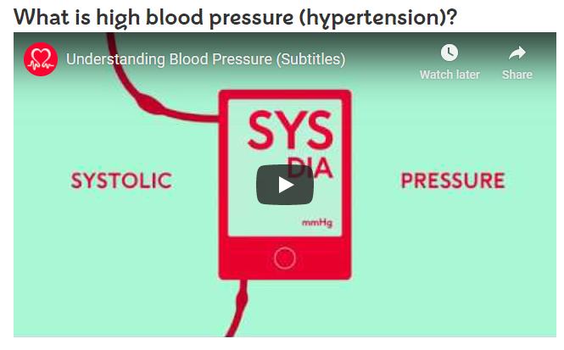
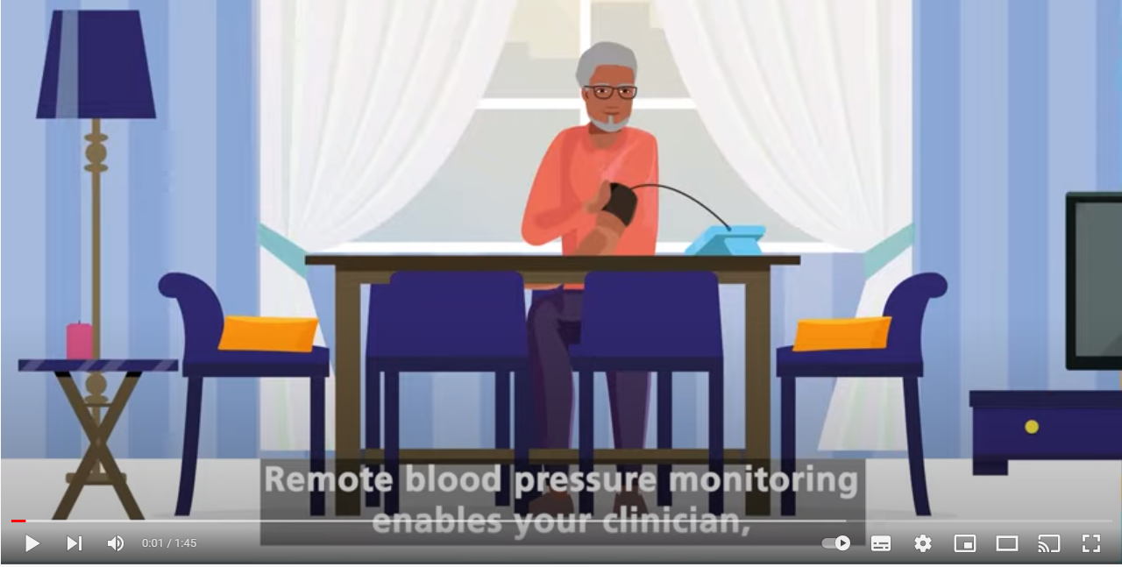
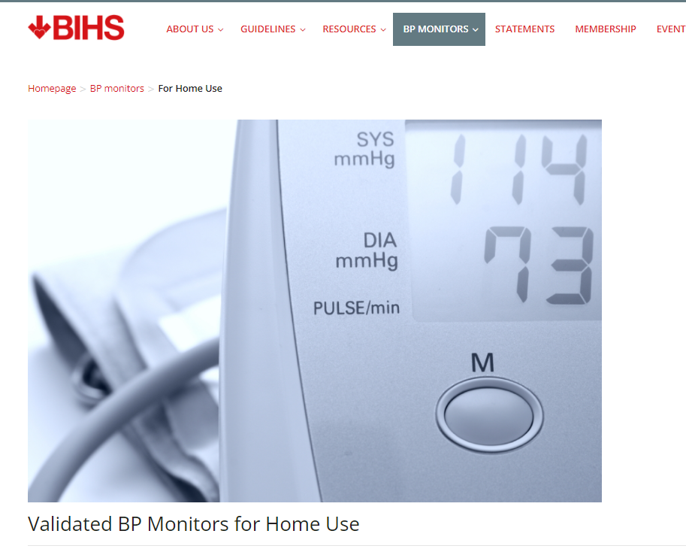
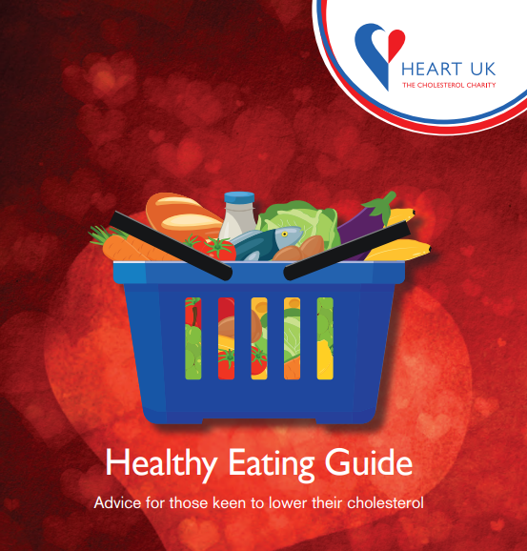
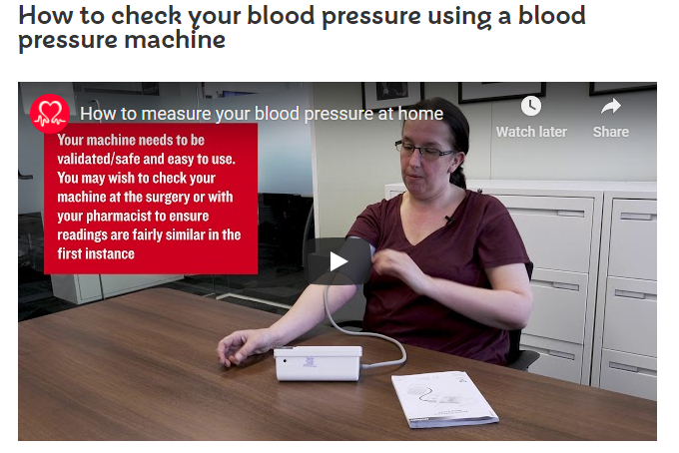
Resources for patients – education & self management
15

Slide 16
National uptake of the UCLPartners Proactive Care Frameworks
Widely welcomed by GPs and primary care teams:
Over 8,000 downloads of the search tools and over 40,000 unique website visits
Adopted into NHS England’s NHS@Home & implementation underway in 14 Integrated Care Systems
National Blood Pressure Optimisation Programme prioritises implementation of the UCLPartners Proactive Care Framework for Hypertension by all 15 AHSNs
RCGP’s Long Term Condition Recovery Guidance June 2022 recommends UCLPartners Proactive Care Frameworks to support prioritisation

Slide 17
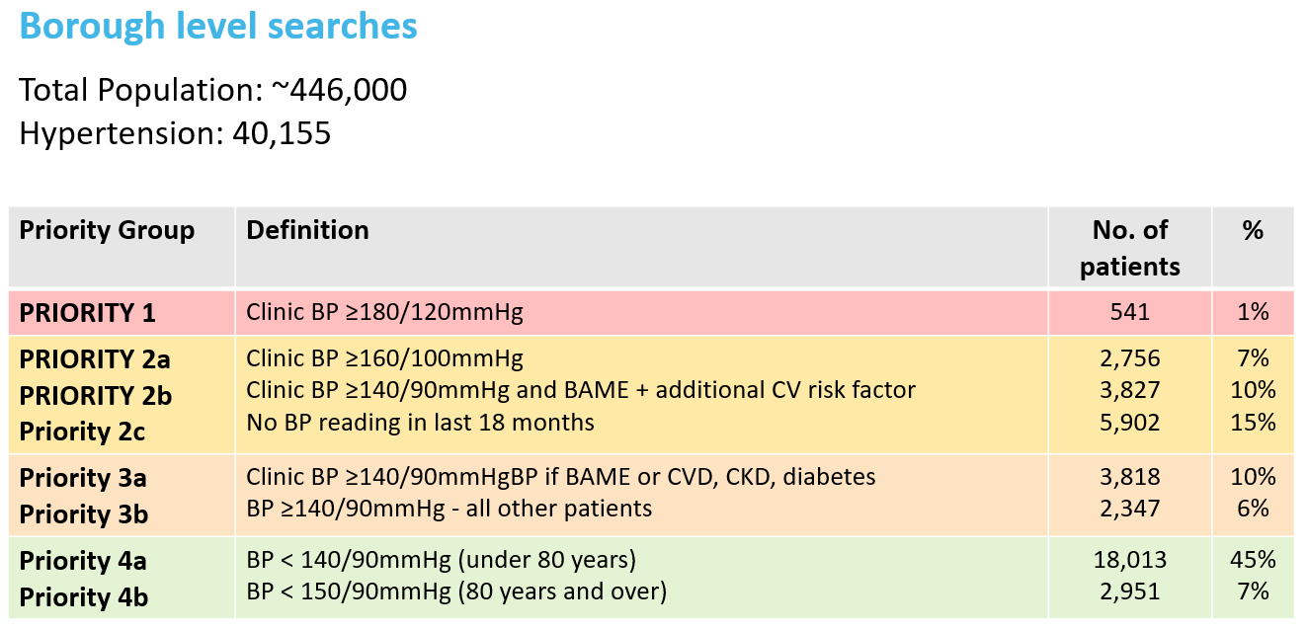
Stratification: improving outcomes and increasing capacity
Stratification informs workflow and workforce planning
Helps GPs meet QOF and other targets
Shift between priority groups over time shows clinical impact
18% highest priority
52% low priority

Slide 18
Case studies – improving care and releasing capacity
In Knowsley, the UCLPartners asthma framework was implemented across 3 primary care networks. In 11 practices they risk stratified patients and focused their early efforts on reviewing those at highest risk. Over 200 patients had their treatment optimised and when the searches were re-run, there were 50% fewer patients in the high-risk cohort because their treatment optimisation had been prioritised.
In Haringey, the UCLPartners hypertension framework was implemented in 5 practices. Over 3 months, they demonstrated a 41% reduction in patients in the highest risk group and 13% reduction in the second highest risk group because of treatment optimisation.
Lakeside PCN (180,000 patients): by adopting the UCLPartners stratification and prioritisation, they released sufficient nursing time to perform 650 additional smears.

Slide 20
Matt.Kearney@uclpartners.com

Slide 21
Tackling Hypertension for better CVD outcomes
Dr Raj Bethapudi
GP Partner, trainer, appraiser
Co-chair, NENC ICS CVD Network
Clinical champion, AHSN NENC

Slide 22
CVD Prevention Recovery Plan – Summary
Cardiovascular disease is very treatable however the Covid-19 pandemic has seen CVD-related mortality and risk of morbidity rise significantly
The problem
Possible causes
National & regional recovery actions
~6.9k non-covid excess deaths Jul-Dec 21 being driven by CVD and diabetes
Expected increased burden on UEC and social care capacity due to increased stroke and myocardial infarction (MI) cases
23 million fewer blood pressure (BP) checks in primary care Apr 20-Oct 21 than expected
2 million fewer controlled hypertension cases
Reduced primary or secondary prevention including statins, antihypertensives, aspirin etc - 22% reduction in BP control (QoF 20/21)
Under recording of COVID-19 deaths – this could be due to an increase in subclinical COVID or long-term impacts of COVID-19
People not seeking help as worried about getting COVID-19 or access to help is more difficult
An over-stretched NHS, including ambulance pressures
Changes in risk behaviour including lower exercise, changes in diet, smoking, alcohol etc.
Management of key risk factors:
- Atrial Fibrillation
- Blood Pressure
- Cholesterol
Four key actions
Monitor and target unwarranted variation
System leadership on CVD prevention
Support general practice
Public communications
The Long Term Plan commits to preventing 150k heart attacks, strokes and dementia cases by 2029 through cardiovascular disease prevention

Slide 23
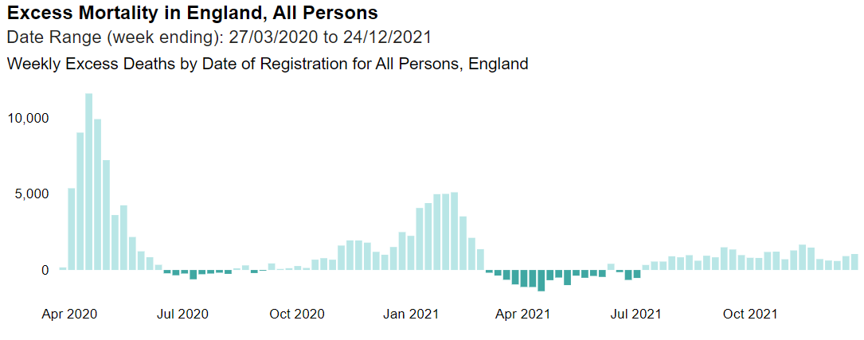
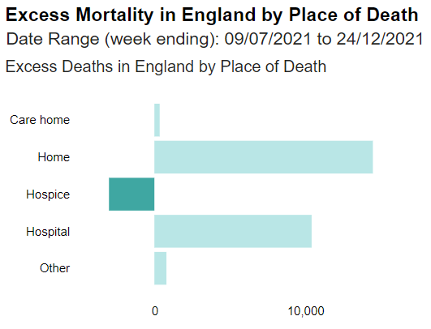
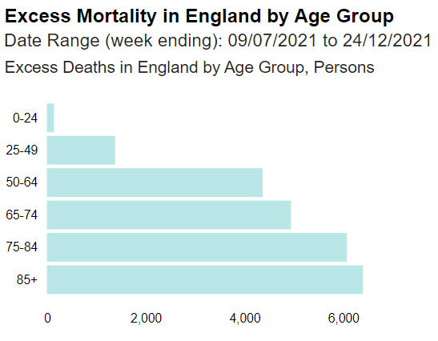
The problem
Possible Causes
Recovery actions
Between 3rd Jul and 24th Dec 21 there were ~6,900 non-Covid excess deaths – primarily driven by CVD and diabetes. This trend is continuing
~6.9k non-covid excess deaths
There were 6,879 non-covid excess deaths between 3rd Jul and 24th Dec 2021 (23,319 excess deaths, of which 16,440 had COVID-19 as the underlying cause)
This difference is primarily seen in deaths at home and is most apparent for cardiovascular disease and diabetes
The difference is less apparent in the 0-24 age group and there is no clear deprivation or ethnicity gradient to the data
Sources: OHID excess mortality tool
Notes:
Excess deaths is the difference between the number of registered deaths and the number expected if the pandemic had not occurred.
The most deprived and Asian groups have seen the highest COVID death rates to date and therefore the recent excess deaths may be an underestimate.
This data is particularly concerning as estimates of excess deaths in recent months are thought to be an underestimate as expected deaths have not yet been adjusted to reflect the large number of deaths during the initial waves of the pandemic.

Slide 24
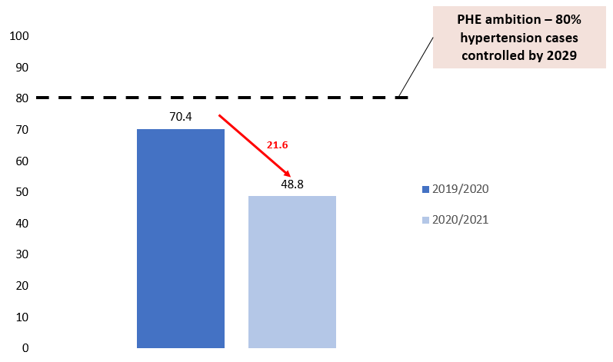
The problem
Possible Causes
Recovery actions
Hypertension is the leading risk factor for stroke. An increase in incidence could lead to a major increase in social care demand (currently £4.5billion per year) and destabilising effect on patient flows out of and through hospitals
The 3 December Omicron variant letter from NHSE to systems offers temporary income protection on primary care CVD levers and incentives (QoF, DES and IIF) to allow increased capacity for vaccine rollout. Practices were asked to prioritise higher risk patients.
Restoration of general practice metrics and incentives from 1 April 22 will be key to CVD prevention.
% hypertension patients treated to target (QoF)
In 2020/21, 2 million fewer people were recorded as having controlled hypertension compared to 2019/20
In 2019/20, 6 million people had controlled hypertension; this fell to 4.1 million in 2020/1
Delays of greater than 6 weeks before hypertension medication intensification and delays of greater than 12 weeks before blood pressure follow-up after intensification are associated with an increased risk of an acute cardiovascular event or death from any cause; the greatest rate of increase in risk occurs in the first nine months.
Sources: QoF
Notes:
There is currently additional points (double compared to usual) in QoF for prescribing related to AF, heart failure, Diabetes and prescribing of statins.
Practices had to agree with their commissioners a plan on how Qof care will be delivered with prioritising/inequalities focus. If communicating out regarding this commissioners should be able to disseminate and direct areas of focus using PHM packs.
The BMA/RCGP prioritisation guide states clinical priority in long term conditions includes ‘uncontrolled hypertension’ as green – i.e. should be a focus.

Slide 25
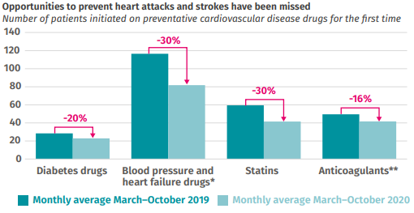
The problem
Possible Causes
Recovery actions
Blood pressure checks and CVD prescriptions fell during the pandemic
BP Checks
Prescribing
IPPR analysis shows that there were 470,000 fewer new prescriptions of CVD prevention drugs such as antihypertensives, statins, anticoagulants and oral antidiabetics between March and October 2020 compared to the previous year.
From Apr’20-Oct’21 23 million fewer BP checks performed in primary care compared to pre-pandemic.
There has been some recovery but this has plateaued significantly below normal levels – BP checks in Oct 21 were 59% of the pre-pandemic monthly average.
Count of monthly BP checks in primary care
Sources: GDPPR; IPPR

Slide 26
The problem
Possible Causes
Recovery actions
Possible causes of non-Covid excess mortality
1. Reduced primary or secondary prevention including statins, antihypertensives, etc
2. People not seeking help as worried about getting COVID-19 or access to help is more difficult
3. Overall system pressure, including ambulance services
4. Changes in risk behaviour including lower exercise, changes in diet, smoking, alcohol etc
Tackling Cardiovascular Disease is tackling Inequality

Slide 27
What can practices do?
Introducing a hypertension champion within your practice
Communications and messaging to patients
Encouraging the use of BP monitors at home
Supporting patient self-management
Investment in training and leadership
Support from other primary care services
PCN/QOF action plan with simple an meaningful data, available to all staff

Slide 28
Support from AHSN NENC
Karen Verrill
Blood Pressure Optimisation
Programme Manager, AHSN NENC

Slide 29
We can provide support with:
Advice and guidance on implementation of the framework
Troubleshooting including raising issues with the national team
Accessing searches and how to run them
Resource Packs
Development of a Community of Practice to share good practice and resources.
Expressions of Interest:
If you would like to register your interest in implementing the framework and/or be part of the Community of Practice, please complete this register of interest form www.smartsurvey.co.uk/s/MRACK7/

Slide 30
Q&A panel
Dr Matt Kearney, Executive Clinical Director for Cardiovascular Health
Kate Phillips, National CVD Programme Manager
Dr Raj Bethapudi, Co-chair, NENC ICS CVD Network & Clinical Champion, AHSN NENC
Karen Verrill, Blood Pressure Optimisation Programme Manager, AHSN NENC
Kate Mackay, CVD Programme Lead, AHSN NENC

Slide 31
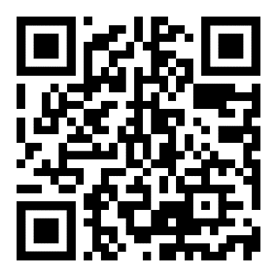
Thank you for listening Register your interest for our community of practice

