Slide 1
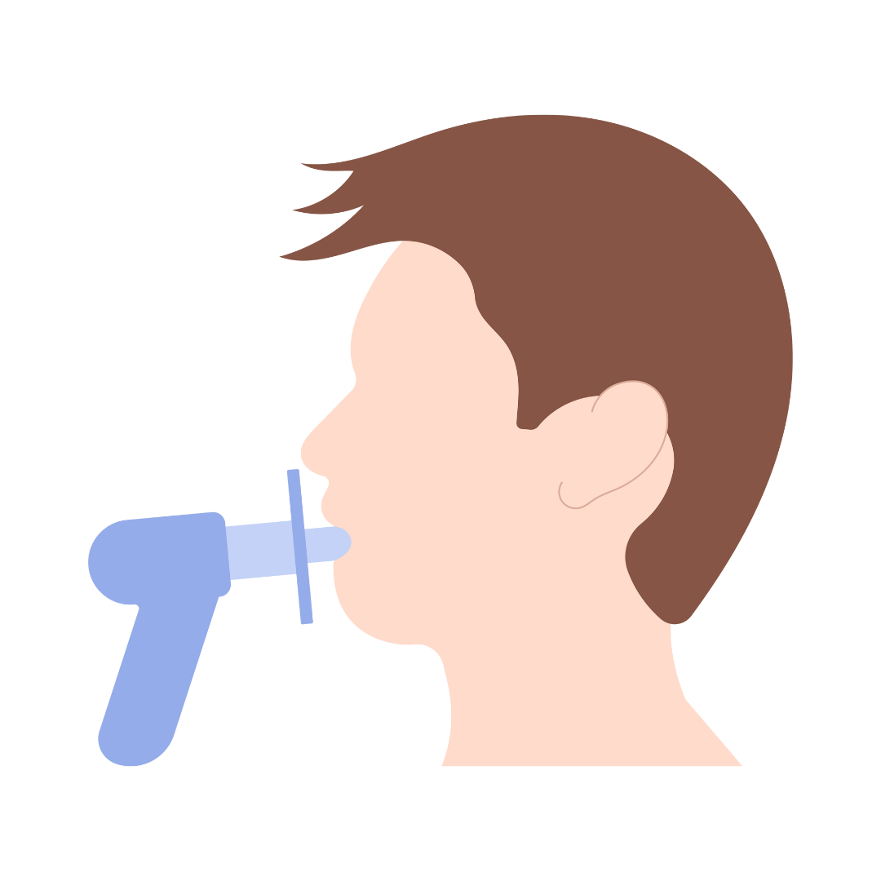
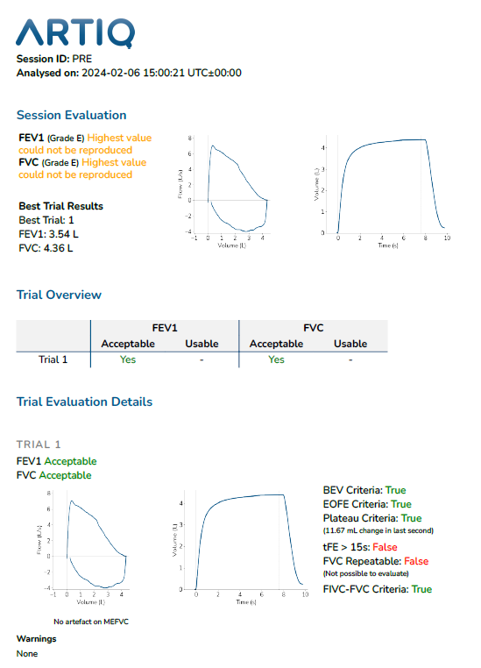
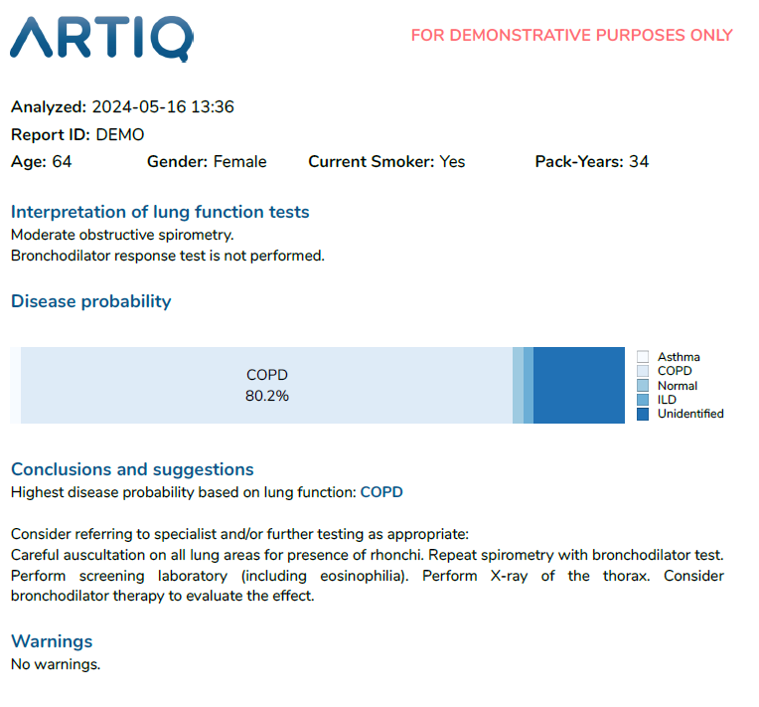
A case study on the impact of Artificial Intelligence supported spirometry in primary care
Claire Adams¹, Elena Smets², Julie Maes², Jon Rees³, Marko Topalovic²
(1) Health Innovation Network, North-East and North Cumbria (HIN-NENC), UK
(2) ArtiQ NV, Leuven, Belgium
(3) School of Psychology, Faculty of Health Sciences and Wellbeing, University of Sunderland, UK
contact: elena.smets@artiq.eu
Introduction
Method
Conclusion
Clinical evaluation of the patient
Execute and interpret spirometry without AI support
VS
Evaluate interpretation of spirometry with AI support
Evaluate quality of spirometry with AI support
The use of ArtiQ.Spiro reduced the time to interpret spirometry results by 50% and clinicians were confident about the AI process.
The use of AI could enable new models of delivery in which a lower-band of workforce execute spirometry with the support of AI, providing the opportunity of increasing the capacity and lowering the cost by 50%.
The use of AI could enable more widespread use of spirometry and support in generating high-quality results.
Spirometry is key in diagnosing respiratory diseases such as asthma and chronic obstructive pulmonary disease (COPD).
BUT its provision in primary care is suboptimal.
Only 13.4% of spirometry performed in primary care meet ATS/ERS guidelines (1)
Long waiting lists in the UK, with an estimated backlog of 200 – 250 patients per 500.000 (2)
2 ARTP-accredited healthcare professionals used ArtiQ.Spiro during 5 months
51 spirometry sessions collected
Outcomes
Interpretation of the spirometry with vs. without AI
Time to interpret results with vs. without AI
Confidence in AI process
Results
Objectives
This case-study investigated the potential impact of AI-supported spirometry on spirometry pathways in the UK.
Interpretation
Time & Confidence
>90% of the spirometry sessions evaluated by both the clinician and the AI to have good quality
Time to interpret results decreased with 50% from 10.6 ± 4.1 min. to 5.6 ± 5.6 min (p<0.001)
For more information about ArtiQ.Spiro, scan the QR-code
The AI software matched the clinical diagnosis in 86% of the cases
Healthcare professionals were confident in the AI process and diagnosis with a median of 4 on a 5-point Likert scale
References
van de Hei SJ, Flokstra-de Blok BMJ, Baretta HJ, et al. Quality of spirometry and related diagnosis in primary care with a focus on clinical use. NPJ Prim Care Respir Med. 2020
Association for Respiratory Technology & Physiology, Primary Care Respiratory Society (2021) Spirometry in primary care: guidance on reinstating spirometry in England (British Thoracic Society)
5 mismatches
2 cases changed to ILD based on AI feedback
(confirmed in chest clinic)

